Slide 1
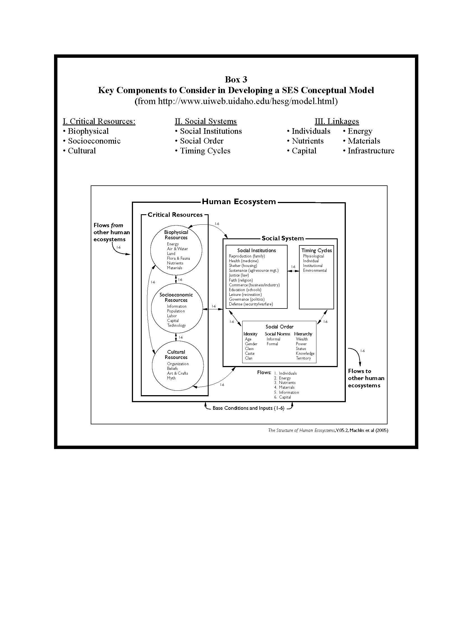
Appendix VI
Example of SES Concept Map for H-W Conflicts in Bhutan
This approach to SES concept mapping
is based on the conceptual modeling of
coupled human and natural systems
(see Lesson Plan, Box 3).
Step #1: Consider Critical Resources related to the
case study. For this example, we considered Bio-
physical Resources to include components of parks
and protected areas (wildlife & landscapes),
agricultural lands, and ecosystem services. Socio-
economic Resources were identified as arising from
rural areas, urban areas, and hydroelectric dams.
Cultural Resources were related primarily related to
the Bhutan’s Buddhist tradition. See next slide
(Appendix VI-A).
Conservation Bridge – Cornell University

Slide 2
Appendix VI-A
CRITICAL RESOURCES
Biophysical Resources:
Parks & Protected Areas
Wildlife
Monkeys Dholes
Pigs
Tigers Leopards
Landscapes
Forests:
Trees Shrubs NTFP
& Grasses
Alpine
Meadows
Mountains
Agricultural Lands
Crops Yaks Cattle Minor
Livestock
Ecosystem Services (ES)
Water Others
Socio-economic Resources:
Rural Areas
Farmers Communities
Guides & Conservation
Homestays Officers
Urban Areas
Groceries Butcheries Hotels Restaurants
Tourism
Bureau
Hydroelectric
Dams
Cultural Resources:
Conservation Textiles & Taboo on Meat-eating
Ethic Festivals Killing Diet
Conservation Bridge – Cornell University
Notes:
Comments:
These resources were identified primarily from the Case Study (Appendix III) and associated readings. They illustrate the relationship between agricultural lands supporting rural livelihoods and wilderness areas managed by the government for the protection of wildlife and their habitats. Despite Bhutan’s dependence on subsistence agriculture, rural areas are also tightly linked to its growing urban population. Hydroelectric dams were added because of their reliance on ecosystem services (water), ability to provide power for both rural and urban areas, and major contribution to the country’s GDP. As illustrated later, Bhutan’s culture is heavily influenced by its conservation ethic arising from Buddhism and a commitment to pursuing Gross National Happiness. Interestingly, this prevents the killing of animals, but not the eating of meat. Bhutan is known for its religious festivals and ethnic textiles, which in addition to its parks and protected areas are the base for a lucrative foreign tourism industry. This is the country’s second most significant source of revenue for its rural and urban economies.

Slide 3
Appendix VI
Example of SES Concept Map for H-W Conflicts in Bhutan
Step #2: Next, consider Critical Linkages inter-
connecting components of the Critical Resources
identified in Step #1. These relate to the ‘flows’
connecting resources (see key below). Use arrows,
including double-headed arrows, to illustrate these
linkages. These diagrams can get very ‘messy’…which
is part of the exercise. For simplicity sake, we have
only focused on the interrelationships directly
involving pigs, tigers, crops, cattle, farmers, and
Bhutan’s Conservation ethic in this example. See
next slide (Appendix VI-B).
Key:
Individuals Energy
Nutrients Materials
Capital Infrastructure
Conservation Bridge – Cornell University
Notes:
Comment:
Infrastructure often is used to describe physical structures such as buildings, roadways, and utilities. However, there are also organizational infrastructures that convey social-political-cultural systems that support human wellbeing. The direction of arrows indicates a linkage transfer from a ‘source’ to a ‘sink.’

Slide 4
Appendix VI-B-1
LINKAGES INTERCONNECTING CRITICAL RESOURCES
Biophysical Resources:
Parks & Protected Areas
Wildlife
Monkeys Dholes
Pigs
Tigers Leopards
Landscapes
Forests:
Trees Shrubs NTFP
& Grasses
Alpine
Meadows
Mountains
Agricultural Lands
Crops Yaks Cattle Minor
Livestock
Ecosystem Services (ES)
Water Others
Socio-economic Resources:
Rural Areas
Farmers Communities
Guides & Conservation
Homestays Officers
Urban Areas
Groceries Butcheries Hotels Restaurants
Tourism
Bureau
Hydroelectric
Dams
Cultural Resources:
Conservation Textiles & Taboo on Meat-eating
Ethic Festivals Killing Diet
Conservation Bridge – Cornell University
Notes:
Comments:
This is basically a prey-predator food web (providing nutrients & energy) that includes crops (for herbivores like pigs) and cattle (for carnivores like tigers & leopards). Tigers represent the top carnivore. Forests provide nutrients and energy for
herbivores as well as cattle. Forests provide ecological “infrastructure” in the form of ecosystem services (ES) supporting agricultural production.

Slide 5
Appendix VI-B-2
LINKAGES INTERCONNECTING CRITICAL RESOURCES
Biophysical Resources:
Parks & Protected Areas
Wildlife
Monkeys Dholes
Pigs
Tigers Leopards
Landscapes
Forests:
Trees Shrubs NTFP
& Grasses
Alpine
Meadows
Mountains
Agricultural Lands
Crops Yaks Cattle Minor
Livestock
Ecosystem Services (ES)
Water Others
Socio-economic Resources:
Rural Areas
Farmers Communities
Guides & Conservation
Homestays Officers
Urban Areas
Groceries Butcheries Hotels Restaurants
Tourism
Bureau
Hydroelectric
Dams
Cultural Resources:
Conservation Textiles & Taboo on Meat-eating
Ethic Festivals Killing Diet
Conservation Bridge – Cornell University
Notes:
Comments:
Farmers are dependent on agricultural production for food (energy & nutrients) and money (capital) and forests for food (NFTP), forage (shrubs & grasses), and materials (trees). Enterprises like tourism can provide alternative income. ES
support Urban Areas that provide socio-political infrastructure for Rural Areas (see Appendix VI-C). Communities provide social infrastructure and conservation officers provide technical infrastructure. Rural Areas often provide a workforce for Urban Areas.

Slide 6
Appendix VI-B-3
LINKAGES INTERCONNECTING CRITICAL RESOURCES
Biophysical Resources:
Parks & Protected Areas
Wildlife
Monkeys Dholes
Pigs
Tigers Leopards
Landscapes
Forests:
Trees Shrubs NTFP
& Grasses
Alpine
Meadows
Mountains
Agricultural Lands
Crops Yaks Cattle Minor
Livestock
Ecosystem Services (ES)
Water Others
Socio-economic Resources:
Rural Areas
Farmers Communities
Guides & Conservation
Homestays Officers
Urban Areas
Groceries Butcheries Hotels Restaurants
Tourism
Bureau
Hydroelectric
Dams
Cultural Resources:
Conservation Textiles & Taboo on Meat-eating
Ethic Festivals Killing Diet
Conservation Bridge – Cornell University
Notes:
Comments:
Conservation Ethic based in Buddhism (religion) and Gross National Happiness (socio-political) influence most socio-economic interactions in Rural & Urban Areas.

Slide 7
Appendix VI
Example of SES Concept Map for H-W Conflicts in Bhutan
Step #3: Next, repeat Steps # 1 & 2 for the Social
System, namely components related to Social
Institutions, Timing Cycles, and Social Order. These
are often more difficult to clearly identify without
input from someone very knowledgeable of
Bhutanese society. Providing more details than given
in this example could be the basis for additional
research by students. See next two slides
(Appendices VI-C & D).
Conservation Bridge – Cornell University

Slide 8
Appendix VI-C
SOCIAL SYSTEM
Social Institutions
Ministry of Bhutan Trust
Agric. & Forests Fund
Parliamentary Bhutan
Democracy Constitution
Gross National Bhutan Power
Happiness Corporation
K-12 Schools Colleges
Clinics & Monasteries
Hospitals
Rural Communities: Extended Families
Councils Enterprises Government
Cycles
Five Year Growing
Plans Seasons
Tourist Festivals
Seasons & Holidays
School Parliamentary
Year Elections
Social Order
Identity: Buddhism Gross National
& Hinduism Happiness
Monocracy
& King
Norms: Gross National Buddhism
Happiness
Hierarchy: Urban vs. Education Rural Level
Buddhist vs. Foreign Conservation
Hindu Tourists Officer vs. Farmer
Conservation Bridge – Cornell University
Notes:
Comments:
Beyond the social systems that characterize today’s emerging economies, Bhutan’s Social Institutions, Cycles, and Order are heavily influenced by its Buddhist tradition and nationwide commitment to the principles of Gross National Happiness. This includes a strong commitment to providing education, medical services, and economic development for its citizens; maintaining cultural identity; and protecting the environment. Although a parliamentary democracy since 2008, which continuing to use a five-year strategic planning process, there is still deep affection for the King (currently the 5th, Jigme Khesar Namgyel Wangchuck) and along tradition of a benevolent family monarchy, especially in rural areas.

Slide 9
Appendix VI-D
LINKAGES INTERCONNECTING SOCIAL SYSTEM
Social Institutions
Ministry of Bhutan Trust
Agric. & Forests Fund
Parliamentary Bhutan
Democracy Constitution
Gross National Bhutan Power
Happiness Corporation
K-12 Schools Colleges
Clinics & Monasteries
Hospitals
Rural Communities: Extended Families
Councils Enterprises Government
Cycles
Five Year Growing
Plans Seasons
Tourist Festivals
Seasons & Holidays
School Parliamentary
Year Elections
Social Order
Identity: Buddhism Gross National
& Hinduism Happiness
Monocracy
& King
Norms: Gross National Buddhism
Happiness
Hierarchy: Urban vs. Education Rural Level
Buddhist vs. Foreign Conservation
Hindu Tourists Officer vs. Farmer
Key:
Individuals Energy
Nutrients Materials
Capital Infrastructure
Conservation Bridge – Cornell University
Notes:
Comments:
Again, for the sake of simplicity, we have focused our attention on farming households, which typically are extended family groups. Many of the Social Institutions, well as the Cycles and Social Order, provide an important socio-political context, that is infrastructure, supporting rural livelihoods. The educational system offers individuals a non-farming career pathway, including politics and government service. The Bhutan Trust Fund for Environmental Conservation supports critical conservation projects in the country and in the past has supported individuals seeking graduate degrees in the US and UK. The development of local enterprises, such as stores, restaurants, and tourism facilities, offers alternative employment and income fort rural households.

Slide 10
Appendix VI
Example of SES Concept Map for H-W Conflicts in Bhutan
Step #4: Next, develop Critical Linkages between
Critical Resources and the Social System. Since
Cycles and Social Order provide Social Infrastructure
for Social Institutions, they have been abbreviated
to simplify the diagram. See next slide (Appendices
VI-E).
Key:
Individuals Energy
Nutrients Materials
Capital Infrastructure
Conservation Bridge – Cornell University

Slide 11
Appendix VI-E
LINKAGES CONNECTING CRITICAL RESOURCES & SOCIAL SYSTEM
Critical Resources
Social System
Biophysical Resources:
Cycles
PPAs: Wildlife & Landscapes
Social Institutions
Ministry of Bhutan Trust
Agric. & Forests Fund
Parliamentary Bhutan
Democracy Constitution
Gross National Bhutan Power
Happiness Corporation
K-12 Schools Colleges
Clinics & Monasteries
Hospitals
Rural Communities: Extended Families
Councils Enterprises Government
Agricultural Lands
Socio-economic Resources:
Rural Areas
Urban Areas
Cultural Resources
Social Order
Conservation Bridge – Cornell University
Notes:
Comments:
As mentioned, the Social System provides cultural-political-social and physical infrastructures that support Critical Resources, especially those arising from government agencies (e.g., Ministry of Agriculture and Forests). Individuals and financial recourses (Capital) are necessary to build and maintain the Social System.

Slide 12
Appendix VI
Example of SES Concept Map for H-W Conflicts in Bhutan
Step #5: In this last step, we will connect Bhutan to
the rest of the world by identifying some of the
Critical ‘Input-Output’ linkages. See next slide
(Appendix VI-F).
Key:
Individuals Energy
Nutrients Materials
Capital Infrastructure
Conservation Bridge – Cornell University

Slide 13
Appendix VI-F
CONNECTING the BHUTAN HUMAN ECOSYSTEM
Bhutan Human Ecosystem
Critical Resources
Social System
Biophysical Resources
Cycles
Socio-economic Resources
Social Institutions
Cultural Resources
Social Order
Foreign Tourist
Trade
Overseas
Universities
India
International
Conservation
Organizations
Overseas
Employment
International
Commerce
Conservation Bridge – Cornell University
Notes:
Comments:
Bhutan must import many products from abroad (e.g., food, gasoline, equipment, etc.), and India is its primary trade partner. Its top two sources of foreign currency are export of hydroelectricity to India and international tourism. International conservation organizations, especially the World Wildlife Fund, are very interested in assisting the government in managing the country’s rich biodiversity. Many capable Bhutanese seek undergraduate educational opportunities abroad (e.g., India and Thailand) and many conservation professional have pursued graduate degrees in the US and UK. Immigration overseas for employment is relatively minor and can represent a source for remittances to family in Bhutan.

