Slide 1

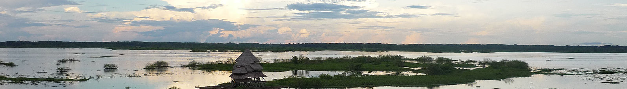
Ecosystem Services Part 2:
Linking Ecosystems & Their Processes to What People Value and to Human Actions
A tribal village near Iquitos, Peru in the Northern Amazon derives many social benefits and ecosystem services from the river.
Notes:
Notes for instructor: Ask learners, what’s the difference between an ecological benefit and a social benefit resulting from a particular management choice? How would you trace changes in the biophysical makeup of an ecosystem forward to the social effects of that change? Can learners identify a negative example of ecosystem degradation leading to poor social outcomes?

Slide 2


Reminder: What Are Ecosystem Services (ES)?
ES are the benefits that humans receive from nature, sometimes called natural capital
Examples include clean air and water; flood control; arboreal shade and cooling; pollination from birds and insects; raw materials and wild food; and recreation in nature.
In theory, ES can be valued using standard methods developed by economists, but when intrinsic value is involved, such methods are challenged.

Slide 3
How Do Natural Systems “Support” (Make Possible) Ecosystem Services?
Ecosystem attributes along with ecological processes together produce ecosystem services.
Sometimes there are many ecological factors involved in supporting a service at a particular locale.
Identifying the underlying ecological factors that support a service is part of current fundamental research.
Biophysical Measures
Notes:
Notes to Instructor: For example, a healthy and biodiverse migratory bird marsh (service) depends upon the ecosystem attributes of a community of plants for habitat and food, which depend on the process of nutrient cycling to preserve clean water.

Slide 4
Relationship between Science, Services, and Actions
The diagram depicts the relationship between ecological attributes and processes that scientists measure and ecosystem services. Human decisions and behaviors, like management actions, result in changes in those attributes and processes—either positively or negatively. Science that can inform policies, decisions, or behaviors it is called actionable science—i.e., a linking measure can be identified.
Notes:
Notes to Instructor: Consider providing a specific example of the relationships depicted in the diagram. For example, people value waterways that are not clogged with nuisance algae. The biophysical processes that keep waterways free of this nuisance are rain infiltration into the watershed soil to limit run-off of excess nutrients and other pollutants along with riparian plant diversity or complexity and floodplain wetlands. However, waterways can be degraded if management allows removal of riparian corridors and doesn’t limit fertilizer use and stormwater run-off. A good linking measure might be clear water, free of unsightly dead algae.

Slide 5
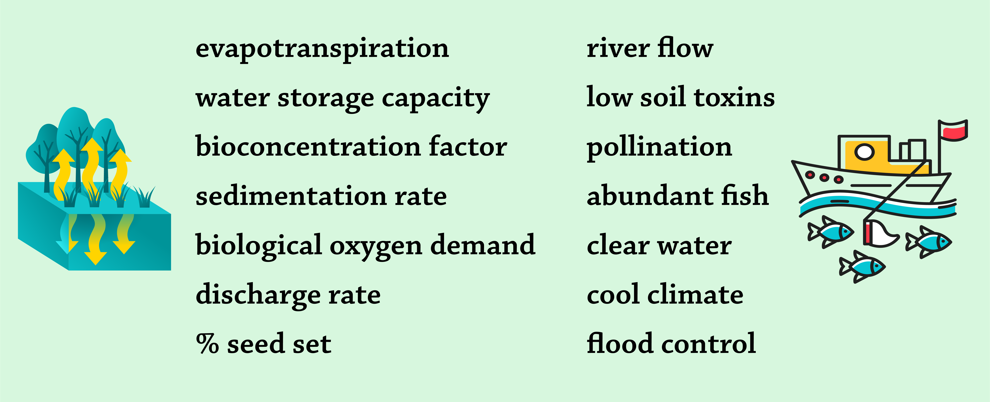
How Did You Match the Scientific Measures with the Most Appropriate Ecosystem Service?
Scientific terminology is typically not understandable to the public, and when it is, people will rarely say they value what the terms represent.

Slide 6
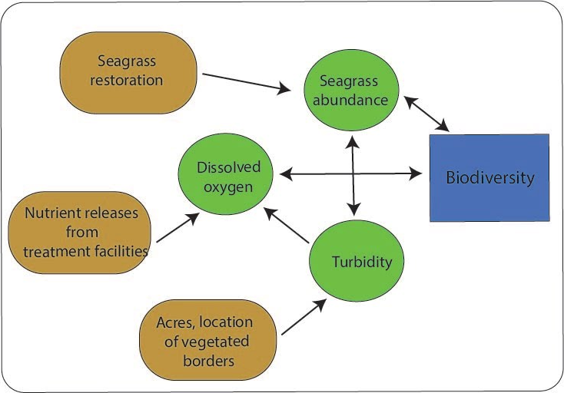
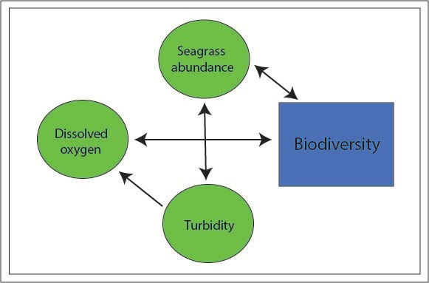
How Can We Make Science Be More Useful to Policy Makers and Natural Resource Managers?
Develop a solutions-oriented causal diagram:
Identify the ecosystem attribute(s) and process(es) that support an ecosystem service.
Identify actions that can influence those attributes and processes in ways to protect or enhance the service.
Be sure the suggested solutions are relevant in the particular social context.
Note: These two causal diagrams assume people value biodiversity
Scientific causal diagram, not solution-oriented
Solution-oriented causal diagram; actions in brown
Notes:
Notes to Instructor: The next slide provides an example of a solution that is not tenable in the social context.

Slide 7



Are Certain Solutions (Policy Actions) Appropriate in All Settings?
No! Solutions are very time- and place-based specific. Example:
Scientists know that as impervious cover increases in a watershed, uncontrolled stormwater flows to rivers can result in die-off of coastal seagrass and biodiversity.
However, suggesting removal of large areas of pavement in the watershed is typically not a policy action that will garner support.
Suggesting implementation of green roofs and tree planting to increase rain infiltration and reduce nonpoint run-off down coastal streams may be tenable.
Remove urban and suburban pavement
Provide funds for green roofs and street plantings
Notes:
Notes to Instructor: Point out to learners that this is an example of why it is important for scientists who want to do actionable work to work with policy makers up front of their research—so that the scientists know what types of policy options are tenable.

Slide 8
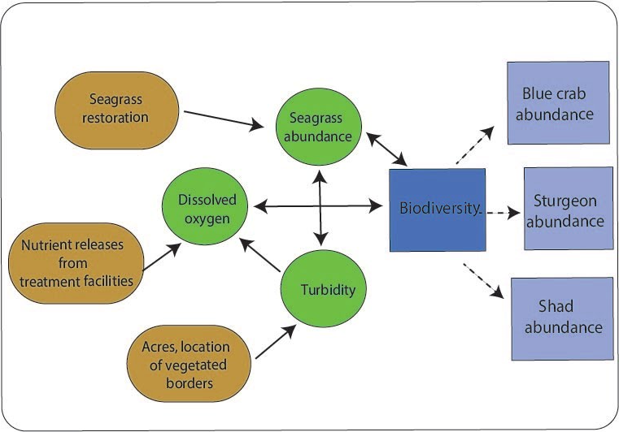
What Are Linking Measures and Why Are They
Important to Ensuring Science Is Actionable?
Example at right: Biodiversity per se is often not valued by people, but specific organisms are; thus, a linking measure is needed in the causal diagram.
Linking measures:
Are both scientifically and socially relevant
Can be quantitatively related to the underlying ecological factors and they can be translated into outcomes that are meaningful to non-technical audiences
A solution-oriented causal diagram (linking measures are in light blue)
Notes:
Notes to Instructor: Remind the learners that linking measures go by different names depending on what source one reads e.g., scientific or biophysical outcome measures, socially relevant ecological outputs, biologically relevant indicators, or intermediate services.

Slide 9
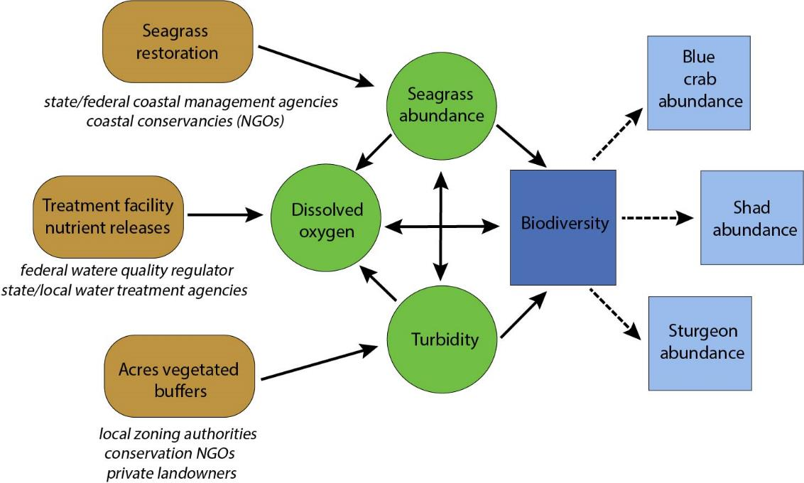
How Can We Finalize Our Causal Diagram for Actionability?
Identify responsible parties:
Who could potentially implement the actions
Who can provide insights into action-oriented research by helping identify additional options (action variables), the costs of various options, and legal or regulatory drivers that can foster or impede action in the S-E system.
A solution-oriented causal diagram, showing potential responsible parties under the actions in brown.

Slide 10



Why the Need for Linking Measures?
Scientific measurements of ecosystem features and ecological processes that underlie ecosystem services help inform natural resource management and policy.
While scientists often think what they measure (e.g., primary
production) is an ecosystem service, it is not because
people rarely value those measures.
In fact, scientists rarely measure directly what people value
(e.g., beautiful trees, walks in the forest).
Linking measures help garner public support for policies.
GPP – R = NPP
CO₂
photosynthesis
O₂
9

Slide 11

Can You Identify Some Linking Measures for the Below Example?
Linking Measures Example: Urban Forests
What ecologists measure in forests: Species, tree density, biomass
What people value (and understand): Walks in forests, health benefits
What policy makers need: Public support to increase tree planting programs
This requires evidence that trees matter to what people value.
Notes:
Notes to Instructor for a Fuller and More Extended Explanation: Let’s take a fictional example. Urban forests have been identified as important in the provision of ecosystem services. Scientists study forests based on their “structure” (number of species, tree density, biomass, dead wood/underbrush). But people don’t value those scientific measures, and in fact, they don’t even understand what most of them are. However, people do value reductions in the incidence of asthma. Thus, to get public support behind urban reforestation projects (that cost taxpayers money), links between asthma and scientific measures of urban forests are needed that both the scientists and policy makers or economists can work with. Let’s focus on the scientific metric tree biomass. Scientists know that tree biomass can be quantitatively linked to both cooling effects and to removal of air pollutants—known as particulate matter (PM). And: epidemiologists know that PM levels are good predictors of asthma and that warmer temperature exacerbate asthma. So, policy makers garner taxpayer support for urban forestry programs by linking them to asthma. Economic analyses can further public support for the programs by showing the reduced health costs. So, PM and temperature reduction are Benefit Relevant Indicators. It is worth noting that identifying linking variables is not easy for all ecosystem services and is an active area of research.

Slide 12

Linking Measures Example: Urban Forests
Get the Evidence (the “link” using causal diagrams):
People value reducing asthma problems.
Scientists know that asthma is associated with poor air quality.
Scientists know that as tree biomass or density increases, air quality improves.
A good linking measure is air quality (as for example,
measured by particulate matter).
Policy makers garner support for regulating PM
concentrations, and towns plant trees to comply.
Notes:
Notes to Instructor for a Fuller and More Extended Explanation: Let’s take a fictional example. Urban forests have been identified as important in the provision of ecosystem services. Scientists study forests based on their “structure” (number of species, tree density, biomass, dead wood/underbrush). But people don’t value those scientific measures, and in fact, they don’t even understand what most of them are. However, people do value reductions in the incidence of asthma. Thus, to get public support behind urban reforestation projects (that cost taxpayers money), links between asthma and scientific measures of urban forests are needed that both the scientists and policy makers or economists can work with. Let’s focus on the scientific metric tree biomass. Scientists know that tree biomass can be quantitatively linked to both cooling effects and to removal of air pollutants—known as particulate matter (PM). And: epidemiologists know that PM levels are good predictors of asthma and that warmer temperature exacerbate asthma. So, policy makers garner taxpayer support for urban forestry programs by linking them to asthma. Economic analyses can further public support for the programs by showing the reduced health costs. So, PM and temperature reduction are Benefit Relevant Indicators. It is worth noting that identifying linking variables is not easy for all ecosystem services and is an active area of research.

