Slide 1
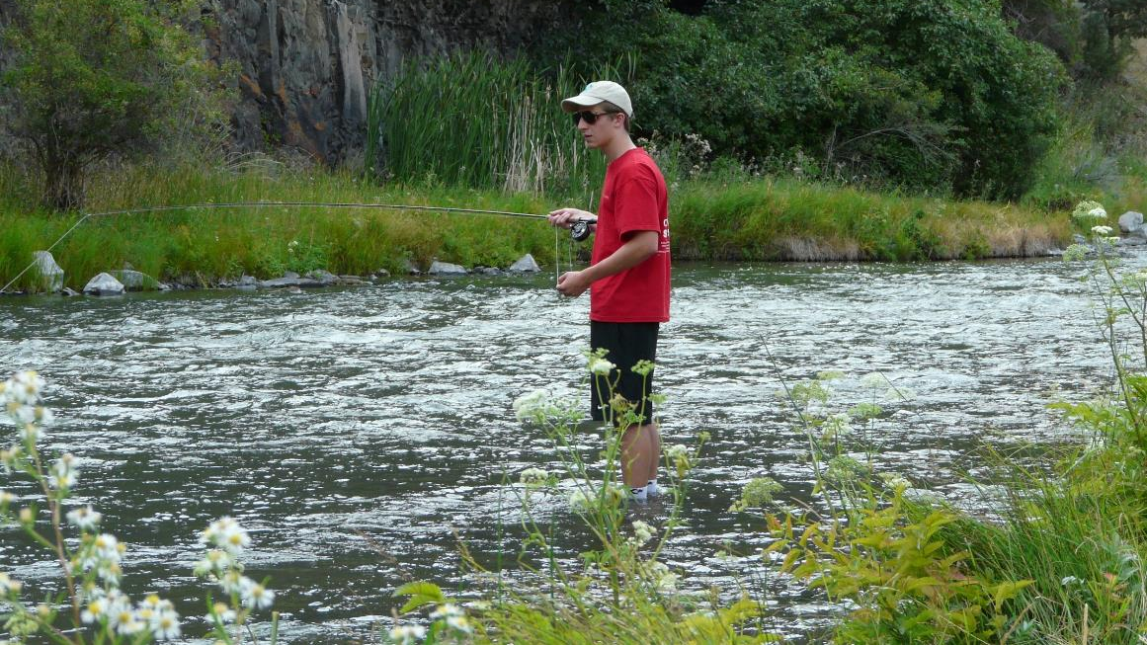

Ecosystem Services Part 1: Defining and Valuing Nature
Notes:
Notes to Instructor: On the following slides, query learners using the questions in blue.

Slide 2

What Is Value?
Question 1.
How can you describe the value you place on something?
How would you compare something you value to something different that another person values (e.g., soil health vs. swimming in a clean lake)?
Would that value change if you lived in a different part of the world or had less money?
Notes:
Notes to Instructor: The last part of this question is getting at the fact that ecosystem services are place-based and contextual and that some of them are personal (i.e., if you have less money, obtaining water that has a cost becomes more valued).

Slide 3

What Are Ecosystem Services (ES)?
Ecosystem services are the benefits that humans receive from nature, sometimes called natural capital.
Examples include clean air and water; flood control; arboreal shade and cooling; pollination from birds and insects; raw materials and wild food; and fertile soil for farming.
In theory, these ES can be valued using standard methods developed by economists that can be in monetary or indirect non-monetary terms.

Slide 4

Value from an Ecosystem Services Perspective
Value is what something that’s associated with nature is worth to people.
What an ES costs and the value or benefits it delivers are not necessarily equal.
Nature’s values need not be revealed in markets but often are.
The value of foregone activities (“opportunity cost”) must be considered.

Slide 5
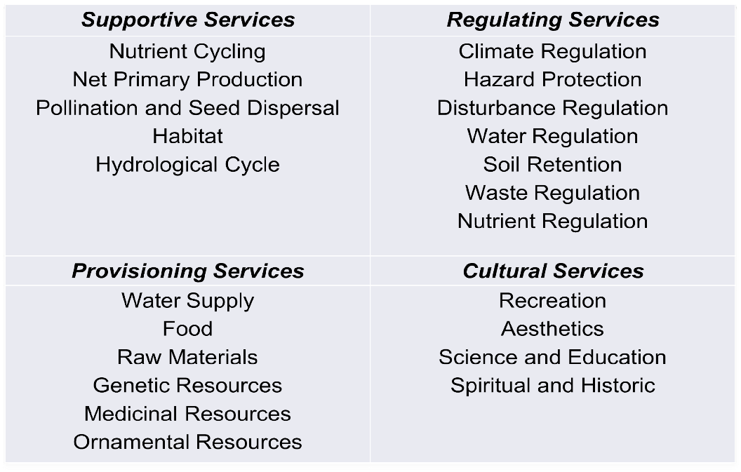
How Ecologists Have Categorized
Ecosystem Services
Question 2. Which of the following are not ecosystem services?
Notes:
Notes to Instructor: This is a bit of a trick question; however, the point is that learners need to understand that the entity must be of value to people. For most of the provisioning services in the table (water supply, food, medicinal resources, ornamental resources) people will tell you they value them either monetarily or non-monetarily. Most of the others are biophysical/ecological attributes or processes that help in the provisioning of ecosystem services, but they are not services because people will rarely express that they value them. Indeed, people don’t even understand what many of them mean. (Exception: scientifically educated people may).

Slide 6
Types of ES Value
Extractive Use Value
Value from “consuming” natural resource
Question 3. Can you list natural resource examples related for each of the six types of values?
Use Value
Non-Extractive Use Value
Non-consumptive value
Indirect Use Value
Value from the functioning of ecosystems
Economic Value
Existence
Value
Value from knowing resource exists
Non-Use Value
Option
Value
Value from preserving for future potential use
Bequest
Value
Value from preserving for future generations
Note: This is only one way to categorize types of ES value.
Notes:
Notes to Instructor: Non-use values are sometimes called passive-use values. Ask learners to provide examples for each of these. Here are some:
Extractive use value: e.g., coal, water, timber
Non-extractive use value: e.g., seascape views, land
Indirect use value: Value of ecosystems and biophysical processes necessary for an ecosystem service; e.g., wind for energy production; nutrient processing for healthy soil; forage food (plankton, etc.) of fisheries
Existence value: The value of knowing something exists—usually expressed as a sense of well-being; e.g., a mountain, knowing marine life is diverse
Option value: Value of preserving a natural resource in case you wish to use it (key here is potential use by the individual valuing it; the value of having an option) e.g., parks, substitutable species
Bequest value: The value of knowing biodiversity will be available to future generations (key here: is future use by others)

Slide 7
Types of ES Value
Extractive Use Value
Value from “consuming” natural resource
This Lesson 1 will
focus primarily on
Use Valuation like
market & non-market
valuation.
Use Value
Non-Extractive Use Value
Non-consumptive value
Indirect Use Value
Value from the functioning of ecosystems
Economic Value
Existence
Value
Value from knowing resource exists
Lesson 3 will
delve into
Non-Use Valuation
like intrinsic and cultural value.
Non-Use Value
Option
Value
Value from preserving for future potential use
Bequest
Value
Value from preserving for future generations

Slide 8

Valuation Methods: Market-Based Price
Is a type of use value
Is sold commercially so data are available in monetary units
Is easiest for determining value and creating policies but most ecosystem services do not
have markets
Is assumed to represent the social benefits
that an additional unit confers
Question 4. Why do you think the method is linked to getting more or having less? i.e., rather than a fixed amount of the service
Notes:
Notes to Instructor: Answer to question: How much people will pay is closely tied to what they already have. If they have plenty of “x”, they are unlikely to pay much for more, and they are also are more likely to accept a lower price if they sell a unit of what they have plenty of. See next slide for graph of supply vs. demand and price.

Slide 9
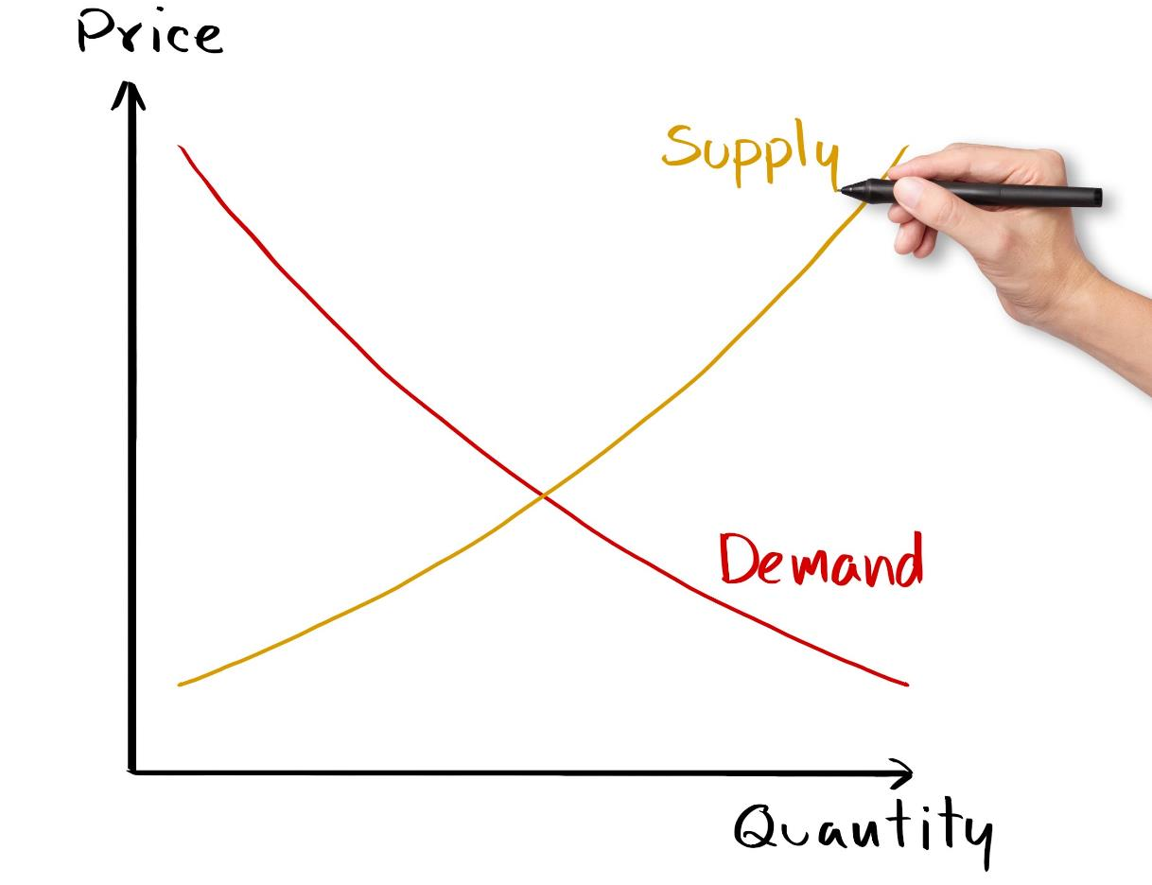
Notes:
Notes to Instructor: This is a classic supply – demand curve. The price something garners on the market (i.e., what a person is willing to pay) is closely tied to the supply (i.e., how much people have).

Slide 10


Valuation Methods: Market-Based Price
Is a type of use value
Is sold commercially so data are available in monetary units
Is easiest for determining value and creating policies but most ecosystem services do not have markets
Is assumed to represent the
social benefits an additional unit confers
Question 5. What is an example of something in nature that can be monetized based on markets (i.e.,
has commercial value)?
Notes:
Notes to Instructor: Answer to questions: Examples of market-based natural benefits include timber, commercial fisheries, or other entities in which prices are clear, such as the cost of salmon or the cost of a unit of water in countries that use water markets (Note: There are some emerging markets, including those for U.S. water out west. The carbon market has also been struggling to be successful because it still largely depends on someone covering the initial costs of what is sold on the market. It could work if regulations put a cap on carbon losses/CO2 release and then trading could occur; currently, this is working for SO2 emissions in the U.S.)

Slide 11
Valuation Methods: Market-Based
Cost Avoidance
Is a type of indirect use value
Nature provides the service, but it could be replaced through commercial markets
Could refer to the value of preserving nature to avoid future costs that will occur
Is sometimes called replacement cost
Question 6. What is an example of something that could be valued based on what it would cost to get it if nature did not provide it?
Notes:
Notes to Instructor: Answer to question: Cooling services of forest and trees—the cost of extra air conditioning; flood protection with seawalls if wetlands were not on the coastline; clean drinking water—filtration structures. Note this depends on having markets for whatever is used to replace the lost ecosystem process or structure.

Slide 12
Question 7. How might you go about assigning value to each of the six types of ecosystem services? (i.e., what method would you use?)
Extractive Use Value
Value from “consuming” natural resource
Use Value
Non-Extractive Use Value
Non-consumptive value
Indirect Use Value
Value from the functioning of ecosystems
Economic Value
Existence
Value
Value from knowing resource exists
Non-Use Value
Option
Value
Value from preserving for potential future use
Bequest
Value
Value from preserving for future generations
Notes:
Notes to Instructor: Have the learners first take a stab at how they might do this. Perhaps break up learners into groups. The next slide identifies the economic method and after that goes into a bit more detail.

Slide 13
Valuation Method for Each Type of ES Value
Extractive Use Value
Value from “consuming” a natural resource
Market Data
Use Value
Non-Extractive Use Value
Non-consumptive value
Revealed Preference Methods
Indirect Use Value
Value from the functioning of ecosystems
Productivity or Cost-avoidance Method
Economic Value
Existence
Value
Value from knowing resource exists
Stated Preference Methods
Non-Use Value
Option
Value
Value from preserving for potential future use
Bequest
Value
Value from preserving for future generations
Notes:
Notes to Instructor: Be sure learners note that market data are the easiest to value (i.e., cost per extra unit exists in $). The other methods all require different ways to evaluate value and what is found may or may not be expressed in currencies ($).

Slide 14


Valuation Methods: Non-Market
They are not estimated based on market prices (i.e., not commercial).
They can observe choices, but not prices.
Most ecosystem services must be valued using non-monetary economic methods.
They require that a link be established between changes in the quantity or quality of the resource and changes in the stated or observed behavior of people.
  e.g., changes in air quality may result in people moving to another area.
Notes:
Notes to Instructor: Make sure the learners understand that “economists” are trained in mathematics and statistical methods to help identify how people value things…so economics does not just mean money and markets.

Slide 15
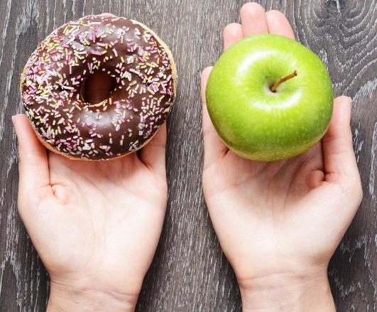
Valuation Methods: Non-Market
Methods involve discovering preferences:
revealed preferences – based on choices/decisions people make
stated preferences – based on what people say their preferences are
Once preferences are determined, they can sometimes be monetized.
e.g., by stating their willingness to pay for something
Question 8. How might you implement these two methods to determine the value of a natural resource or natural process?
Notes:
Notes to Instructor: The next few slides provide the answers but for you, but for now: revealed preferences are when economists look at markets to see what people pay or what people actually do, not what they say; stated preferences are what people say when given choices (in writing, with images, scenarios) and are asked to state their preferences or indicate how much more they would pay for one over another.

Slide 16
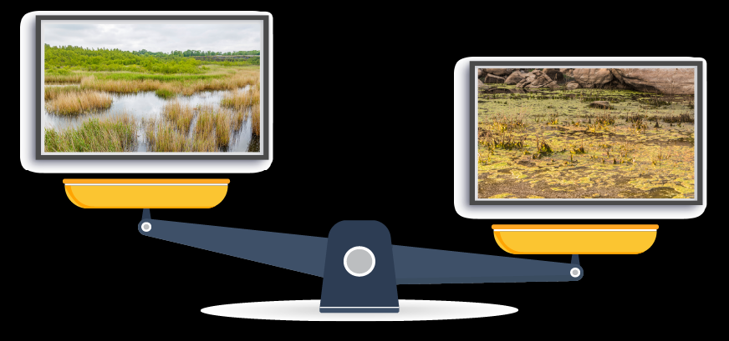
Stated Preference Method Example
Question 9. If you are shown the below two images on computer screens, which one do you prefer? By how much (more)? Why?

Slide 17
Stated Preference Method Example
Question 10. What factors other than what appears to be the health of the wetland on the left might apply to your preferences? Hint: Think about the
multi-dimensional nature of ecosystem services.
Notes:
Notes to Instructor: The goal of this question is for learners to recognize that many factors influence the extent to which an ecosystem service is valued. So, the left wetland may be more aesthetically pleasing, but perhaps the wetland on the right might store more water and protect areas from storms. Or perhaps the one on the right is closer to population centers, and so the opportunity to visit it for birdwatching is greater.

Slide 18
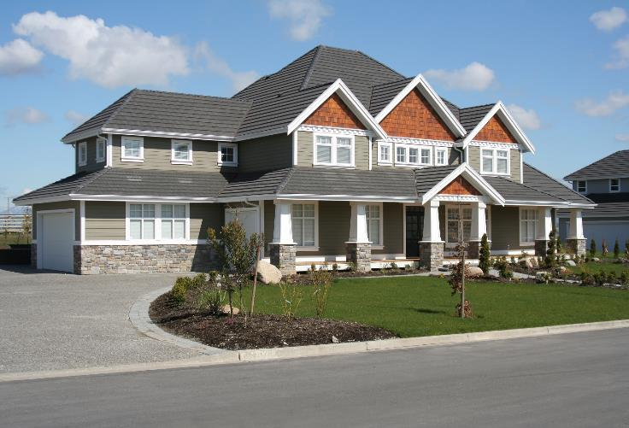
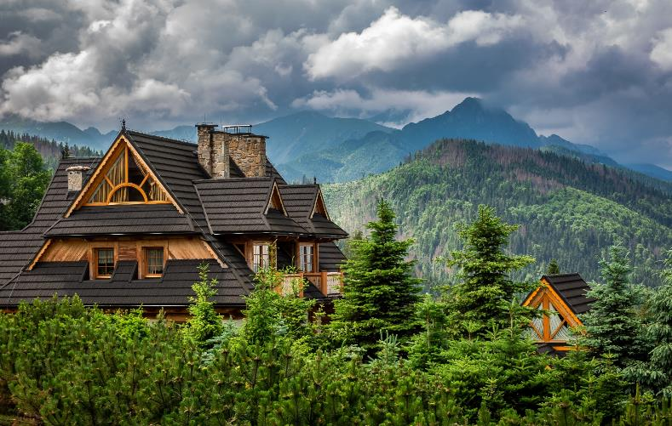
Revealed Preference Method Example
Question 11. How might these two properties differ in terms of how much they sold for? What do you think the ecosystem service is in this example?
Question 12. What are some other examples in which preferences can be revealed that cannot be easily linked to a $ number?
SOLD!
SOLD!
Notes:
Notes to Instructor:
11. The house on the right is likely to be MUCH more expensive. The difference is the view, location, and ability to go to beautiful forest. It is difficult to place a $ on this unless you look at markets and see what people actually paid for the two homes (i.e., revealing their preferences).
12. Other examples: the influence of soil properties on agricultural land or how travel costs may be used as a proxy for recreational value of an entity.

Slide 19

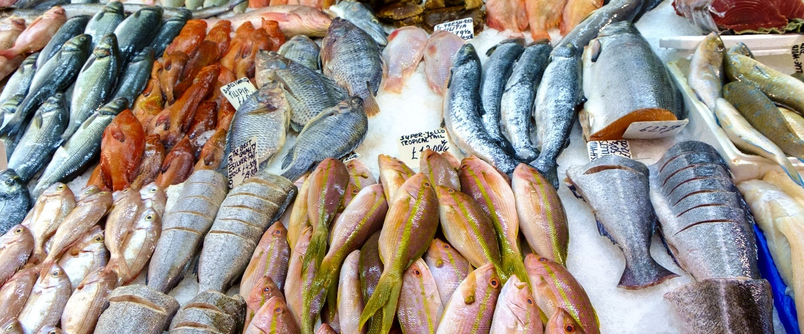

Question 13. What are several reasons that valuation of ecosystem services is useful?
Notes:
Notes to Instructor: Ask learners to come up with at least three reasons. The next slide provides some answers that have been written about extensively.

Slide 20

Why Is Valuation of ES Useful?
Provides a common unit of measure
Uses of natural resources create a range of impacts, usually not in comparable units (generated revenues, changes in fish stocks, loss of tourists, water quality changes, reef degradation).
Facilitates decision making
Benefit-Cost Analysis (BCA) is a systematic enumeration of the gains (benefits) and losses (costs) of particular decisions in common units, for comparison purposes.
Serves as a good public communication tool
Uses of natural resources create a range of impacts, usually not in comparable units (generated revenues, changes in fish stocks, loss of tourists, water quality changes, reef degradation).
Notes:
Notes to Instructor: Point out to learners that objective decision making is fostered when all potential impacts are expressed in the same units.

