Slide 1

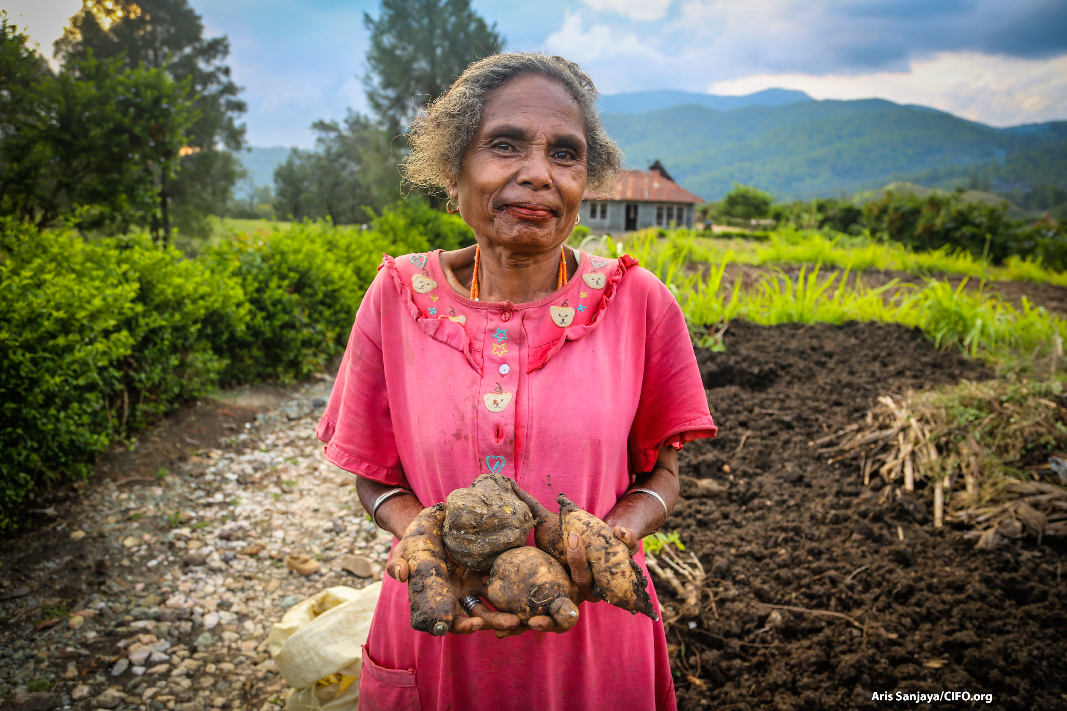
Large-Scale Land Acquisitions (LSLAs)
Land Scale Land Acquisitions

Slide 2

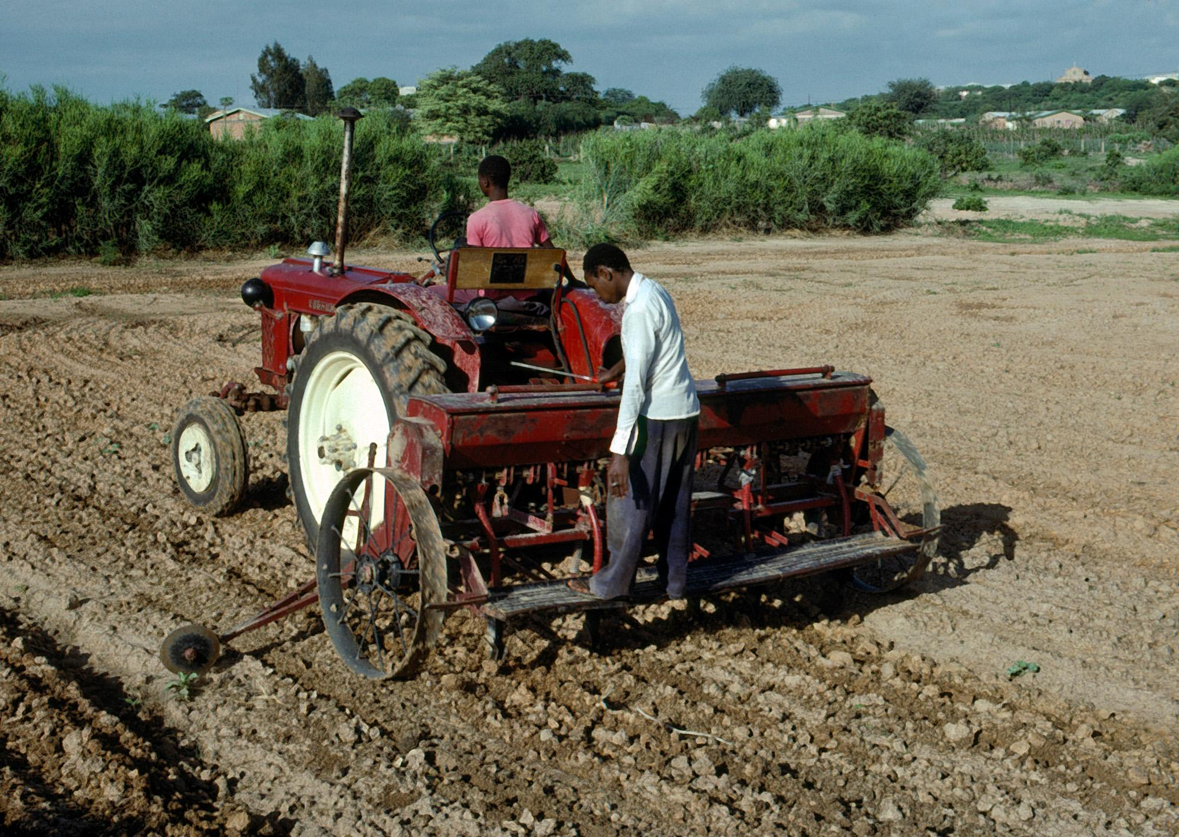
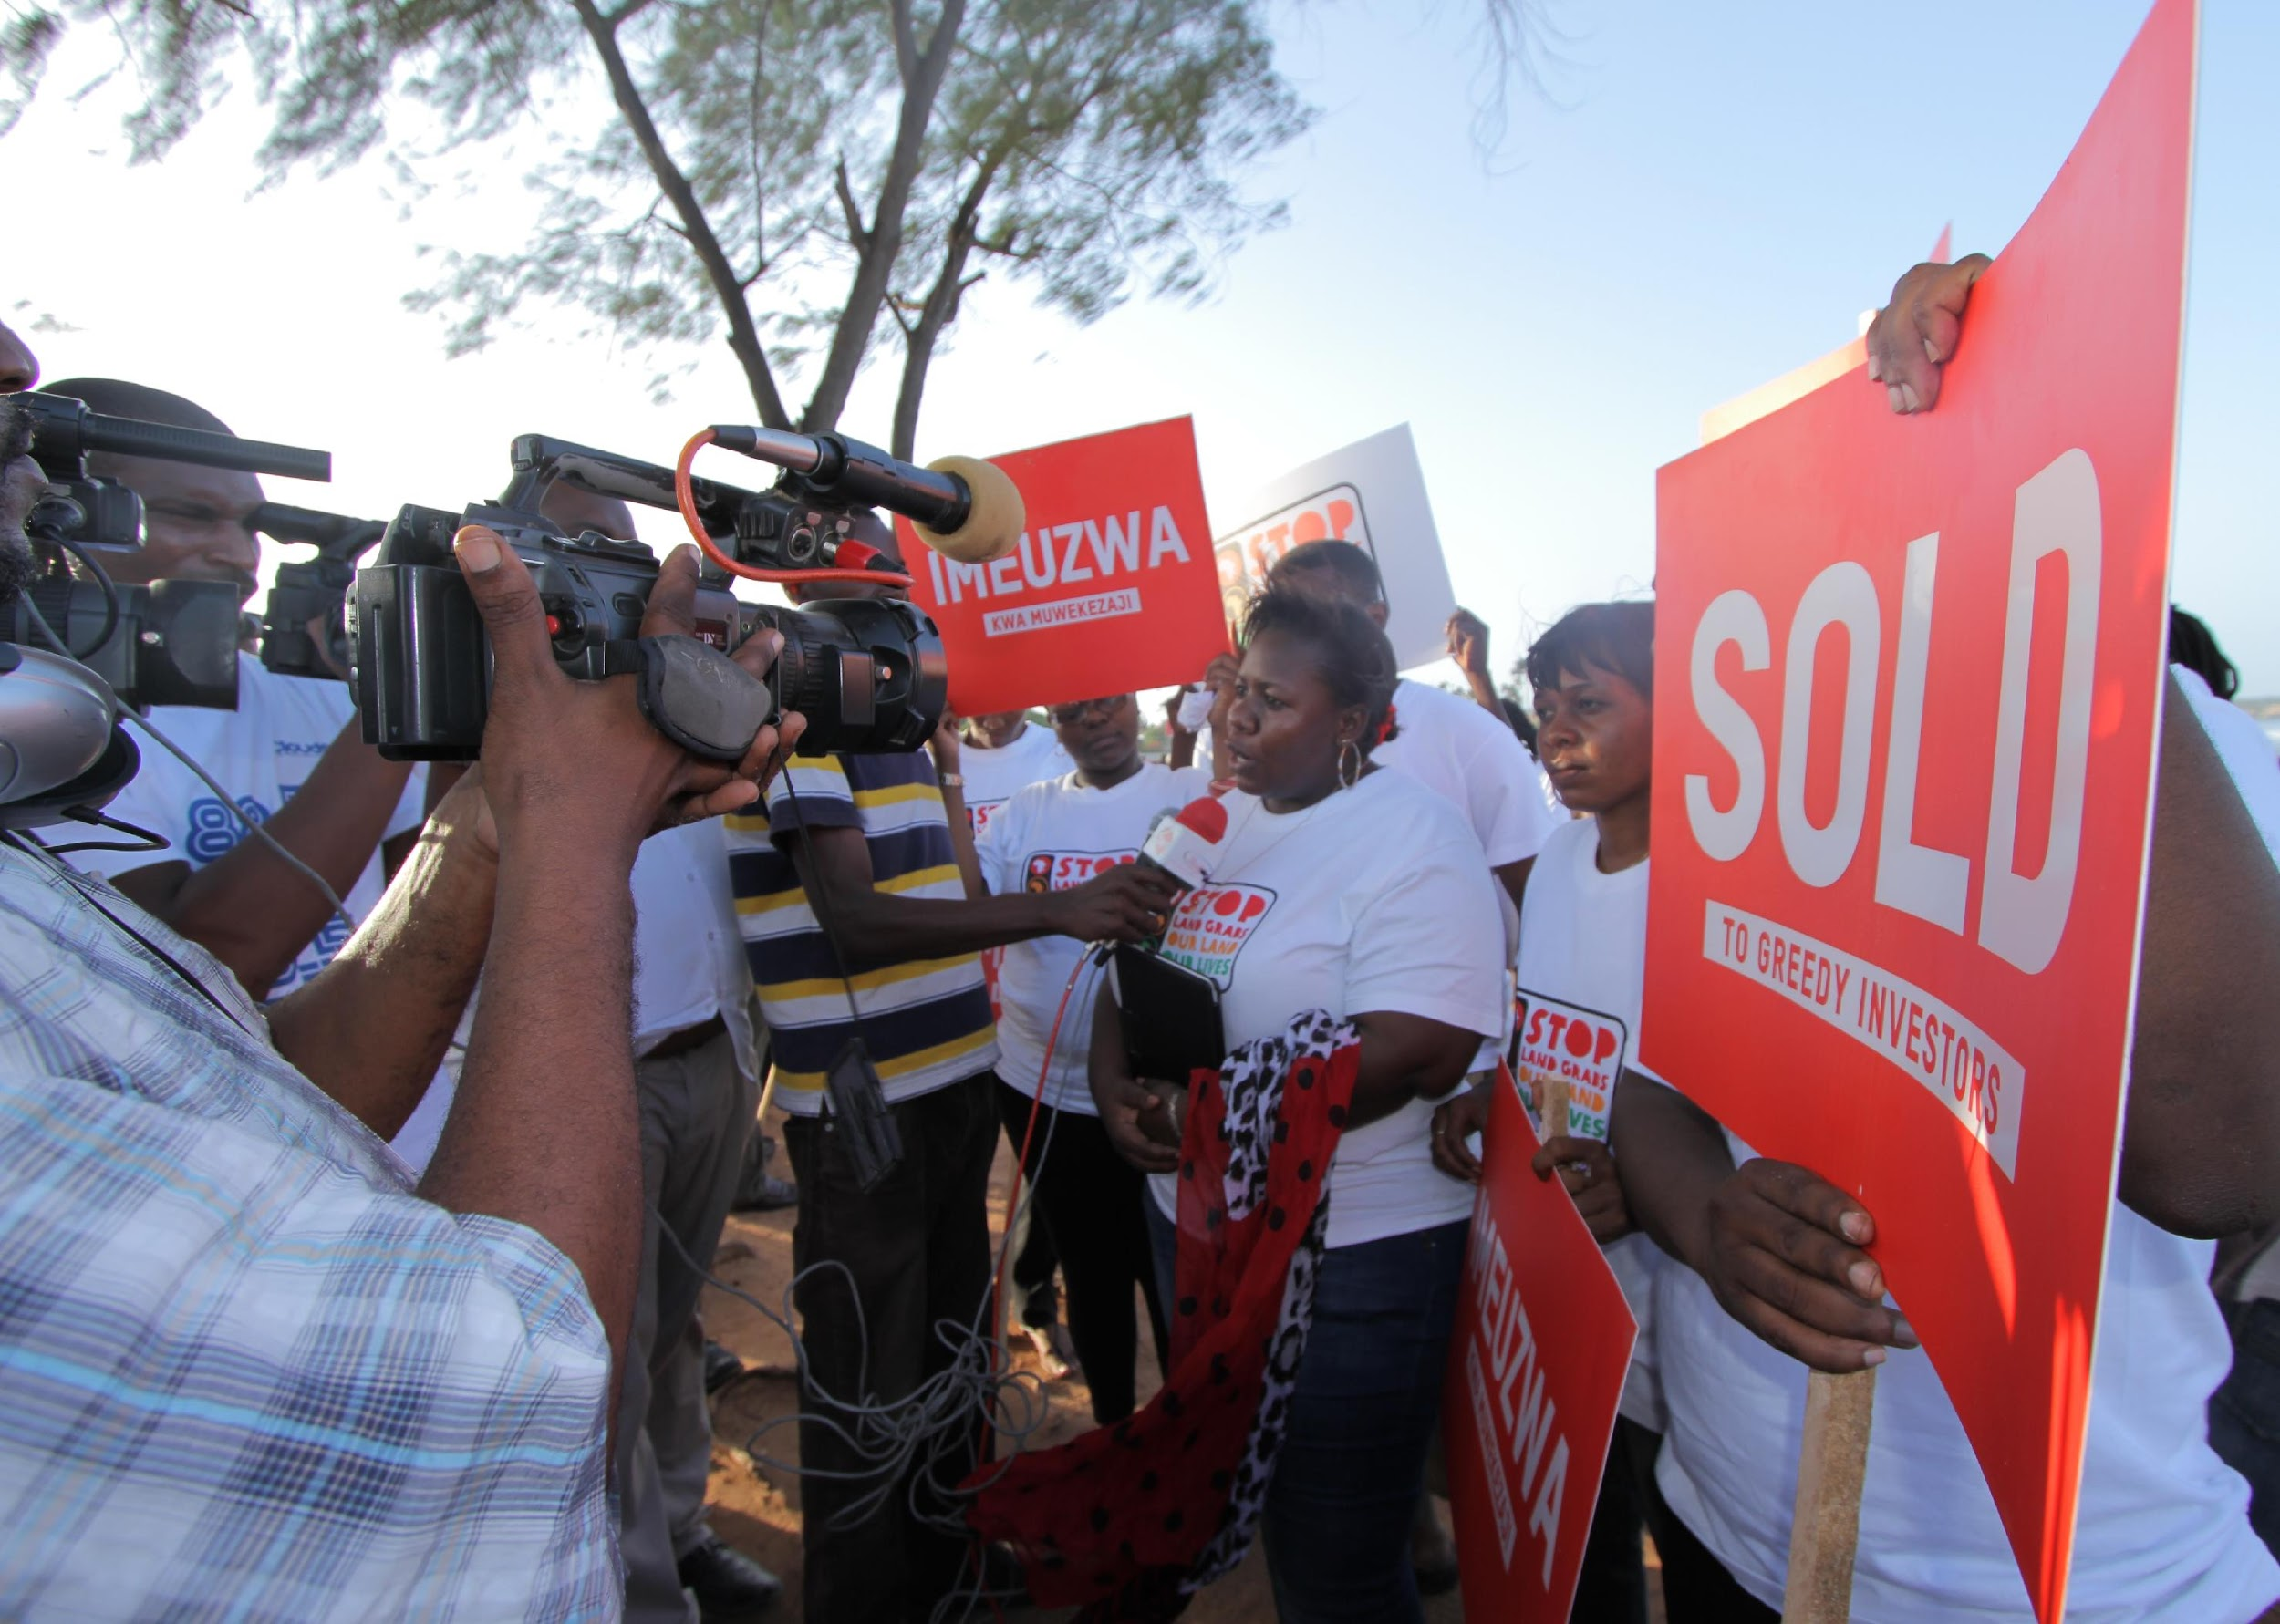
Background on the “Global Land Rush”
Potential Benefits to Local Region:
Government revenue
Economic development/job creation
Infrastructure provisions
Technology transfer
Potential Impacts to Local Region:
Loss of access to land
Loss of forest
Labor disputes
Lack of compliance with contracts
Credit: Africa Renewal
Credit: Oxfam
Notes:
Notes to Instructor: Under potential benefits, the “government revenue” refers to the fact that often purchases require payment of different amounts to governments in order to acquire the land rights. In theory, some of this money should trickle down to citizens and thus create the potential benefit of “economic development/job creation”

Slide 3
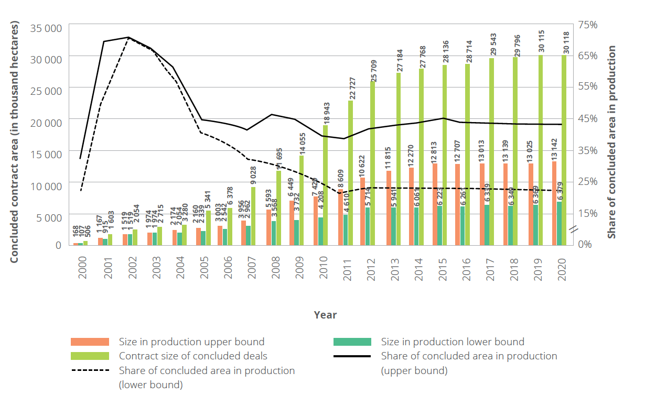
Figure 0.1: Cumulative global contract size of concluded deals over time and size under production (left axis) and
share of concluded size under production (right axis)
Year
Notes: Calculations based on Land Matrix data. The lines show the upper and lower bound of the share of contract size (excl. failed deals) in production. The bars show the absolute size per negotiation status per year. Note that in addition to the accumulative size in production by 2020 there is an additional size in production without year information between 1.6 (lower bound) and 8.2 (upper bound) million hectares.
Image source: Land Matrix Analytical Report III (2021) https://landmatrix.org/resources/land-matrix-analytical-report-iii-taking-stock-of-the-global-land-rush/
Notes:
Notes to Instructor: Graph is in hectares (= 2.5 acres or 0.01 km2). Alert the learners that as they do research, the details of the deals are important to consider because each one can be unique.

Slide 4
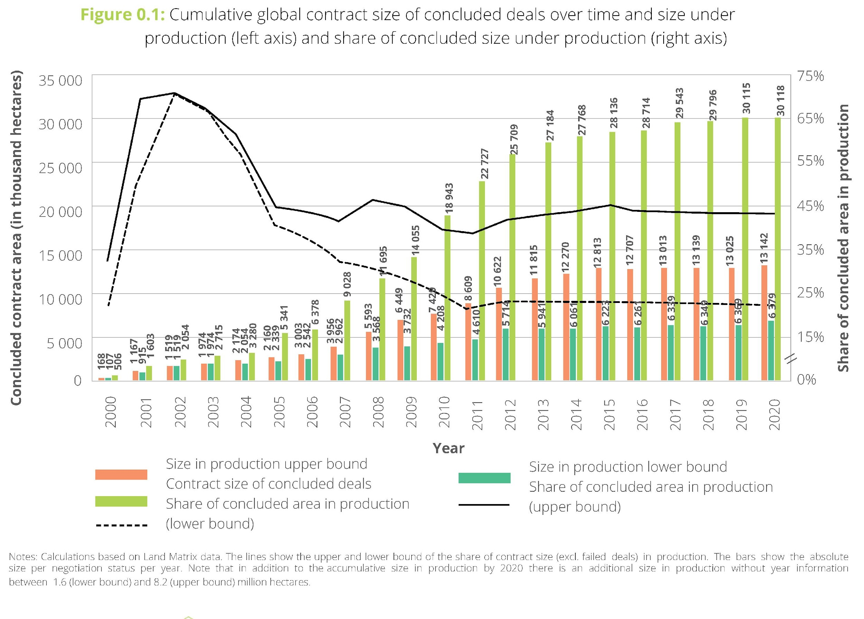
Background on the “Global Land Rush”
Addition of new deals peaked in 2002
  (shown by area in graph)
Slow down occurred due to:
  Country moratoriums on foreign purchases
  Less demand for biofuels
  Post-COVID increase expected in some countries, including Indonesia and India
Global Land Rush is complicated due to the involvement of:
  Many countries, each with different conditions
  Many actors with different investment motives
  Each deal having specific characteristics
Image source: Land Matrix Analytical Report III (2021)
https://landmatrix.org/resources/land-matrix-analytical-report-iii-taking-stock-of-the-global-land-rush/
Notes:
Notes to Instructor: Graph is in hectares (= 2.5 acres or 0.01 km2). Alert the learners that as they do research, the details of the deals are important to consider because each one can be unique.

Slide 5
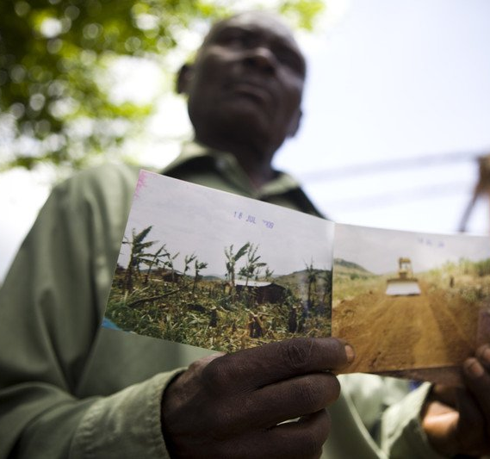
Background on the “Global Land Rush”
There is a huge lack of transparency on land governance issues, especially regarding:
Planning and decision-making processes
Contractual agreements
Level of community involvement
Levels of local compensation, if any
Little is known about the short-term and expected long-term effects of the investments
Key information Sources:
1. Anseeuw, W., Boche, M., Breu, T., Giger, M., Lay, J., Messerli, P., & Nolte, K. (2013). Transnational Land Deals for Agriculture in the Global South. Analytical Report Based on the Land Matrix Database. CDE/CIRAD/GIGA. Bern/Montpellier/Hamburg. https://data.opendevelopmentmekong.net/dataset/matrix
2. Lay, J., Anseeuw, W., Eckert, S., Flachsbarth, I., Kubitza, C., Nolte, K., & Giger, M. (2021). Taking stock of the global land rush: Few development benefits, many human and environmental risks. Analytical Report III. Bern, Montpellier, Hamburg, Pretoria: Centre for Development and Environment. https://doi.org/10.48350/156861
3. Oxfam. (2011, September 12). Land grabs push thousands further into poverty. Oxfamamerica. https://www.oxfamamerica.org/explore/stories/land-grabs-push-thousands-further-into-poverty/
Notes:
Note to Instructor: The photo is from a region in Uganda where Oxfam reported in 2011, that, “at least 22,500 people lost their homes and land to make way for a British timber company, the New Forests Company (NFC). Villagers told Oxfam that some evictions resulted in physical violence, and destruction of property, crops and livestock. Many have been left destitute, without enough food or money to send their children to school. They have received no compensation or alternative land. NFC denies that it was responsible for any evictions.”

Slide 6
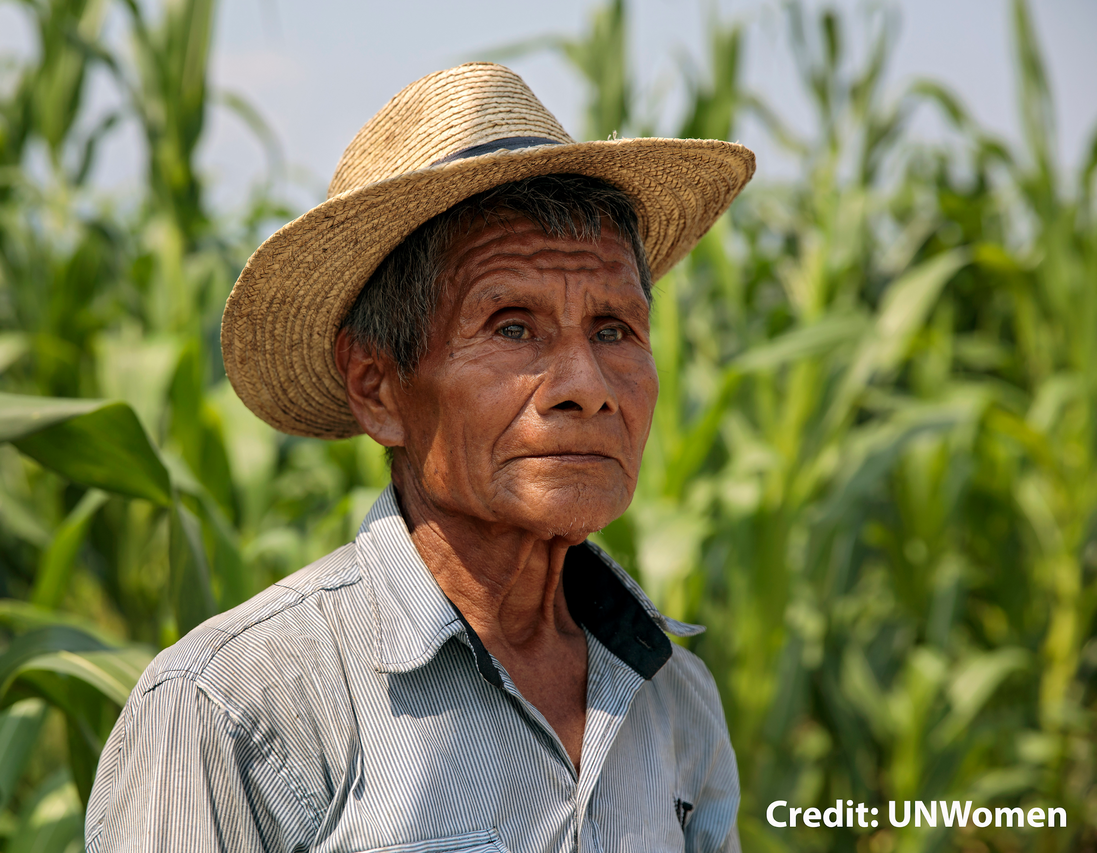
Background on the “Global Land Rush”
Many small-farm holders in developing countries use land that has been considered common property for a long time; this is also called “customary land.”
Investors may make deals with individual landowners or with government (“state”) entities.
In many countries, the state has converted customary land into state-owned land and then denied access to resources, often in collaboration with investors.
When state actors are involved, funds received by the government may or may not benefit the local people/public.

Slide 7
Types of Questions Researchers Have Asked
Have forests been cleared illegally due to the acquisition?
Has the project impacted the number of livestock in the surrounding village?
Has the contract been violated?
Was the whole village informed of the project before it was approved?
How many households lost land and were they compensated?
What amount of promised infrastructure has been built and to what degree were locals involved and then have access?
Has there been a change in natural resources (e.g., water) important to the livelihoods of the local people?
Are the workers local people? And if so, are any underage? Are both local men and women provided employment opportunities?
Has food security changed as a result of the project?
Source: Hett,C.; Nanhthavong, V.; Kenny-Lazar, M., Phouangphet, K. (2017) “Good or bad land deal? A methodology to assess the quality of land concessions and leases in Laos.” https://boris.unibe.ch/id/eprint/111041
Notes:
Notes to Instructor: You may wish to only mention a few of these. These questions are not assigned to the students to answer, but rather are used here to demonstrate the types of questions researchers have been asking in this context. They may help learners “get in the mindset” and develop their own questions about LSLAs.

Slide 8
Lesson Goals
Today’s Goal: To use an open-access database on LSLAs to gather data on the number of deals that have been made in a country and specific characteristics of those deals, including for example: who the investors were, the size range (land area) of the deals, and the intention of the investment.
Working in groups, each will collect data on deals in each of two countries that are similar in size (by area) but are on different continents and have very different income levels.
Lesson Goal: Data gathering will continue as homework, and in the next session (Part 2), groups will meet to summarize their finding in the context of key questions and report out to all. After that, learners will receive instructions to work as groups or independently to gather qualitative information from texts (literature, web, news, etc.) to deepen their understanding of the nature and impact of LSLAs in their assigned countries.
Lastly, in the final session (Part 3), participants will wrap up their textual research independently or in groups and being developing their key points for an editorial on LSLAs that would be suitable for an outlet such as The New York Times. The participants will select an angle to focus on for the piece. Examples include, water rights, economics, purchase vs. lease, etc. The editorial will be written independently and will be completed as homework.
Notes:
Notes to Instructor: This slide is meant to give the learners the goal, for today, as well as where they are going with the lesson as they finish all parts.

Slide 9
Focal Countries for Lesson
Axillary Data by Country
Country | Income¹ |  |  |  | Size² | Climate | Rainfall
 | 2005 | 2010 | 2015 | 2020 | Area (km²) | Climate* | Avg. Rain (“)
Argentina | 5158 | 10429 | 14971 | 8476 | 2.74M | tropical savannah | 30
Sudan |  | 1585 | 2158 | 1415 | 2.38M | tropical/subtropical desert | 6.2
Zambia | 703 | 1489 | 1314 | 985 | 741 km² | humid/subtropical | 35
Chile | 7599 | 12808 | 13574 | 13232 | 748 km² | dry summer/subtropical | 13
Lao PDR | 512 | 1170 | 2135 | 2623 | 231 km² | tropical savannah | 26
Uruguay | 5227 | 11992 | 16729 | 15438 | 174 km² | humid/subtropical | 37
Mozambique | 417 | 472 | 590 | 449 | 785 km² | tropical savannah | 58
Egypt | 1251 | 2593 | 3437 | 3609 | 995 km² | tropical/subtropical desert | 1
¹ Adjusted net income per capita in current (2021) US$ from the World Bank. http://data.un.org/Data.aspx?q=GdP&d=SNAAMA&f=grID%3A101%3BcurrID%3AUSD%3BpcFlag%3A1
² Size from Nation Master https://www.nationmaster.com/country-info/stats/Geography/Area/Land
³ Koppen climates and rainfall from www.weatherbase.com
Notes:
Notes to Instructor: Here is where you assign groups to the pairs of countries highlighted in the same color (e.g., Argentina & Sudan). The purpose of showing this slide is also to emphasize the different geographic regions for the countries in each pair, as well as, the differences in personal income and climate.

Slide 10

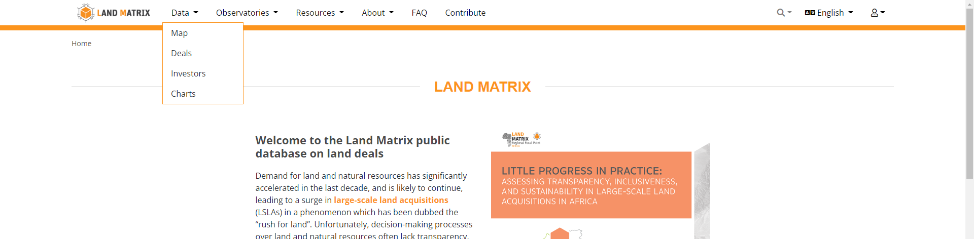
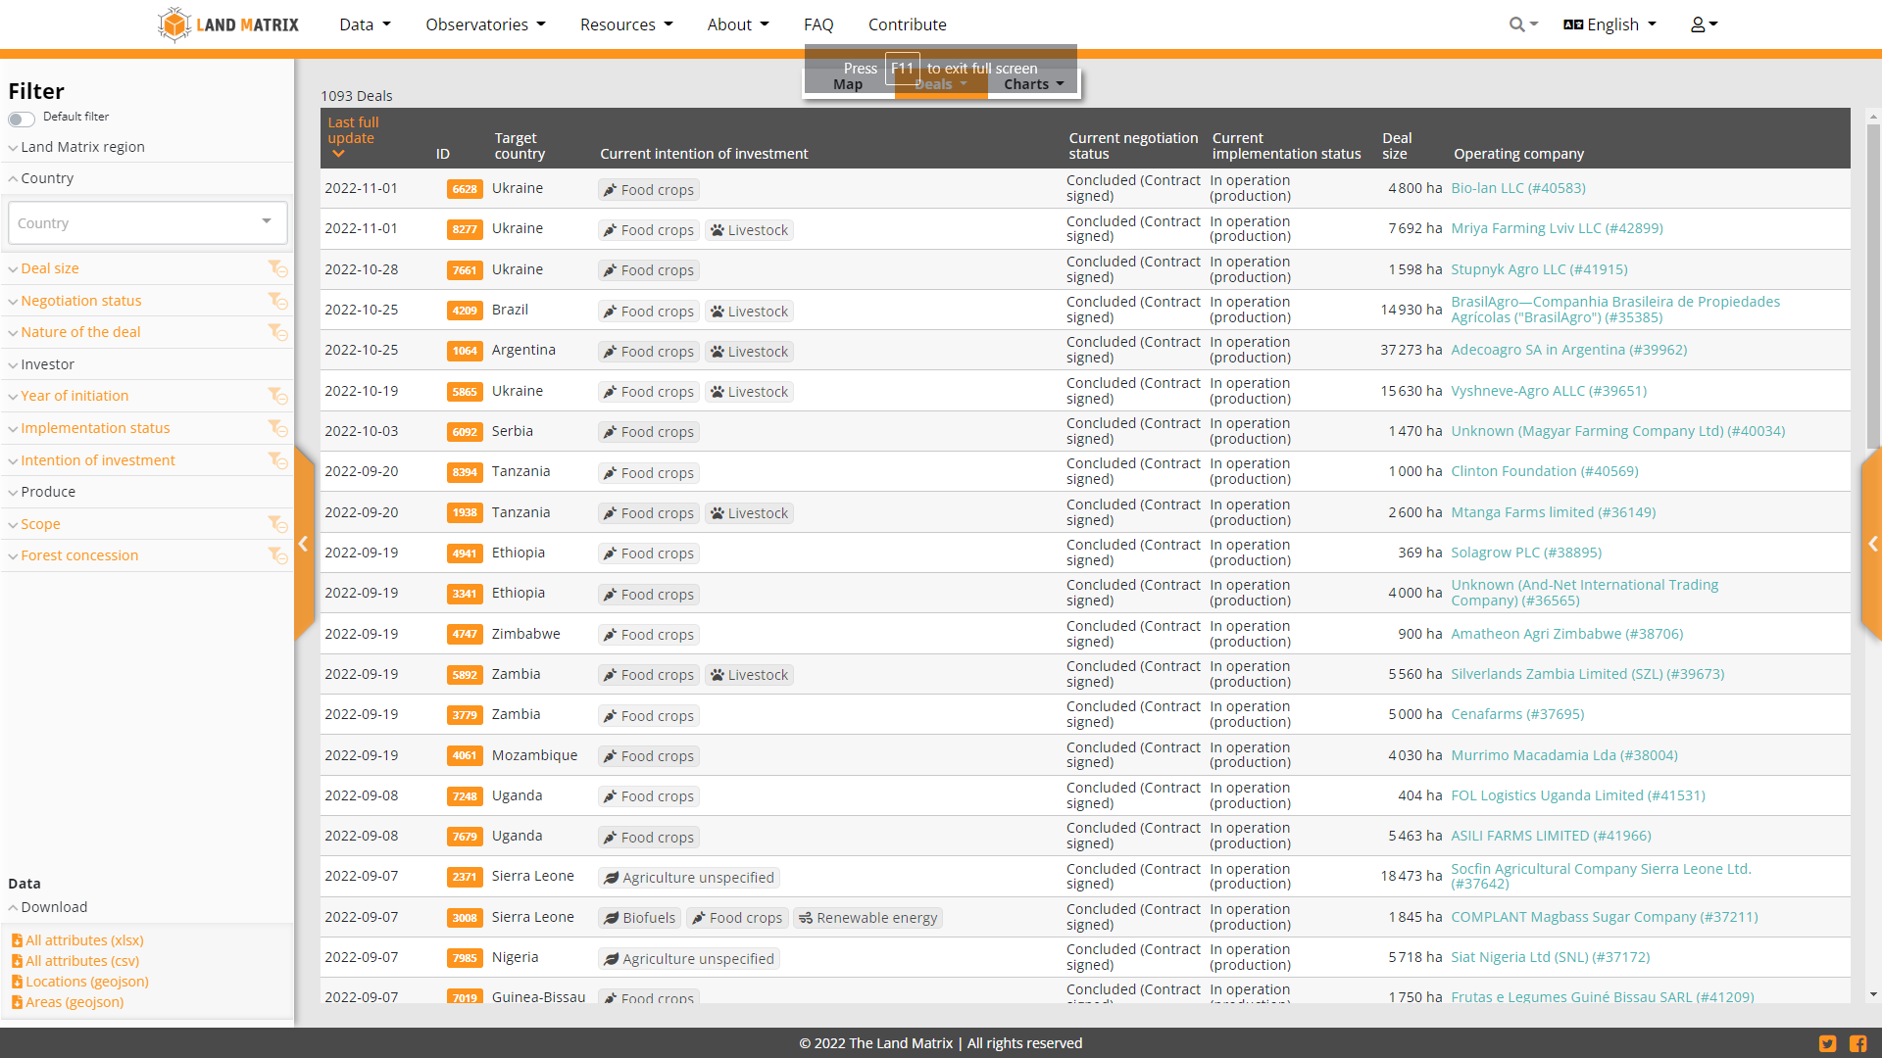
Using the Database
Navigate to Landmatrix.org and then click on Large Scale Land Acquisitions which is in the first paragraph”
https://landmatrix.org/about/lslas-whats-the-big-deal/
2. At the top left, click on “Data” and then on “Deals”
3. Below is what you will see:
Notes:
Notes for Instructors: This is to introduce the learners to the Land Matrix database. Have them open laptops and follow along as you go through steps 1–3.

Slide 11
Using the Database
Choose these filters from dropdown menus on left side of screen each time you use the database.
Land Matrix Region – Select Global.
Country – Select one of your assigned countries at a time.
Deal Size – Leave blank so that all are shown.
Negotiation Status – Select Concluded and Contract Signed.
Nature of the Deal – Select Outright Purchase and Lease.
Investor – Leave blank for now (can change later as desired).
Year of Initiation – Leave blank to include all.
Implementation Status – Select In Operation.
Intention of Investment – Select all categories of agriculture
(biofuel, food crops, fodder, livestock, non-food agriculture
commodities; agriculture unspecified) Uncheck everything else.
10. Produce – Leave blank.
11. Scope – Select Transnational.
12. Forest Concession – Select Excluded.
Notes:
Note to Instructors: Instruct learners to navigate to the left-side dropdown menu and enter these settings. Be sure the learners know that if they leave the Land Matrix database, some of the filters may revert back to the original settings, so they should make sure they are set correctly each time they use the database.

Slide 12
Gathering Data
Collect data using main side (right) of screen
Collect data on the number and size range of deals for each of the two countries assigned as well as the following items in bold for at least 5 deals
(collect information, if provided, for non-bold categories):
  General Info: Size of Deal, Nature of the Deal,
                Intention of Investment, Purchase vs Lease & Price,
                Duration of Lease
                Employment
  Investors
  Data Sources
  Local Communities/Indigenous Peoples
  Former Land Use
  Produce
  Water
  Gender
Notes:
Note to instructor: Tell learners the following:
For some countries and some information, e.g., textual information, you may need to use Google Translate
The amount of information available varies greatly between deals; to find information-rich deals, first, quickly check out 10–15 deals to see that they include information for all of the categories in bold.
If a deal and it does not include information on one of the categories in bold, then leave that deal and select another.
The non-bolded categories are included because the more information that you can get, the better. For example, if you find information on the duration of an agreement, note this, because, for instance, a 50-year agreement may be much more problematic than a 5-year agreement.

Slide 13
Gather quantitative data to address as many questions as possible:
Do you see any patterns between the number or size of land deals and the average income in the countries?
How do crop types, climate, and rainfall interact to contribute to desirability of land for acquisition?
Where are the investors from (both the parent company and the investors/lenders)? What is their net worth (if you can find that information online)?
Did most of the LSLAs involve outright purchases of the land or leasing and why might this be important to local people in the country?
What was the most common intention on the part of the investor (i.e., type of agricultural commodity)? How much of this is in use domestically vs. being exported?
How often is irrigation involved on the land acquired and what can be said about groundwater or surface water sources?
Were jobs created for local people? Do they work for the company?
Is there evidence of conflict or impacts on the local people?
Notes:
Notes to Instructor: The amount and type of information available for each deal is highly variable—make sure to emphasize that fact; so, for some countries, they may not be able to address each question. These are guiding questions, but learners should feel free to add additional topics as they find new information.

