Slide 1
Ecological Restoration and Corporate Greenwashing
British Petroleum, one of the world’s largest oil and gas companies, deploys a green logo that invokes the sun and flowers.

Slide 2
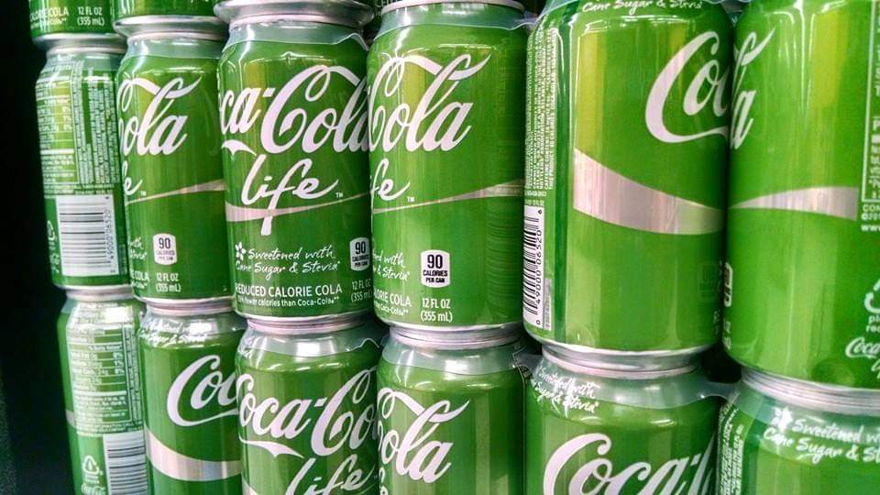
What Is Greenwashing?
“Cola-Cola Life” is made with sugar and stevia. This offers no environmental benefits over a typical soda made from high fructose corn syrup, but the green can implies a more sustainable product.
Greenwashing takes many different specific forms, but they all aim toward one goal:
To make consumers believe that a product or company’s operations are sustainable.
There are several sectors to which greenwashing tactics are applied, including:
consumer goods
energy sourcing
restoration of degraded landscapes
corporate environmental philanthropy
Notes:
Notes to Instructor: Ask learners to share anecdotes or moments of doubt they’ve had as consumers, when contemplating a purchase that claims sustainability.

Slide 3
de Freitas Netto et al. 2020: Concepts and forms of greenwashing: a systematic review
https://doi.org/10.1186/s12302-020-0300-3
Researchers have compiled a list of 19 distinct forms of greenwashing:
1. The hidden trade-off: claims suggest that a product is ‘green’ based on a narrow set of attributes without attention to other important environmental issues (8).
2. No proof: environmental claims that cannot be verified by supporting information or by a reliable third-party certification (8).
3. Vagueness: claims that are so poorly defined or broad that their real meaning is likely to be misunderstood by the consumer (9).
4. Worshiping false labels: misleading consumers into thinking products have been through a legitimate green certification process, by using a false suggestion or certification-like image (9).
Notes:
Notes to Instructor: If time allows, specific examples of each greenwashing tactic may help illustrate these dimensions for all learners.

Slide 4
de Freitas Netto et al. 2020
5. Irrelevance: environmental claims that may be truthful but are irrelevant for consumers seeking specific sustainable products (9).
6. The lesser of two evils: claims that may be true within a product category but distract the consumer from the greater environmental impacts of the category as a whole (9).
7. Fibbing: environmental claims that are simply false (9).
8. False hopes: claims that reinforce a false hope of sustainability in a product category that is not sustainable (9).
9. Fearmongering: claims that fabricate consumer insecurity for not “buying in” to an organization practice, like hydraulic fracking (9).

Slide 5
de Freitas Netto et al. 2020
10. Broken promises: claims promising that extraction will lift up poor, rural communities with riches from mineral rights and economic development, but when evidence shows the contrary, communities are left with irreversible impacts (9).
11. Injustice: environmental communication does not speak directly to communities most affected by extraction, it focuses on a segment of the population that benefits from extraction but do not suffer its consequences (9).
12. Hazardous consequences: greenwashing hides the reality of inequality and distracts the public from the dangers of the risk (9).
13. Profits over people and the environment: to place profit margins over people and the environment -- potentially the greatest greenwashing tactic of all (9).

Slide 6
de Freitas Netto et al. 2020
14. Dirty business: belonging to an inherently unsustainable business but promoting sustainable practices or products that are not representative of the business or the society (9).
15. Ad bluster: Using ads to divert attention from sustainability issues. Exaggerating achievements or presenting alternative programs that are not related to the main sustainability concern (9).
16. Political spin: influencing regulations or governments in order to obtain business benefits that negatively affect sustainability (10).
17. It’s the law, stupid!: touting sustainability accomplishments or commitments that are already required by existing laws or regulations (10).
18. Fuzzy reporting: taking advantage of sustainability reports and their one-way communication channel, to twist the truth or project a positive image in terms of corporate practices (10).

Slide 7
de Freitas Netto et al. 2020
19. Executional Greenwashing: Using elements such as naturalistic colors and sounds. Website backgrounds that represent natural landscapes or pictures of endangered animal species or renewable sources of energy are using executional greenwashing (10).
This Superb Fairy Wren did not
agree to help corporations sell
their products.

Slide 8
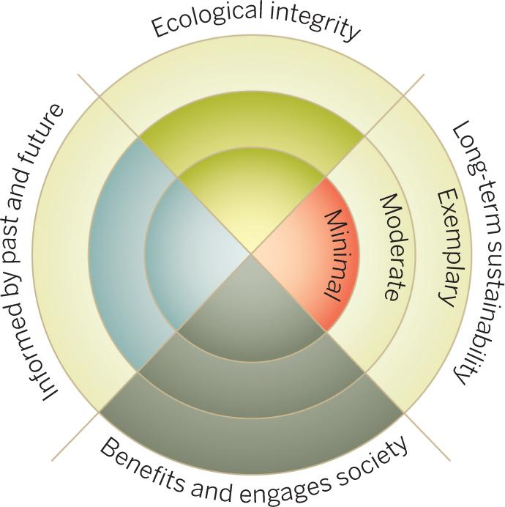
Suding et al 2015: Committing to ecological restoration
https://doi.org/10.1126/science.aaa4216
Researchers have identified four complementary principles for achieving sound ecological restoration plans:
Ecological Integrity
Long-Term Sustainability
Benefits and Engages Society
Informed by Past and Future
The use of four principles identifies trade-offs in the planning process and the extent of departure from the full opportunities presented by comprehensive ecological restoration.
Notes:
Notes to Instructor: Ask learners which of these four principles has often been targeted first in restoration ecology. Which ones are often neglected? Are there any recent changes in applied restoration projects that recuperate the role of the neglected principle, such as integrating indigenous knowledge and climate change scenarios?

Slide 9
Suding et al. 2015
Restoration plans often target one or two of these four principles, but not all.
For example, forest restoration projects frequently target carbon sequestration and local economic benefits but fail to adequately consider the ecological integrity of simple species arrays, long-term sustainable harvesting, and the wisdom of longstanding indigenous knowledge or future climate conditions.

Slide 10
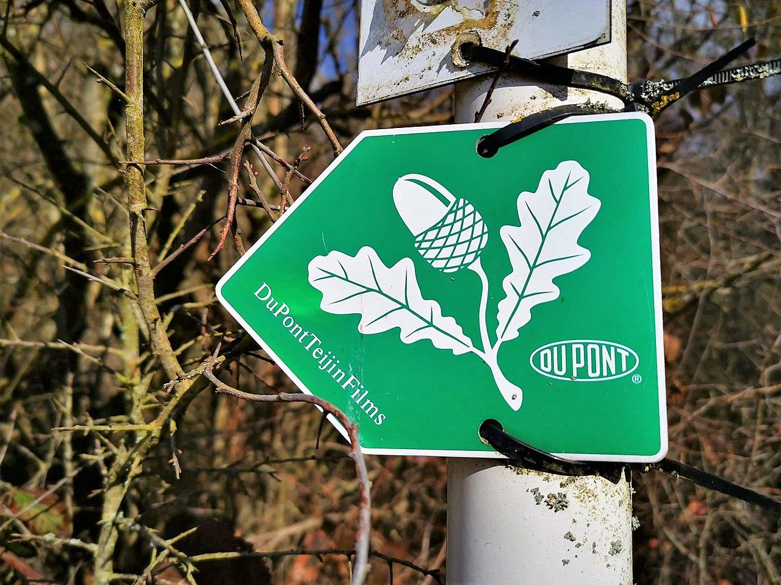
Suding et al. 2015
Similarly, corporate-led ecological restoration projects often tout social or economic benefits without engaging with the more difficult and often costly needs to integrate long-term sustainability, ecological integrity, and knowledge of past and future.
For example, this trail marker uses the form of a White Oak leaf to direct hikers—and it also serves as an advertisement for DuPont’s Teijin PET and polyester films. Until 2021, DuPont refused to disclose its annual release of plastic waste into the environment.
Unaltered image by GilPe via Wikimedia Commons,
Attribution 4.0.

