Slide 1

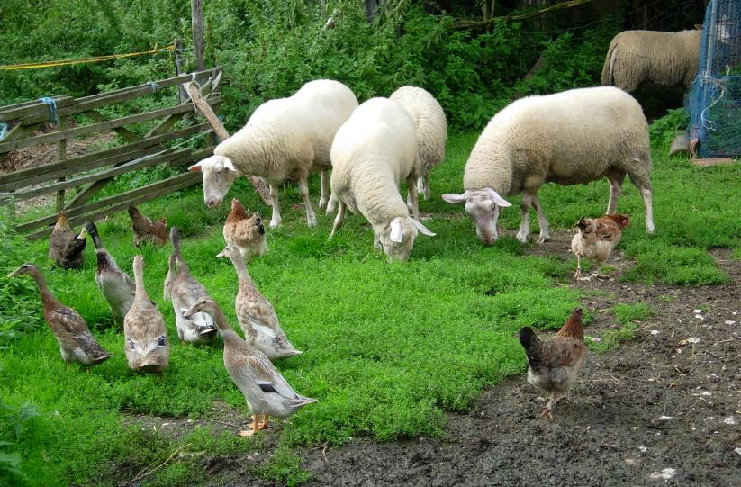
Sustainable Agriculture:
Resistance, Resilience, or Transformational Farming
Permaculture farm in the Swabian mountains, Germany. Photo by Ewig Lernender via Wikimedia Commons, Share-Alike 3.0.
By: Heidi Scott, SESYNC

Slide 2

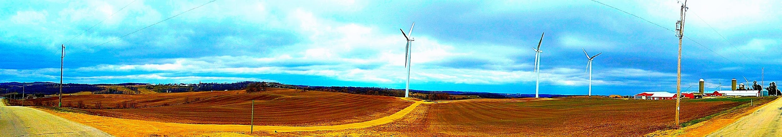
USDA Funding through the EQIP Program
Environmental Quality Incentives Program (EQIP):
Helps farmers implement conservation practices on working lands
Financially supports projects that enhance irrigation efficiency, watershed quality, and renovation of crop, pasture, and forested lands
4 Priority Initiatives: High tunnels, organics, air quality, and on-farm energy production
Galactic Wind Farm, Springfield Wisconsin. Unaltered photo by Corey Coyle via Wikimedia Commons, Attribution 3.0.
Notes:
Instructor: You may present this USDA information as an opportunity for learners to think about how our government provides many possible strategies for implementing conservation, particularly by focusing on their four priority initiatives. However, Basche et al. 2020 analyzed EQIP funding to find the great majority of money went to non-transformational projects. Ask learners to list their own best ideas for transformational farming and where they would identify Priority Initiatives (i.e., permaculture and polyculture; integrated pest management; cover crops and no-till farming; small-scale production for local markets; etc.). Also note that EQIP sets aside at least 10% of funds for “socially disadvantaged and beginning farmers and ranchers”—how does this nod to environmental justice and socio-environmental synthesis affect learners’ sense of the best pathways to apply for funding?

Slide 3
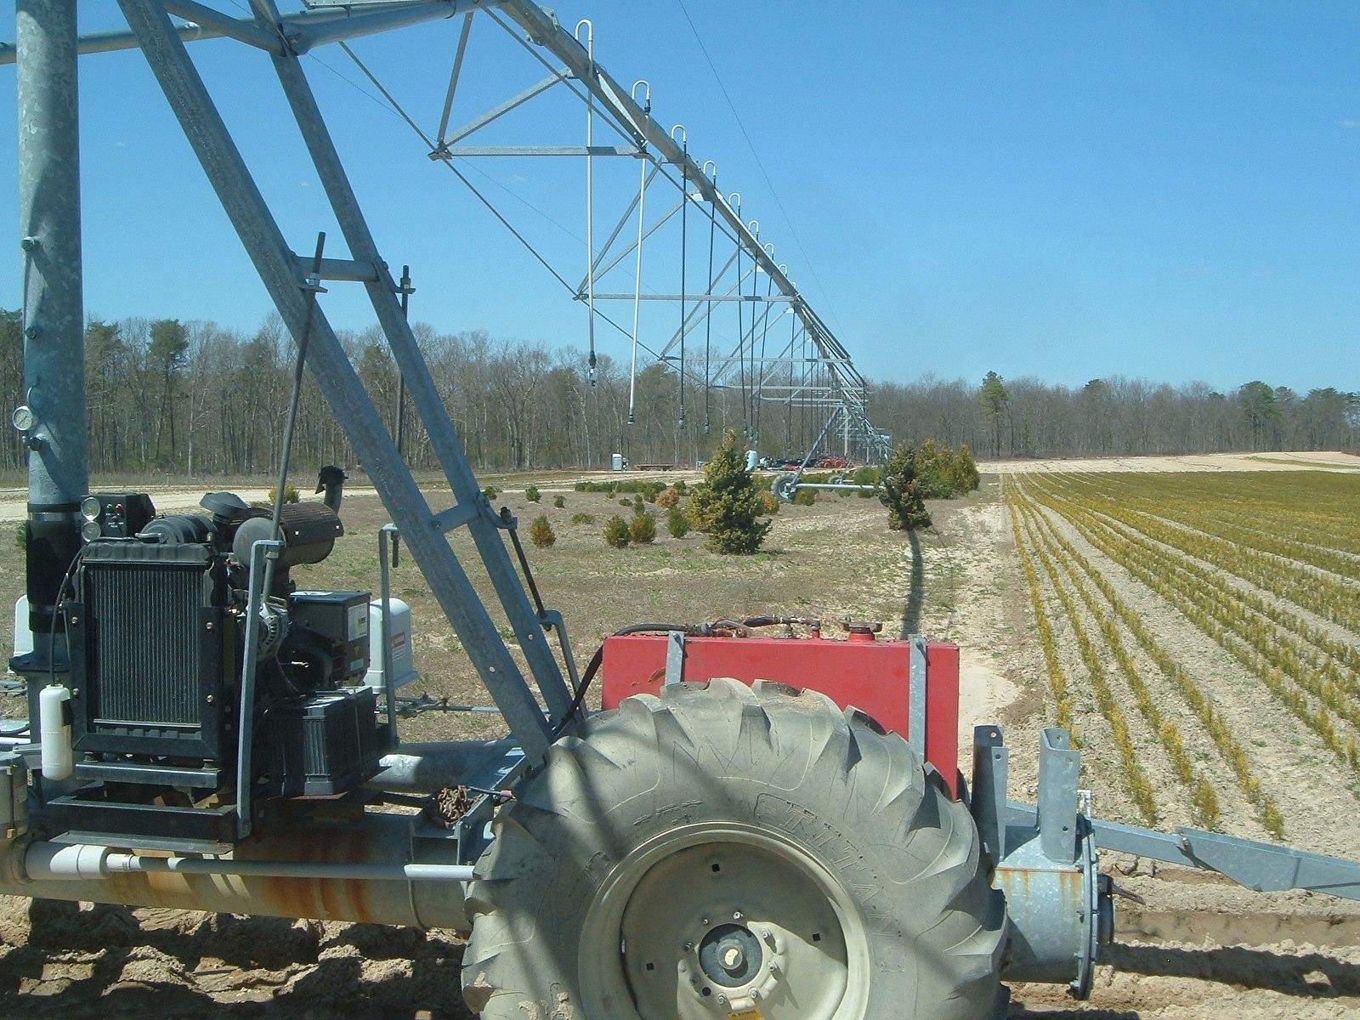
Basche et al. 2020:
Untapped Potential of USDA Funding
Adaptive Strategy Principles:
Resistance: requires the least change in agroecosystem form and function
  Use reactive interventions to target specific problems with existing technology—examples:
    Irrigation systems in drought-prone areas
    Pesticide regimens to target areas experiencing high pest pressures
    Financial tools: insurance, disaster relief
    Resistance strategies received 77% of USDA/EQIP funding in Basche analysis
Drop sprinkler system. Unaltered photo by Max Wahrhaftig via Wikimedia Commons, Share-Alike 3.0.
Notes:
Instructor: Learners might be surprised that these Resistance projects qualify as adaptive strategies for conservation at all. They seem typical of conventional industrial agriculture. Have learners speculate on the reasons that 77% of EQIP funding goes to projects within this category. Is it: farmer’s immediate needs addressed first, before future planning? Lack of imagination, ability to implement, or funding for more transformational changes? Entrenchment of typical Farm Bill priorities and the lobbying of Big Ag corporations to sell their seeds, chemicals, and machines? This funding skew is a fundamental hurdle for anyone interested in agricultural transformation.

Slide 4
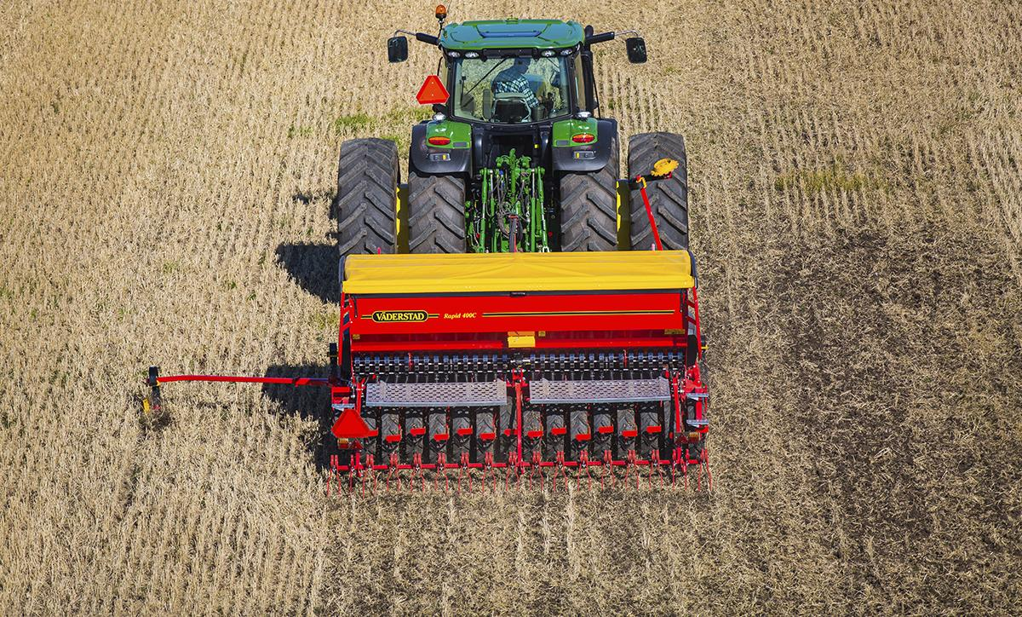
Basche et al. 2020:
Untapped Potential of USDA Funding
Adaptive Strategy Principles:
Resilience: proactive interventions that increase functional and response diversity and reduce risks from multiple threats:
  Use cover crops and no-till planting
  Diversify plant rotation to endure variable rainfall and buffer against economic losses of monocultures
  Enhance profitability with strategic crop choices that optimize soil health, rainfall, and market demands (i.e., farmer’s markets, community supported agriculture)
  Received 20% of EQIP funding
No-till direct drill seed planting. Unaltered photo by Marilijoost via Wikimedia Commons, Share-Alike 4.0.
Notes:
Instructor: Note this Resilience “middle ground” strategy carries aspects of both Resistance and Transformation. Where have learners seen these strategies implemented? Is there any market-side publicity that would encourage consumers to select food grown with these interventions?

Slide 5
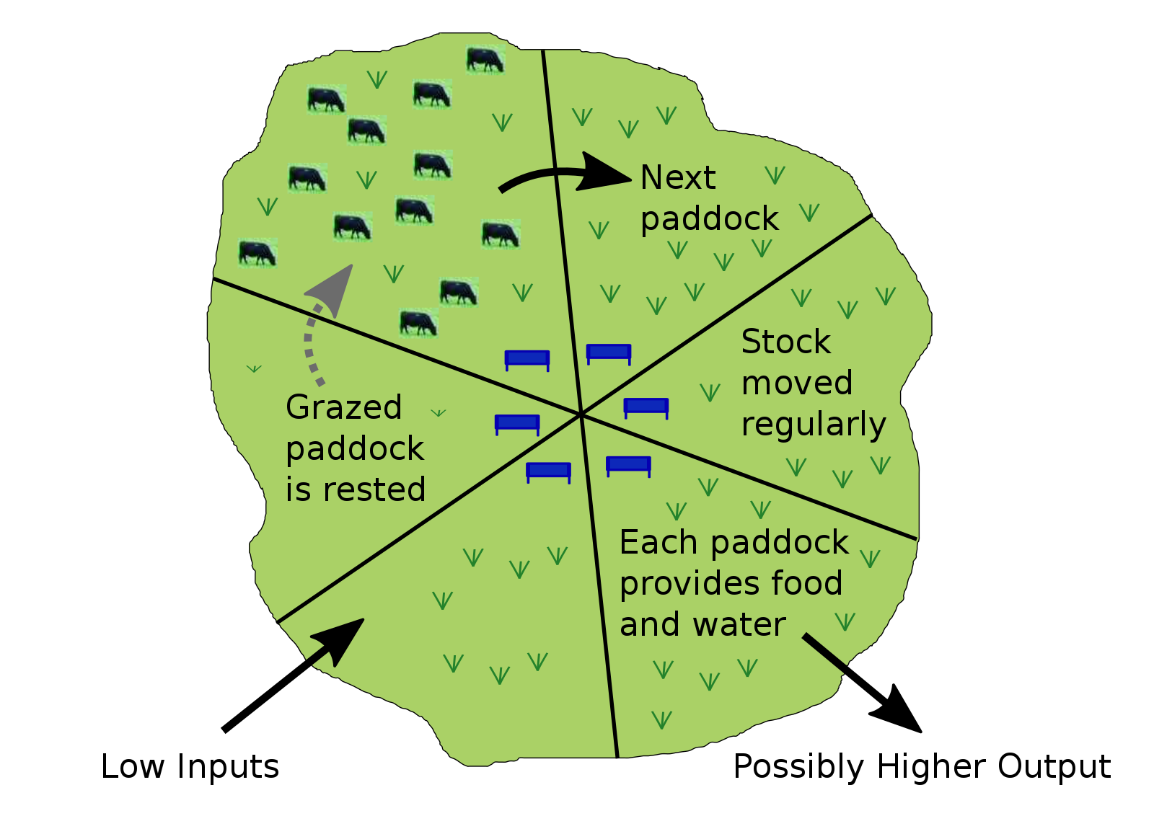
Basche et al. 2020:
Untapped Potential of USDA Funding
Adaptive Strategy Principles:
Transformation: resilience strategies + transition to a new agroecosystem with structure and function suited to future long-term conditions:
  Factor in climate-change projections
  Provide multiple benefits to producer and local community
    For example, transition conventional row crop in floodplain to managed grazing + polyculture: reduces risk of flood damage, enhances water quality, provides food to local community
  Received 2% of EQIP funding
Rotational grazing regimen. Unaltered diagram by Ian Alexander via Wikimedia Commons, Share-Alike 4.0.
Notes:
Instructor: How do transformational techniques such as rotational grazing of animals integrated with polyculture planting challenge the status quo of our agricultural system? Learners should think about today’s stark separation of meat, dairy, egg, vegetable, and fruit farms into specialized, high-input monocultures. How does the conscious integration of multiple uses reduce the burden of inputs (fertilizers, pesticides) while buffering against disease, soil depletion, and crop loss from floods or pest pressure? On the other hand, how are complex biodynamic farms more challenging to manage? How does the low funding of these projects affect our ability to plan for future farm conditions and repair the damage of past industrial agriculture?

Slide 6
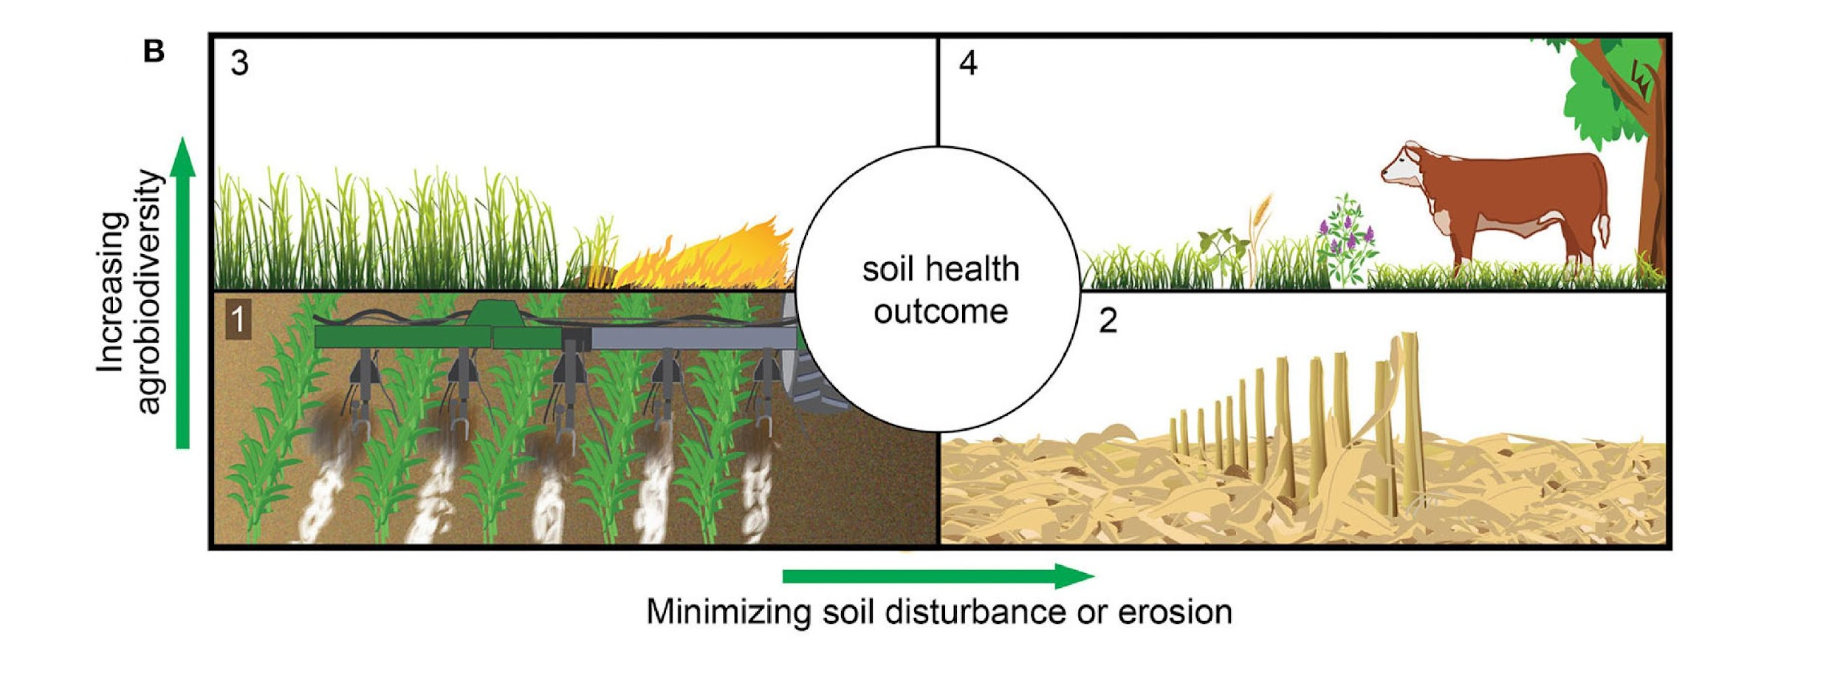
Soil Health Outcomes of Four Classification Types
Figure 1 from Basche et al. (2020)
(B) illustrates the categories within the “soil health outcome” classification, including: Quadrant 1, no change or improvement to soil health, represented by Nutrient Management (590); Quadrant 2, reducing soil disturbance or erosion, represented by Residue and Tillage Management, No-Till (329); Quadrant 3, increasing agrobiodiversity, represented by Prescribed Burning (338); and Quadrant 4, both reducing soil disturbance or erosion and increasing agrobiodiversity, represented by Silvopasture (381).
Notes:
Instructor: Ask learners, where do Resistance, Resilience, and Transformational strategies fit in this 4-quadrant diagram? How does today’s care for soil health affect future crop and animal product yields, quality, and sustainability? What secondary effects in environmental quality may follow from soil health implementation (reduced nutrient and pesticide runoff; reduced dead or hypoxic zones in water bodies; improved clarity of water bodies from less silt and topsoil runoff; greater support of biodiversity on farms; pollinator services; resistance to drought, flood, and extreme wind; etc.)
You may also ask a provocative question: Do vegetarian and vegan diets best support the most sustainable and low-input farming techniques? In other words, how does the integration of farm animals aid in sustainable practices, and how can that biodynamic support be factored into our consideration of the most sustainable, balanced, and healthy diets?

Slide 7
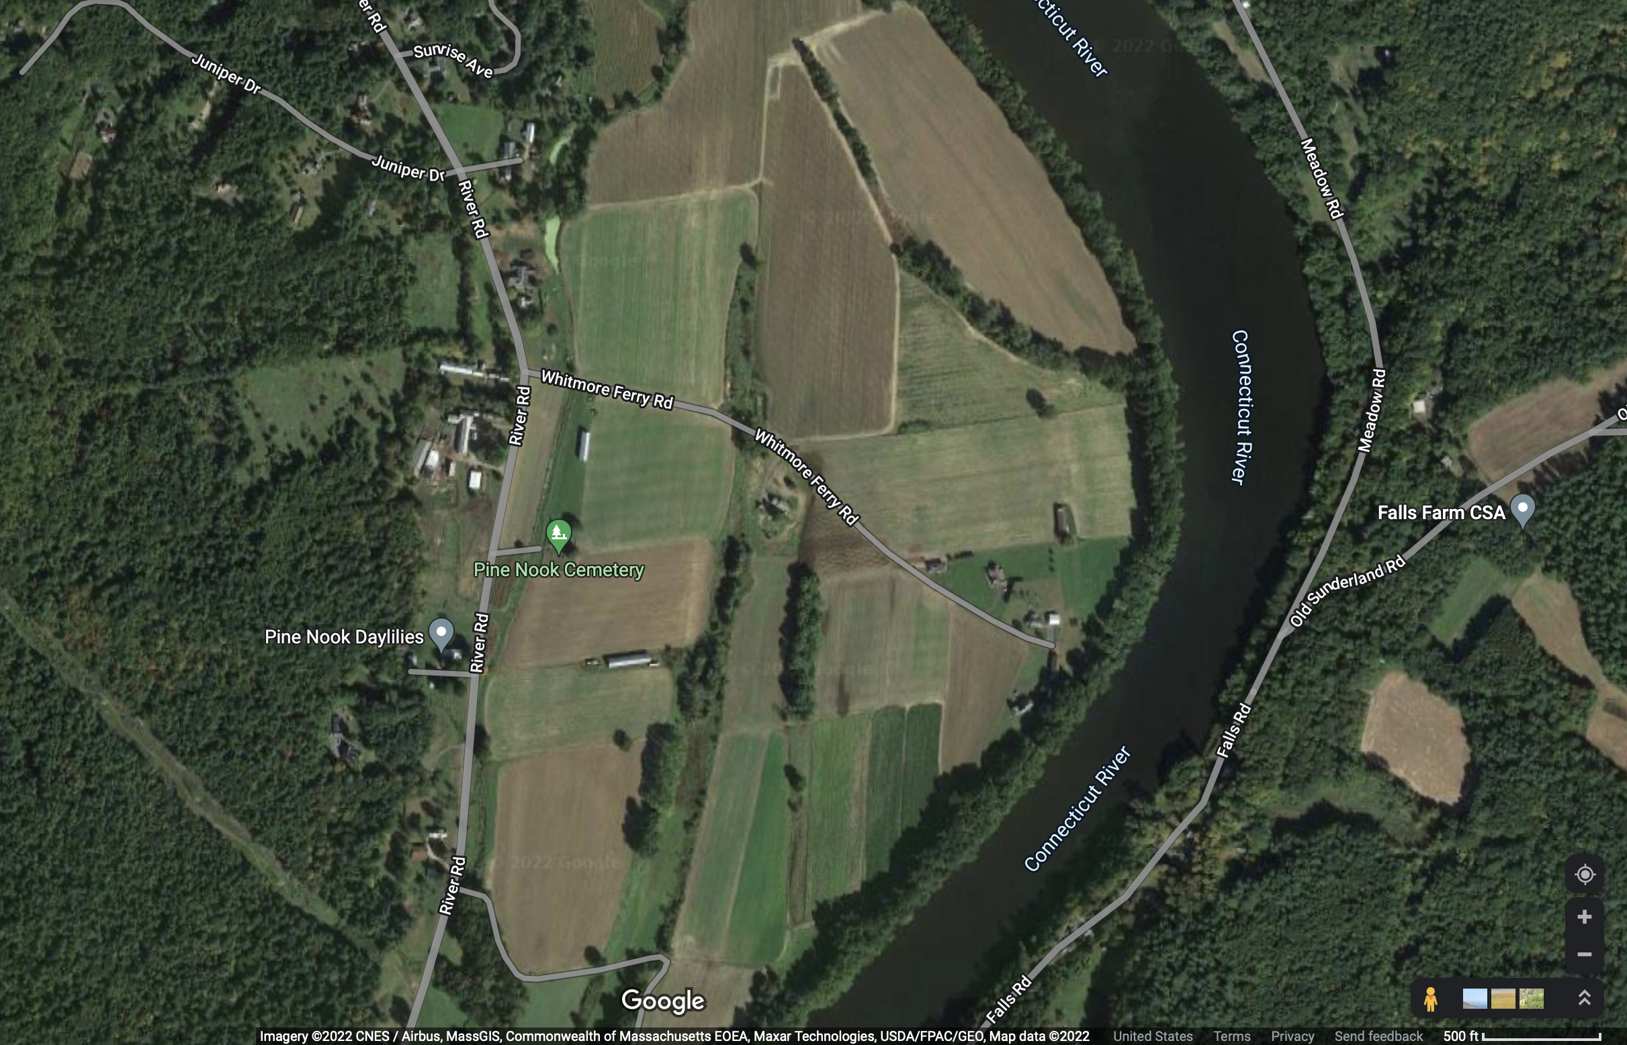
Target Farm #1: Small-Scale Riverside Farm,
25 Acres in New England
Photo courtesy of Google maps/CNES/Airbus, MassGIS, Maxar Tech, USDA/FPAC/Geo, 2022
Notes:
Instructor: have learners note local features, including forest buffers, a flower farm, a CSA, a large river, and multiple medium-sized towns. These social geographies should support their visions for how to apply for EQIP funding.

Slide 8
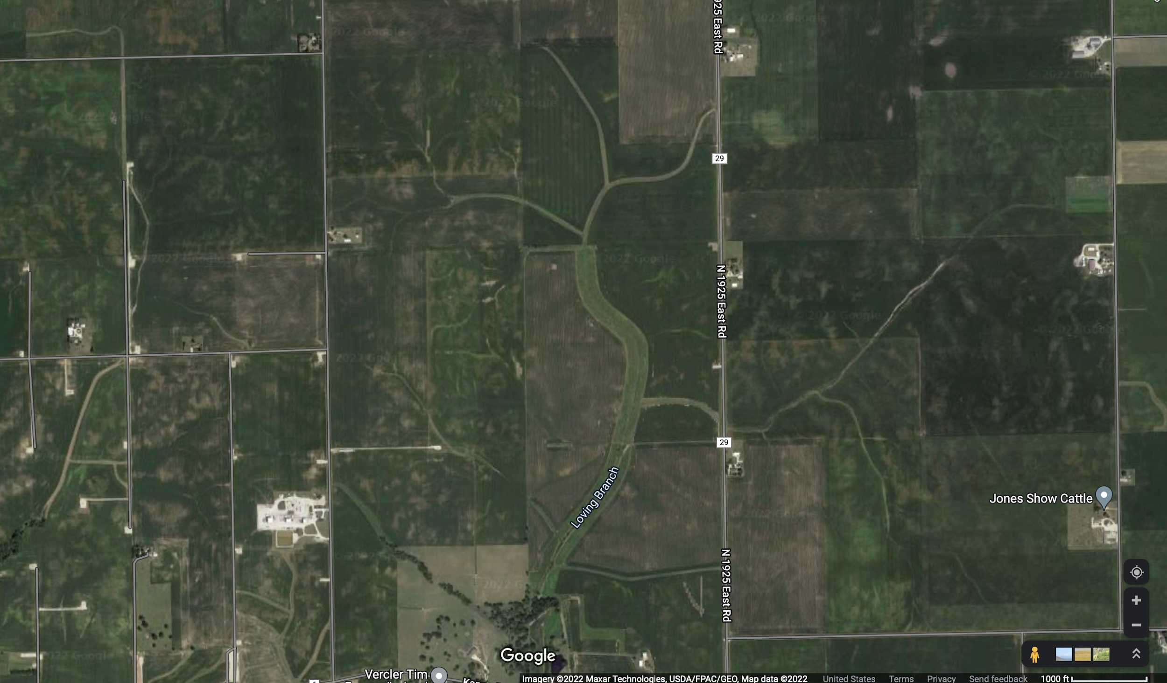
Target Farm #1: Large Midwest Industrial Farm,
1000 Acres in Illinois
Photo courtesy of Google Maps, Maxar Tech, USDA/FPAC/Geo, 2022
Notes:
Instructor: Have learners note local features, including the grid of roadways and farm properties, set against flowing geographical lines like the “Loving Branch” stream and its headwaters. Also note the vast acreage of monocultures (corn), and the proximity of other inputs, such as the “show cattle” farm nearby. These ecological and social geographies should support their visions for how to apply for EQIP funding.

