Slide 1
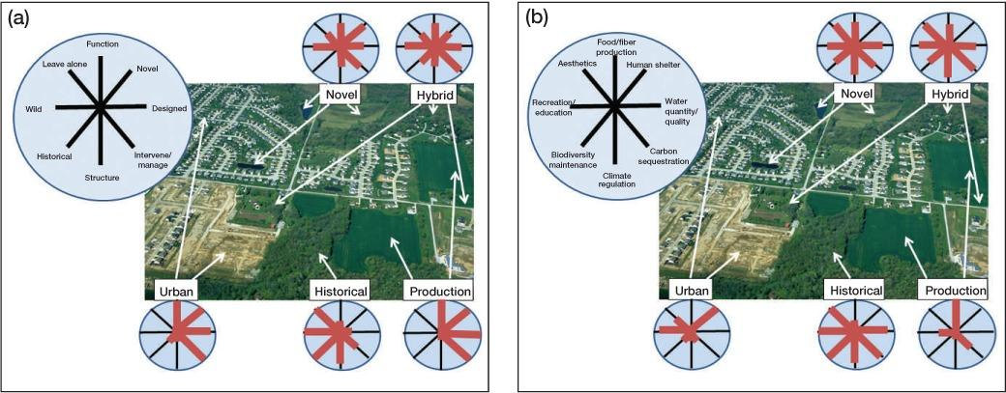
Managing the whole landscape: historical, hybrid, and novel ecosystems
by Hobbs et al.
Frontiers in Ecol & Environ, Volume: 12, Issue: 10, Pages: 557-564, First published: 01 December 2014, DOI: (10.1890/130300)
Notes:
Two perspectives on a typical landscape found in peri‐urban areas worldwide, in which there are various ecosystem states, including those entirely developed for urban use, production areas, and an array of ecosystems modified to a greater or lesser extent spanning the historical–hybrid–novel range. Panel (a) illustrates how diverse landscape elements are differentiated along a range of gradients in characteristics and management emphases (expanded from Kueffer and Kaiser‐Bunbury 2014), whereas panel (b) indicates how different elements provide differing combinations of ecosystem services. The opportunities and constraints vary greatly among elements. This type of mixed landscape is increasingly prevalent as urban areas grow and is often the locus for community conservation and restoration projects. Although the landscape depicted is relatively small scale, similar issues can be identified at broader scales incorporating large nature reserves and production landscapes.

