Slide 1

Governance Theory Part 1:
Revising the Tragedy of the Commons
By: Heidi Scott, SESYNC

Slide 2
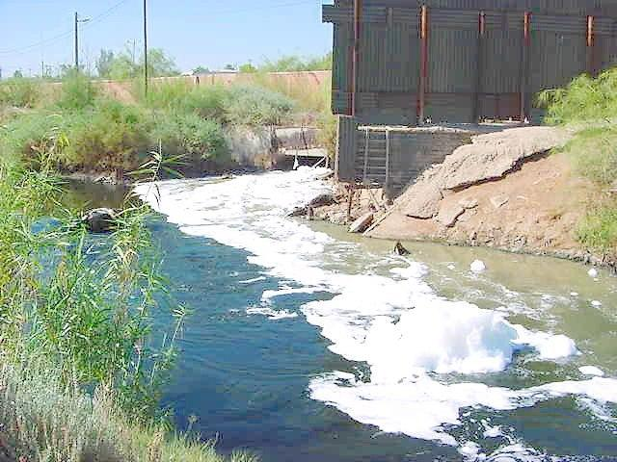

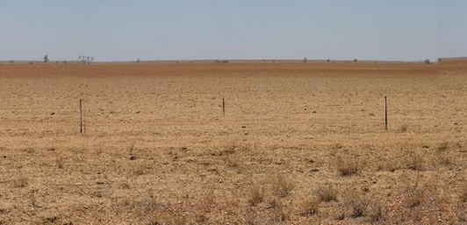
The Birth of a Paradigm
Garrett Hardin’s paradigm: Any common-pool resource will be depleted in time unless it’s privatized or subject to government regulation.
English Commons grazing lands were overgrazed as every individual increased their private benefit by using public lands for fodder.
Overgrazing led to ecosystem collapse and loss of the common resource.
This idea extends to global commons like air and water.
Notes:
Notes for instructor: Ask students if there could be other reasons than individual self-interest for the degradation of English common lands. (Many of the common lands were enclosed for private ownership by wealthy lords during the time of the Enclosure Acts in the 18th-19th centuries, which massively reduced the acreage of common land that poorer farmers and herders had relied upon for hundreds of years. So, in a sense, privatization caused commons degradation—it was not a solution to an existing problem.)
Photo credit: Mark Marathon, Overgrazed Mitchell Grassland. Unaltered. Share-Alike 3.0 license: https://creativecommons.org/licenses/by-sa/3.0/deed.en

Slide 3

Cultural Implications of the Theory
Hardin’s 1960s era theory presents a tragic narrative that humans are individualistic, myopic, and selfish.
Hardin and Paul Ehrlich viewed the growth of human populations as a threat to be avoided by regulating reproduction, including one-child limits and sterilization. (Nordman, 7)
This paradigm is often still taken as truth.
Notes:
Source: Erik Nordman’s book on the Nobel-prize winning Economics scholar, The Uncommon Knowledge of Elinor Ostrom (2020).
For instructor: As an extension, ask participants how no-population growth dogma may affect international aid for developing and vulnerable countries. Hardin and Ehrlich supported disincentives for reproduction as a condition of international grants that provided food aid for developing nations—an uneasy dynamic between the Global North and Global South.
Ask participants whether the “Tragedy” paradigm can be seen as a cultural vision of Western, masculine, colonial, and competitive ideologies. What other cultures can they name that hold other values or have more complexity and diversity?

Slide 4


Preservation of Common Pool Resources
Counter-examples of collective and egalitarian governance structures:
Taxi drivers in Nairobi, Kenya, developed a collective where drivers set price limits and share access to customers around shopping malls, to preserve a limited resource and guarantee that members would have work (Nordman 2).
In 1946, the West Basin Water Association (WBWA) formed in Los Angeles.
  The WBWA operated independently from top-down court decisions on groundwater pumping by collectively agreeing to allocate water access proportionately among its members.
Public entrepreneurship: agencies collectively solve regional problems that an individual or remote agency like the federal government would be unable to regulate (Nordman 27).
Notes:
Source: Erik Nordman’s book on the Nobel-prize winning Economics scholar, The Uncommon Knowledge of Elinor Ostrom (2020).
Ask participants to name other examples of collective governance and speculate on the cultural implications of this paradigm as opposed to Hardin’s Tragedy. For example, collective and polycentric governance grants groups’ and individuals’ diverse opinions, views, and values. It does not assume a single “human nature” of selfishness. Polycentric governance demonstrates the human ability to cooperate to preserve and sustain a common good and seeks creative and equitable solutions to its governance. How does that relate to “social selection” as inherent to our evolutionary history?

Slide 5

A New Theory Emerges
Elinor Ostrom is a Nobel Prize-winning economist and is regarded as the author of the Polycentric Governance theory.
Polycentric governance: Several autonomous groups work together to govern a common natural resource. They use agreed-upon conflict resolution mechanisms and represent many cultures and interests.
Notes:
Source: Adapted from Carlisle and Gruby (2017). https://doi.org/10.1111/psj.12212

Slide 6

Advantages
High adaptive capacity in changing systems
Diverse institutions fit their natural resource systems
Locally based practices are consistent with cultural traditions
Redundancy of actors and institutions mitigates risk
Notes:
Source: Adapted from Carlisle and Gruby (2017). https://doi.org/10.1111/psj.12212

Slide 7
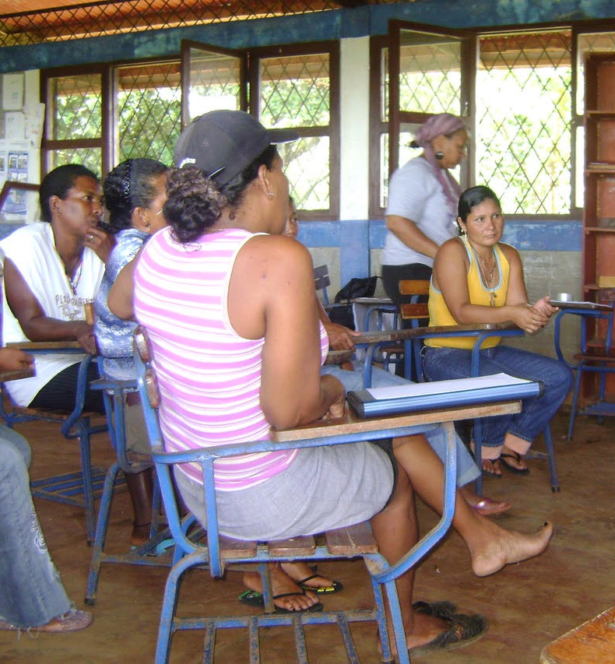
Challenges
Participants must dedicate time and effort to maintain their voice, as well as balance governance groups as conditions change
Lack of standardized rules and regulations requires arbitration
Local actors must collaborate across regions to challenge higher-level authorities in state, federal, and corporate ranks
Notes:
Source: Adapted from Carlisle and Gruby (2017). https://doi.org/10.1111/psj.12212

Slide 8
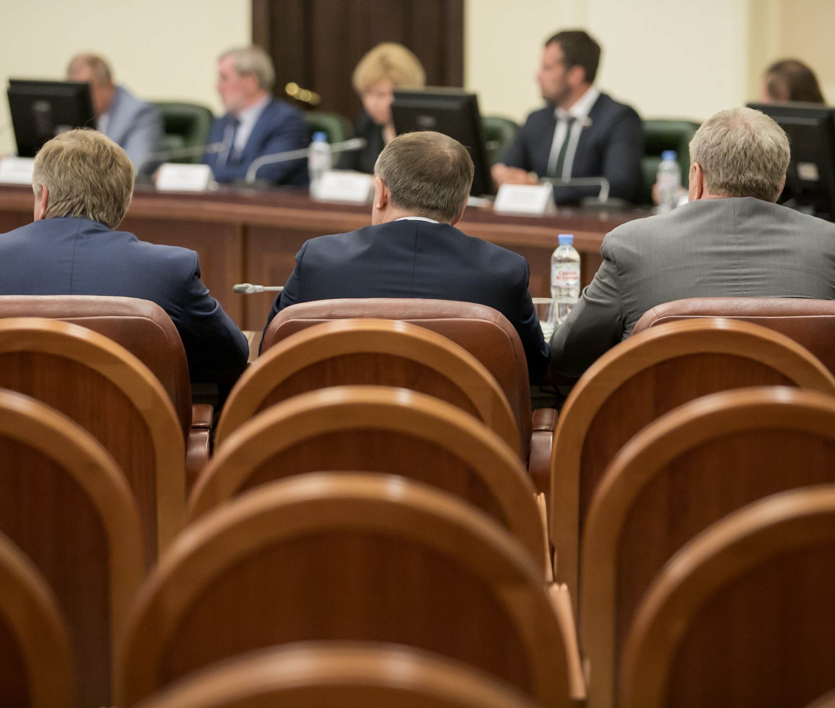
Applying Polycentric Governance to Climate Change
Global governance like the IPCC and the UNFCCC have struggled to manage global consensus to reduce GHG to scale with a 1.5–2-degree limit.
Notes:
Sources: Emergence of polycentric climate governance and its future prospects by Jordan et al. (2015). https://doi.org/10.1038/nclimate2725
Advantages of a Polycentric Approach to Climate Change Policy by Cole (2015). https://doi.org/10.1038/nclimate2490

Slide 9
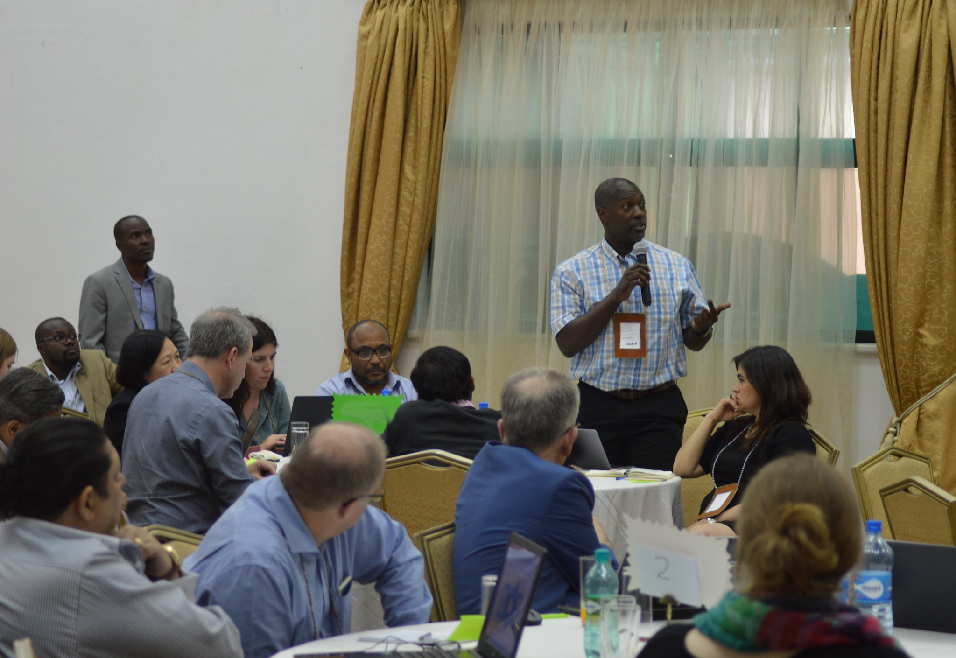
Applying Polycentric Governance to
Climate Change
Collaborative actors from local business, government, and civilians find creative solutions:
  Emissions trading systems, offsetting standards, carbon labelling, inter-city collaboration, zero-carbon transport, green space, retrofitting (Jordan 2015)
PG supports experimentation and evolution toward improved policy in time
PG increases stakeholder communication in many venues (Cole 2015)
Notes:
Ask students to contribute specific knowledge of local, multiple stakeholder forms of governance to improve sustainability in their region.
Sources: Emergence of polycentric climate governance and its future prospects by Jordan et al. (2015). https://doi.org/10.1038/nclimate2725
Advantages of a Polycentric Approach to Climate Change Policy by Cole (2015). https://doi.org/10.1038/nclimate2490

