Slide 1
Network Properties: Short Introductory Slides Using Centrality as an Example of the Use of Network Metrics

Slide 2

Network properties
metrics to describe characteristics of networks
useful for answering questions
(e.g., is there are species in a network that many other species depend on?)
some are simple to calculate but many require matrix algebra
most common ones belong to a group of centrality metrics

Slide 3
Question to participants:
How would you determine the most important
species in this network?
Notes:
Notes to instructor: answers to the questions posed are on the next slide in the sequence.
Ask the students to speculate on how they would figure out which species (node) is most important. Then show the three ways that are listed in the next slide. They may think of additional ones.

Slide 4
Question to participants:
How would you determine the most important
species in this network?
Depends on how you define importance:
species that has the most relationships?
species that can influence the most other species?
species that plays the biggest role in connecting other species?
Notes:
Note to Instructor: Here are three possible ways to indicate importance. Learners may think of additional ones. The following slides define how to calculate the metrics that align with these three. Emphasize that in network science, how importance is defined determines the metric of centrality to select.

Slide 5
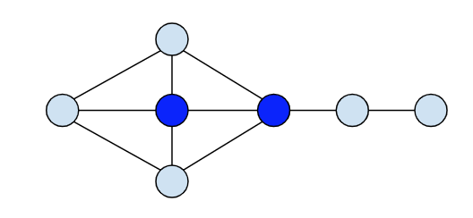
1. An important node may be one with the most relationships, i.e., the most links (“degrees”)
Degree centrality – a node’s degree (# of links regardless of direction).
the simplest measure of centrality
In the below network, which node is most ‘central”?
Notes:
Instructor notes: Ask the participants to indicate which nodes have the highest degree centrality. Answer is in the next slide.

Slide 6
1. An important node may be one with the most relationships, i.e., the most links (“degrees”)
Degree centrality – a node’s degree (# of links regardless of direction).
the simplest measure of centrality
Two nodes have the same highest degree centrality!
Notes:
Instructor notes: Two nodes tie for degree centrality. Be sure to note to participants that this does not mean they are the most influential because a node may have a lot of links but some of the nodes it is linked to may not be linked to many other nodes. So, they must think carefully about what a network metric actually means. The node/species with the highest degree centrality may be really important in terms of resource flows (in a food web) since it is connected to so many other species; however, other species can have strong effects even if they only have a few direct relationships (there may be “indirect effects” in ecological terminology).

Slide 7
2. An important node may be the one with the most access to others (shortest paths to others)
closeness centrality – a node with shortest mean distance
between it and other nodes
In the below network, which node has the lowest closeness centrality score?
A
B
E
D
F
C
D
H
G
Notes:
Instructor notes: Point out to class that unlike degree centrality, closeness is not just focused on the # of relationships but the position of a node in the network. It takes into account the distance a species or person (node) is from others in the network – how many “jumps” (links) to go the shortest path to each. Ask the participants to guess which node has the closeness centrality (lowest metric). Then show them how to do the calculation for one node as in the next slide.

Slide 8
2. An important node may be the one with the most access to others (shortest paths to others)
closeness centrality – a node with shortest mean distance
between it and other nodes
In the below network, which node has the lowest closeness centrality score?
To determine closeness, calculate the following for each node assuming bidirectional (reciprocal) paths; then compare the means; smallest = closest
A
B
E
Node Shortest path for from D
A 3 (D-C-B-A)
B 2
C 1
E 1
F 2
G 2
H 1
D
F
D
C
D
H
G
Average = (3+2+1+1+2+2+1) = 12/7 = 1.7
Notes:
Instructor notes: Instructor notes: Here is the calculation for the D node which has the shortest average distance from other nodes. Participants would have to do such calculations for all nodes and then compare the node averages to find the smallest one (closest avg distance). Note that: such nodes might have better access to information from other nodes or more influence.
Note: if you want to show all the calculations, they are on the next slide

Slide 9
 | A | B | C | D | E | F | G | H
A |  | 1 | 2 | 3 | 4 | 5 | 5 | 4
B | 1 |  | 1 | 2 | 3 | 4 | 4 | 4
C | 2 | 1 |  | 1 | 2 | 3 | 3 | 2
D | 3 | 2 | 1 |  | 1 | 2 | 2 | 1
E | 4 | 3 | 2 | 1 |  | 1 | 1 | 1
F | 5 | 4 | 3 | 2 | 1 |  | 1 | 2
G | 5 | 4 | 3 | 2 | 1 | 1 |  | 1
H | 4 | 4 | 2 | 1 | 1 | 2 | 1
SUM | 24 | 19 | 14 | 12 | 13 | 18 | 17 | 15
mean | 3.4 | 2.7 | 2 | 1.7 | 2 | 3 | 2.4 | 2.14

Slide 10
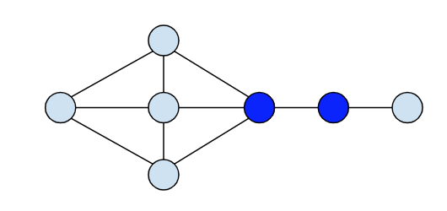
3. An important node may be one providing
the most bridges to other nodes
betweeness centrality – the node that lies on the shortest path between two other nodes in the network the most times
(i.e., removing it severs parts of the network)
In the below network, which node is the most important bridge?
x
Notes:
Instructor notes: This metric is also focused on the position of a node in the network. Ask the participants: which node helps bridge the most other nodes? Have them guess before showing the answer in next slide.

Slide 11
3. An important node may be one providing
the most bridges to other nodes
betweeness centrality – the node that lies on the shortest path between two other nodes in the network the most times
(i.e., removing it severs parts of the network)
In the below network, which node is the most important bridge?
x
if dark node is lost
Notes:
Betweenness centrality belongs to the node colored in blue here. We can think about this node as a ‘bridge’ between nodes in a whole network. Thus, the node’s removal divides the network in two or more parts. In a species network, this can tell you which species, if lost (goes extinct), will have the greatest impact on the community, i.e., is a keystone species. Or if it’s a social network, loss of this actor node would impact others in the network potentially isolating some of them.

Slide 12
We can also ask questions about entire networks
Network connectance = # links/nodes²
i.e., the # of possible connections that are realized
Out of all the connections possible, how many are actually present?
Notes:
Info for Instructor: This metric focuses on the whole network not just one or more nodes. It is a general reflectance of the connectivity of the network as a whole. Ask the participants to quickly calculate the metric letting them know that the illustrated network has only directional (one-way) links. If it had any bidirectional links, each of those would count as two connections. Calculated answer is in next slide.

Slide 13
We can also ask questions about entire networks
Network connectance = # links/nodes²
i.e., the # of possible connections that are realized
Out of all the connections possible, how many are actually present?
9 species/people
4 connections
Connectance = 4/81 = 0.49

Slide 14
Problem with connectance calculation:
can’t use it to compare networks with different #s of nodes because the number of interactions does not scale with the square of the # of nodes
so… we use Network average degree = # links/# nodes
i.e., the average node degree, where node degree = its # of links
A
B
C
Notes:
Info for Instructor: It is problematic to compare two networks with different numbers of nodes (species) since the number of interactions does not scale with the square of the # of nodes/species. Doubling number of species won’t quadruple number of interactions generally… So often researchers use:
Average Degree - note this is the average node degree and summing all the links and dividing by # nodes is mathematically equivalent to determining the degree of every node and averaging those; note that for node links that points inward and outward, this counts as two links.
Continue to next slide for calculations.

Slide 15
Problem with connectance calculation:
can’t use it to compare networks with different #s of nodes because the number of interactions does not scale with the square of the # of nodes
so… we use Network average degree = # links/# nodes
i.e., the average node degree, where node degree = its # of links
A
Node A degree = 3;
Node B degree = 1;
Node C degree = 2
B
C
Network Average Degree = 4/9 = 0.44

