Slide 1
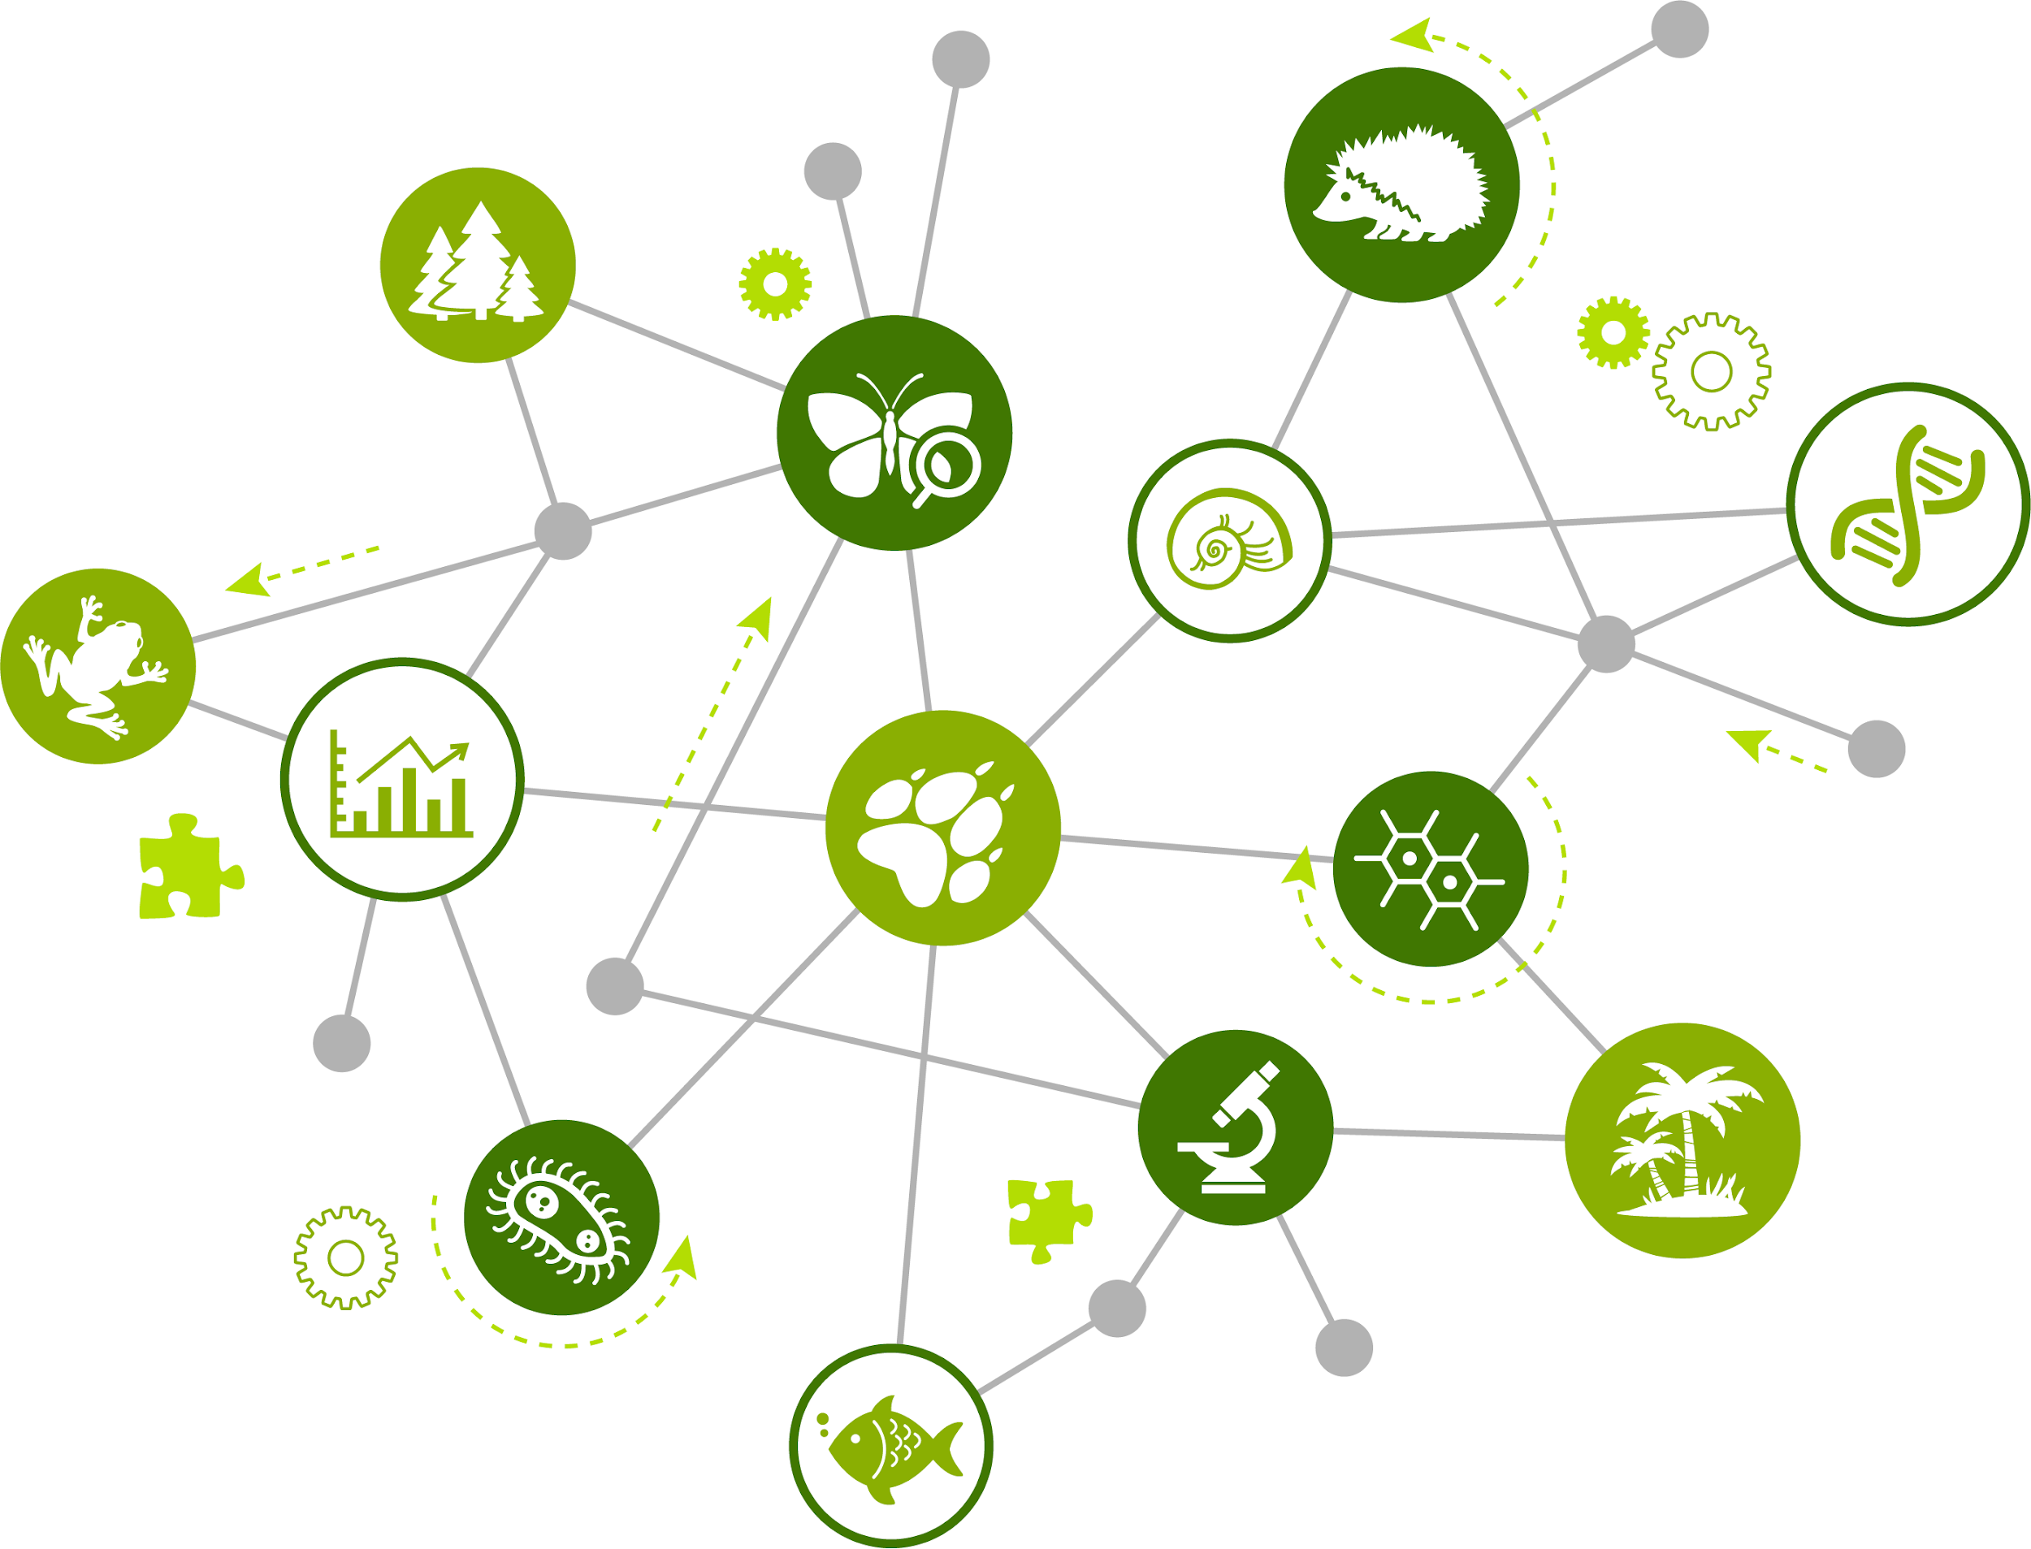
Network Methods to Understand Complex Systems
Part 2: Social

Slide 2
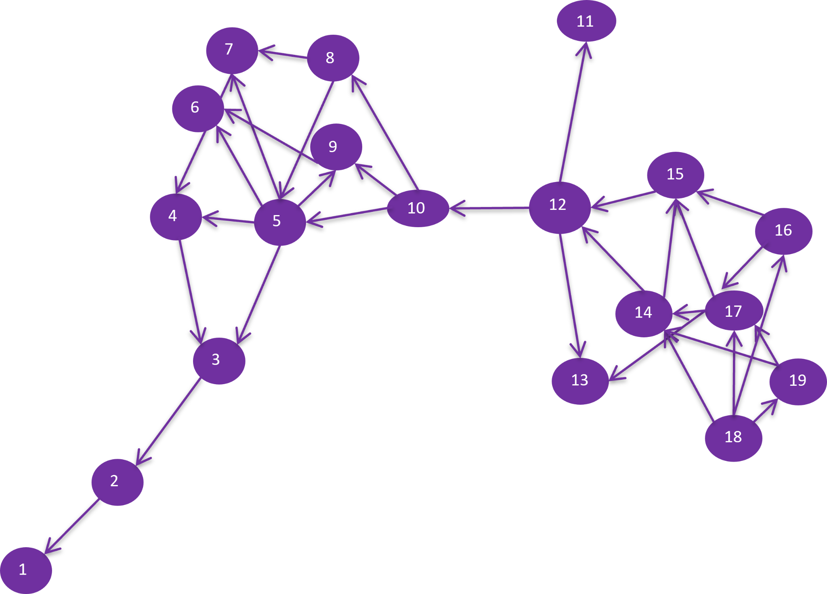

Slide 3
Network Centrality metrics
what are they and why are they useful?
characterize aspects of a node’s positions in a network
useful in identifying most influential actor* (node)
*actor = person, institution, group
How is an actor’s influence in a network assessed?
Number of relationships?
Speed of influence?
Ability to connect others?
There’s a centrality metric for each…
Notes:
Notes to Instructor: Slides are animated so you can first prompt the participants to answer the questions and then bring up answers.

Slide 4
Centrality metrics
node degree
closeness
betweenness
node linked to the
most other nodes
(reflects # of relationships)
has shortest average mean
distance to all other nodes
(reflects ability to influence
others “quickly”)
falls on the shortest paths the most times
(reflects bridging btw parts of network)
Notes:
Info for Instructor:
Node degree method: count up the number of links for each node and compare among nodes
Closeness method: for a node, determine the number of links away it is to every other node; add these numbers up then divide by the total number of nodes and you have the average closeness for that node. Do this for every node and the one with the shortest average closeness value is where the network’s closeness centrality is the greatest.
Betweenness method: number of times a node lies on the shortest path between two other nodes in the network (i.e., it bridges nodes; removing it severs parts of the network); controls flow of information between nodes and groups of nodes
NEXT 3 slides include the purple image. Ask participants to identify the highest node degree; best closeness; and best betweenness. Animation click brings up the answer

Slide 5
Node degree
11
7
8
6
9
15
4
5
10
12
5
16
14
17
3
13
19
18
2
1

Slide 6
Closeness centrality
11
7
8
6
9
15
10
12
4
5
10
16
14
17
3
13
19
18
2
1

Slide 7
Betweenness centrality
11
7
8
6
9
15
12
4
5
10
12
16
14
17
3
13
19
18
2
1

Slide 8
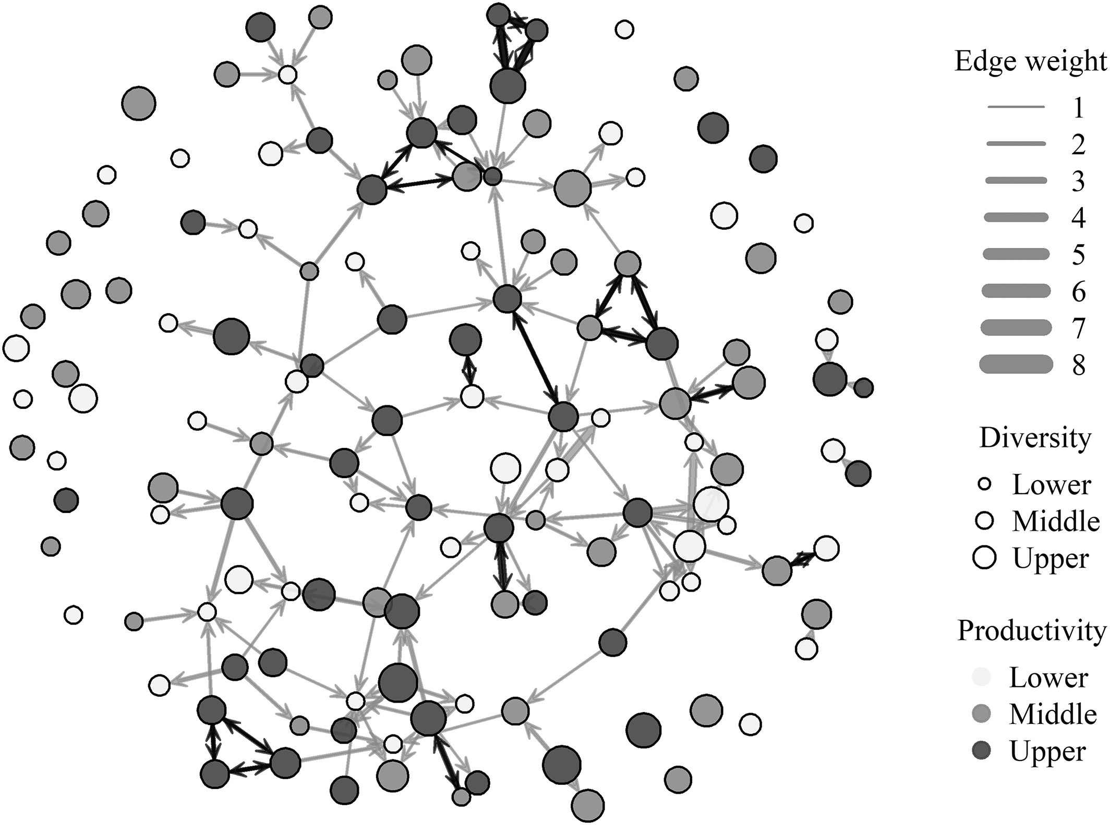
Aniak food sharing network
Source: Figure 2 from Scaggs et al. 2021. Linking subsistence harvest diversity and productivity to adaptive capacity in an Alaskan food sharing network. DOI: 10.1002/ajhb.23573
Notes:
Notes to Instructor (in this figure, “edge” is synonymous with “links”):
Node diameter scaled by household's harvest diversity
Node shading indicates productivity
Direction of links indicated by arrows
Black links represent instances of reciprocity.
Thickest links have heavier weights (i.e., transfer of multiple resource types between two households)

