Slide 1
Network Methods, Part 3: Socio-environmental Motifs and Multilayer Networks

Slide 2
14
social
10
ecological
7
17
18
2
16
6
11
9
8
15
19
5
4
20
3
12
13
1
Figure adapted from: Holme & Rocha 2022 https://doi.org/10.48550/arXiv.2105.12537

Slide 3
Motif: least likely to occur in random network (green arrows)
Common network in null model (purple arrows)
social
14
ecological
10
7
17
18
2
16
6
11
9
8
15
19
5
4
20
3
12
13
1
Figure adapted from: Holme & Rocha 2022 https://doi.org/10.48550/arXiv.2105.12537

Slide 4
Anti-motifs: common subnetworks in null model; underrepresented in model of inquiry (black arrows)
14
social
10
ecological
7
17
18
2
16
6
11
9
8
15
19
5
4
20
3
12
13
1
Figure adapted from: Holme & Rocha 2022 https://doi.org/10.48550/arXiv.2105.12537

Slide 5
A
B
Clan 1
Clan 2
Clan 1
Clan 2
shared resource
shared resource
ecological ties
forest patch
forest patch
social ties

Slide 6
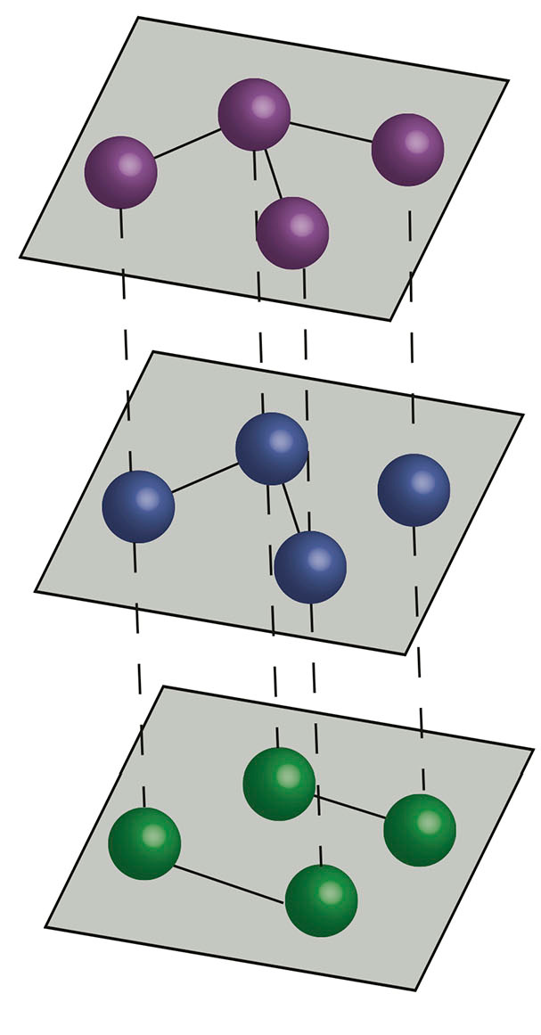
multi-plex networks: interlayer links connect nodes that represent
the same actor (here, a reptile group) in different layers.
intra-layer
connection
“plex” (network layer) = type of reptile (family)
2
3
spatial point (“department”)
1
4
inter-layer
connection
movement of traffickers
2
1
3
4
2
1
3
4

Slide 7
10 networks, each with 34 states (locations)
Movements of taxa trafficking)
plex (network layer) = taxa (m= 10)
Nodes = states in different places
(n=34)
Taxa 1
Taxa 2
Taxa 3
Taxa 10

