Slide 1
Governance Lessons 2. Case Studies in Polycentric Resource Management
Notes:
These slides are useful for an introductory discussion for Lesson 2; participants should be familiar with the Acton et al. study for this lesson. It is advantageous but not required that participants have completed Lesson 1 (Revising the Tragedy of the Commons) and read the Cole (2015) paper for this session.

Slide 2
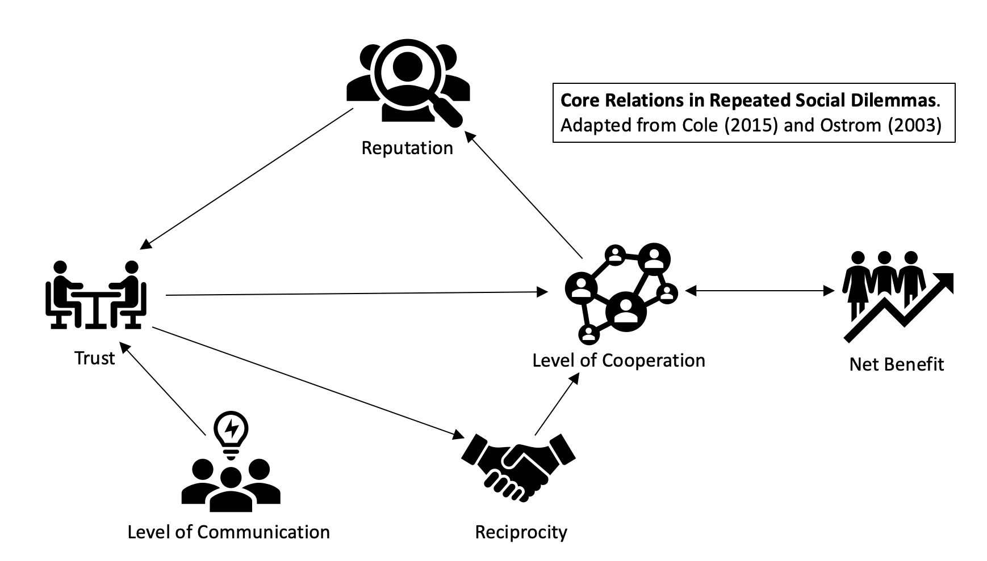
Polycentric Governance:
Critical Elements of Success
Communication and Trust: Increases cooperation as it seeks socially optimal strategies, exchange of promises, forms expectations of others’ behavior, adds value to payoffs, reinforces norms, and promotes development of group identity (Cole 2015; Ostrom 2003).
Notes:
Cole, following Ostrom, stresses the importance of human elements of communication and trust as a critical baseline for good-faith governance. Ask participants how they develop good lines of interaction to develop trust for their peers and supervisors. How much is related to cross-cultural respect, listening, and reciprocity among different actors?

Slide 3
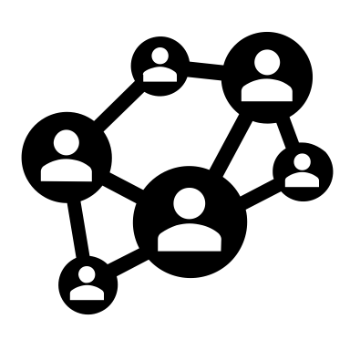
Polycentric Governance:
Attributes
Attribute 1: Multiple, overlapping decision-making centers with some autonomy
Features: Governance is shared among federal, state, public, and community agencies
Each group constitutes a distinct decision-making center with autonomy
Attribute 2: Established processes of cooperation, competition, and conflict resolution
Features: Permit requirements and due process to regulate different types of ecosystem use
Data sharing, workshops, open communication and arbitration of conflict
(Adapted from Acton et al., 2021; Carlisle and Gruby, 2017; Epstein et al., 2015)
Notes:
These are the structural elements that enable sound polycentric governance. Ask participants to think of the actors in charge of governance of a local natural resource. Where does governance and decision-making overlap? How are conflicts arbitrated? What resources (data, equipment, time, audiences) could be shared for better outcomes?

Slide 4
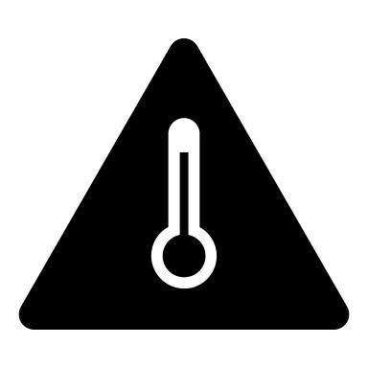
Social Fit:
Enabling Conditions
Condition 1: Governance structure includes diverse institutions
Features: Agencies have distinct cultures, distinct rules, and norms to carry out mandates
Condition 2: Governance designers seek cross-scale linkages
Features: Linkages across jurisdiction, governance level, and geography
Deliberation, collaboration, and learning; cross-cultural sharing increase over time
Condition 3: Stakeholders represent many levels across political jurisdictions
Features: Key representatives come from federal, state, community, and tribal organizations
Condition 4: Jurisdiction of actors is coterminous with the boundaries of the system
Features: Vast or complex areas have holistic ecosystem-based governance that may be distinct from specific ecological, cultural, or political boundaries
(Adapted from Acton et al., 2021; Carlisle and Gruby, 2017; Epstein et al. 2015)
Notes:
A good “social fit” means that the governance of the natural resource in question is well-designed to support pre-existing cultures, norms, values, and behaviors. Rather than an outsider or top-down approach where a remote manager makes assumptions about these conditions, the governance design deliberately integrates a variety of local actors.
What are some negative examples of top-down governance that show poor social fit for the local cultures and natural system? (The history of Native American tribal “reservations” provides many cases of reductive, exploitative, and non-representative federal governance.)

Slide 5
Social Fit:
Dimensions
Dimension 1: Institutions interplay with values, beliefs, and social customs of groups
Features: Governance structure aligns with values and norms of various actors
Inter-agency tension in the early governance system can be alleviated over time
Dimension 2: Governance designers account for stakeholder expectations and needs
Features: Actors have different worldviews, values, norms, and policy interpretations that can conflict
Over time collaboration and communication create better governance outcomes
Tension resulting from ontological differences may remain
Dimension 3: Governance system resolves conflicts and promotes social learning
Features: Actors from different levels work together to promote institutional innovation and learning
Function can be eroded by overturn of personnel that results in lost memory, teaching, and learning
(Adapted from Acton et al., 2021; Carlisle and Gruby, 2017; Epstein et al. 2015)
x
Notes:
Good social fit promotes social learning and evolution of the governance system to improve through time. But attrition of participants reduces governance memory and trust-built relationships. These forms of collaborative, integrative, evolved governance take time to develop and require ongoing investments of time, good faith, and adaptation.

