Slide 1
Survive the Century Lesson 2:
Climate Change Decisions for Your Grandchild
By: Heidi Scott, SESYNC

Slide 2
Greening America’s Capitals: Before and After, Helena MT U.S. Environmental Protection Agency, Public Domain

Slide 3
Subterranean Singapore 2065 by Finbarr Fallon

Slide 4
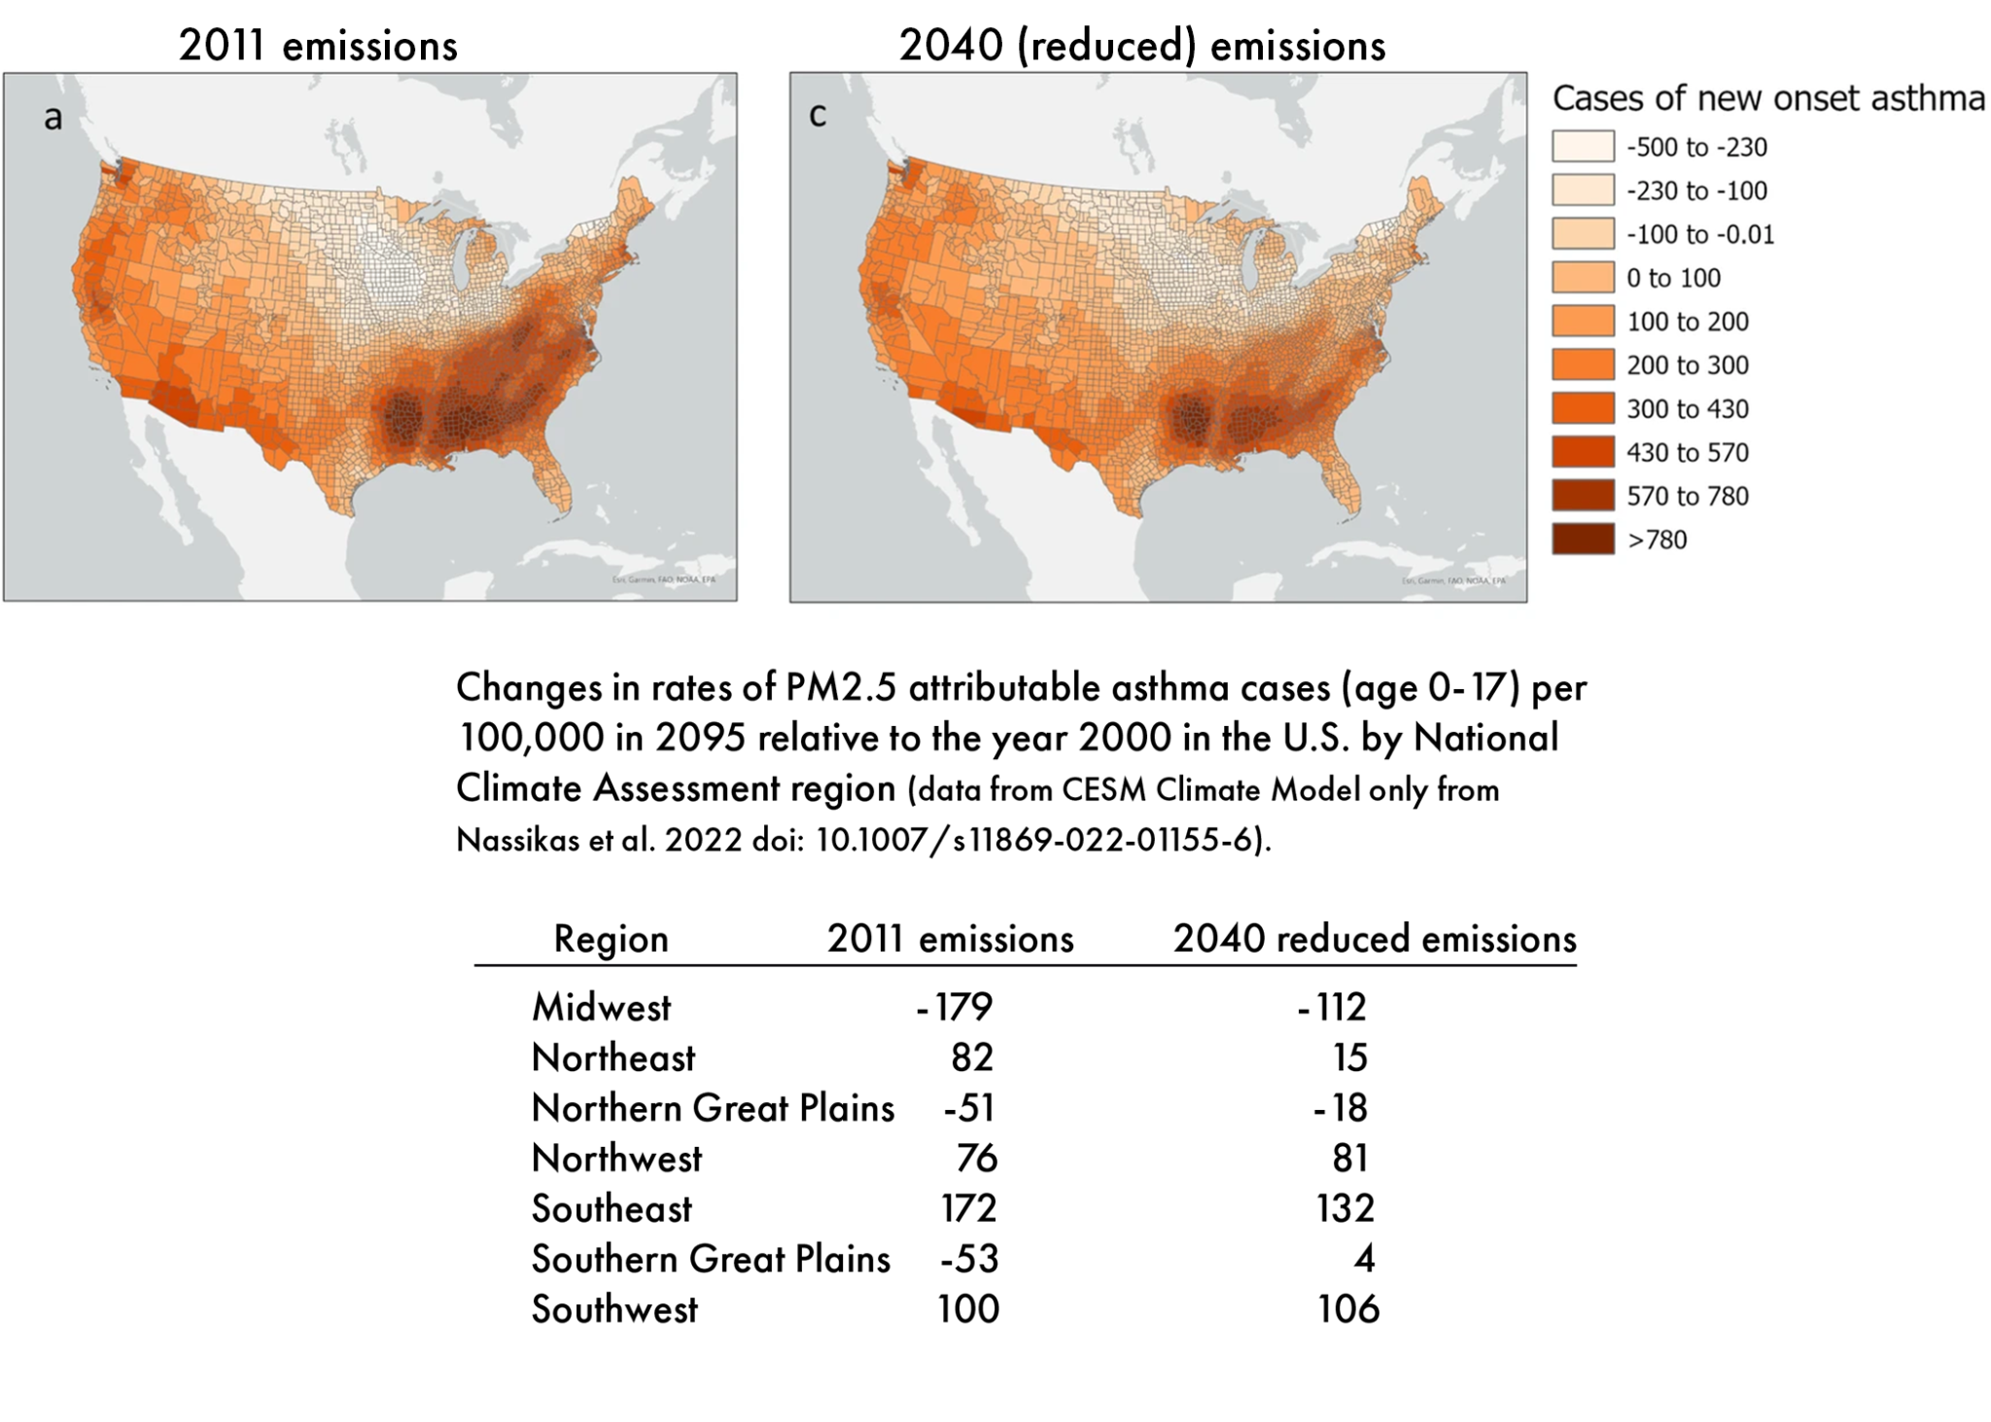
Projected future incidence of childhood asthma in the U.S. if emissions stayed at early 21st -century levels (scenario 2011) and if regulations significantly reduced emissions (scenario 2040)

