Slide 1
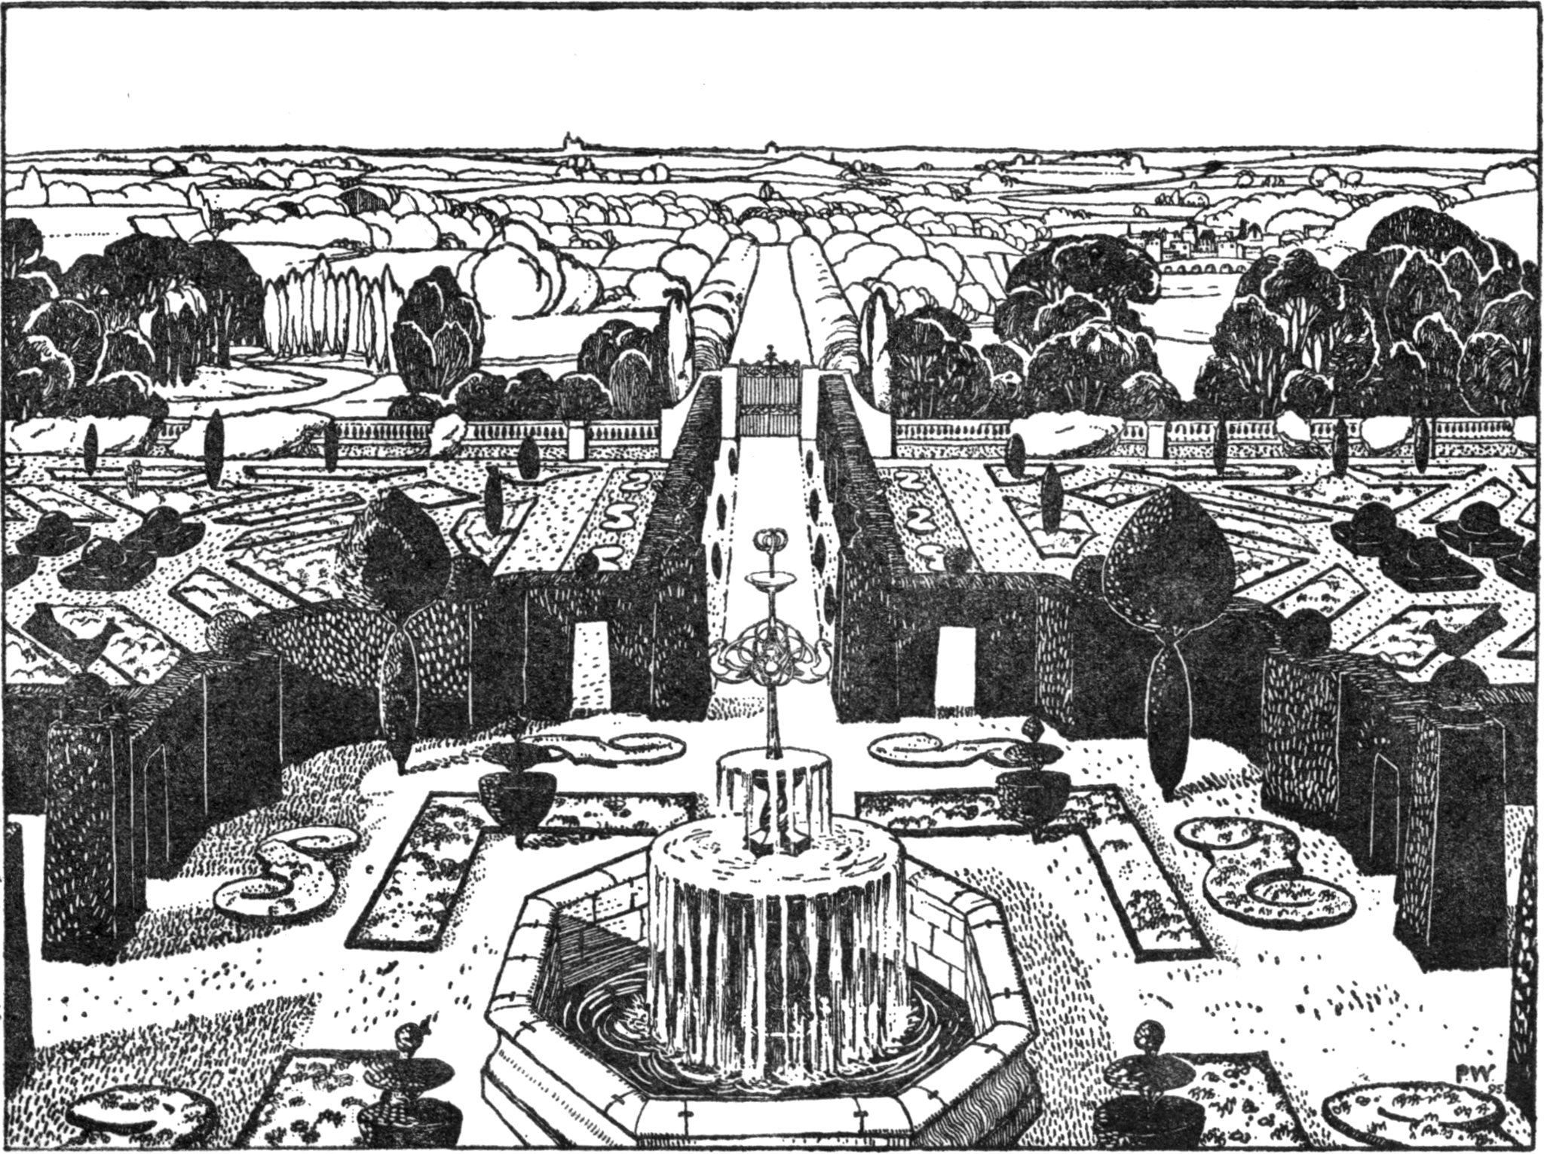
Garden-craft Old and New - Perspective View of Garden in Plan Following by John Dando Sedding (1902). Public Domain via Wikimedia Commons

Slide 2
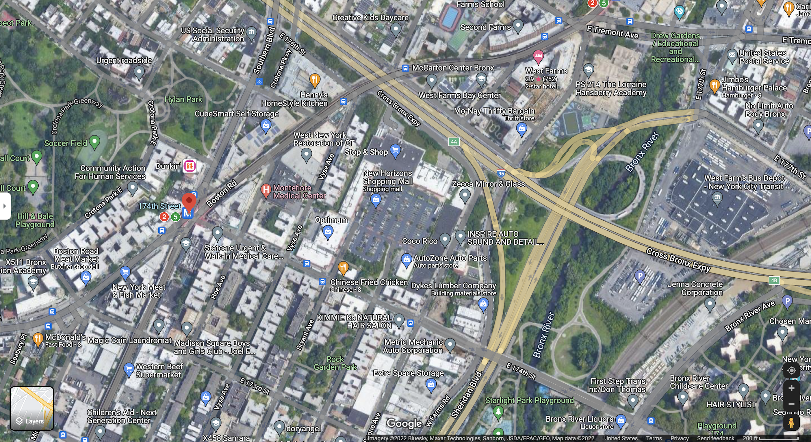
Urban landscape: The Bronx, New York

Slide 3
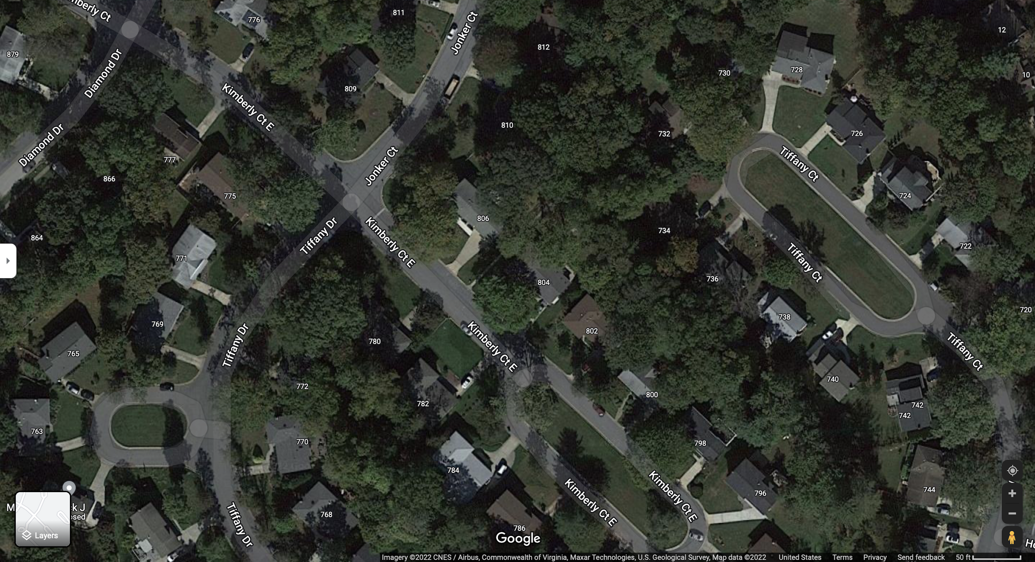
Suburban Landscape: Gaithersburg, Maryland

Slide 4
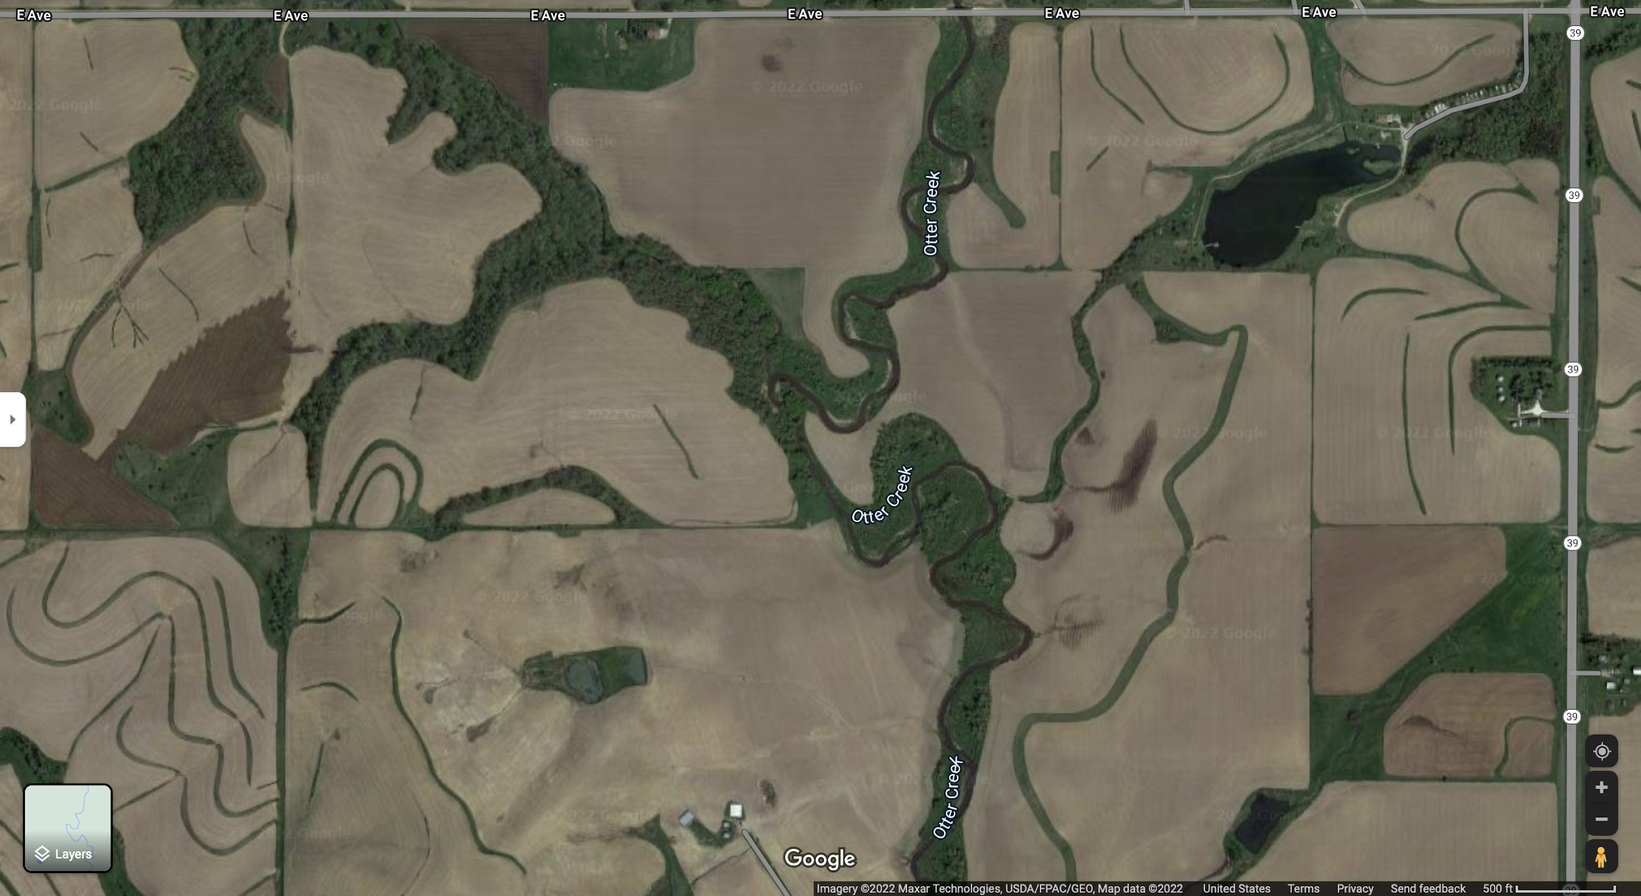
Rural Landscape: Crawford County, Iowa

