Slide 1
Epistemology & Ontology: Case Study of Ecological Knowledge
Snowshoe hare population dynamics and predator-prey interactions
By: Alec W. Armstrong
Notes:
Note to Instructors: These slides were prepared as part of a lesson introducing ecology to non-ecologists interested in socio-environmental systems. Many of the text-only slides may be more useful as notes— instructor/facilitator can hide them and pair with visuals on adjacent slides or find new images. All images and figures are either in the public domain or taken from publications cited on the slide and listed in the bibliography at the end.

Slide 2
Questions to Consider…
How do ecologists produce knowledge?
What assumptions do they make?
What methods do they use?
How do these methods influence their work?
What ontological commitments do ecologists build upon?
How do ecologists evaluate competing claims about the world?
Example: Population cycles of snowshoe hares
Notes:
Notes to instructor: If the participants have not yet discussed these words—epistemology, ontology, metaphysics—have them do so now. Perhaps begin by asking them to jot down what they think these word mean and then discuss their answers. Let the participants know that the questions on this slide are what we are REALLY exploring in this lesson.

Slide 3
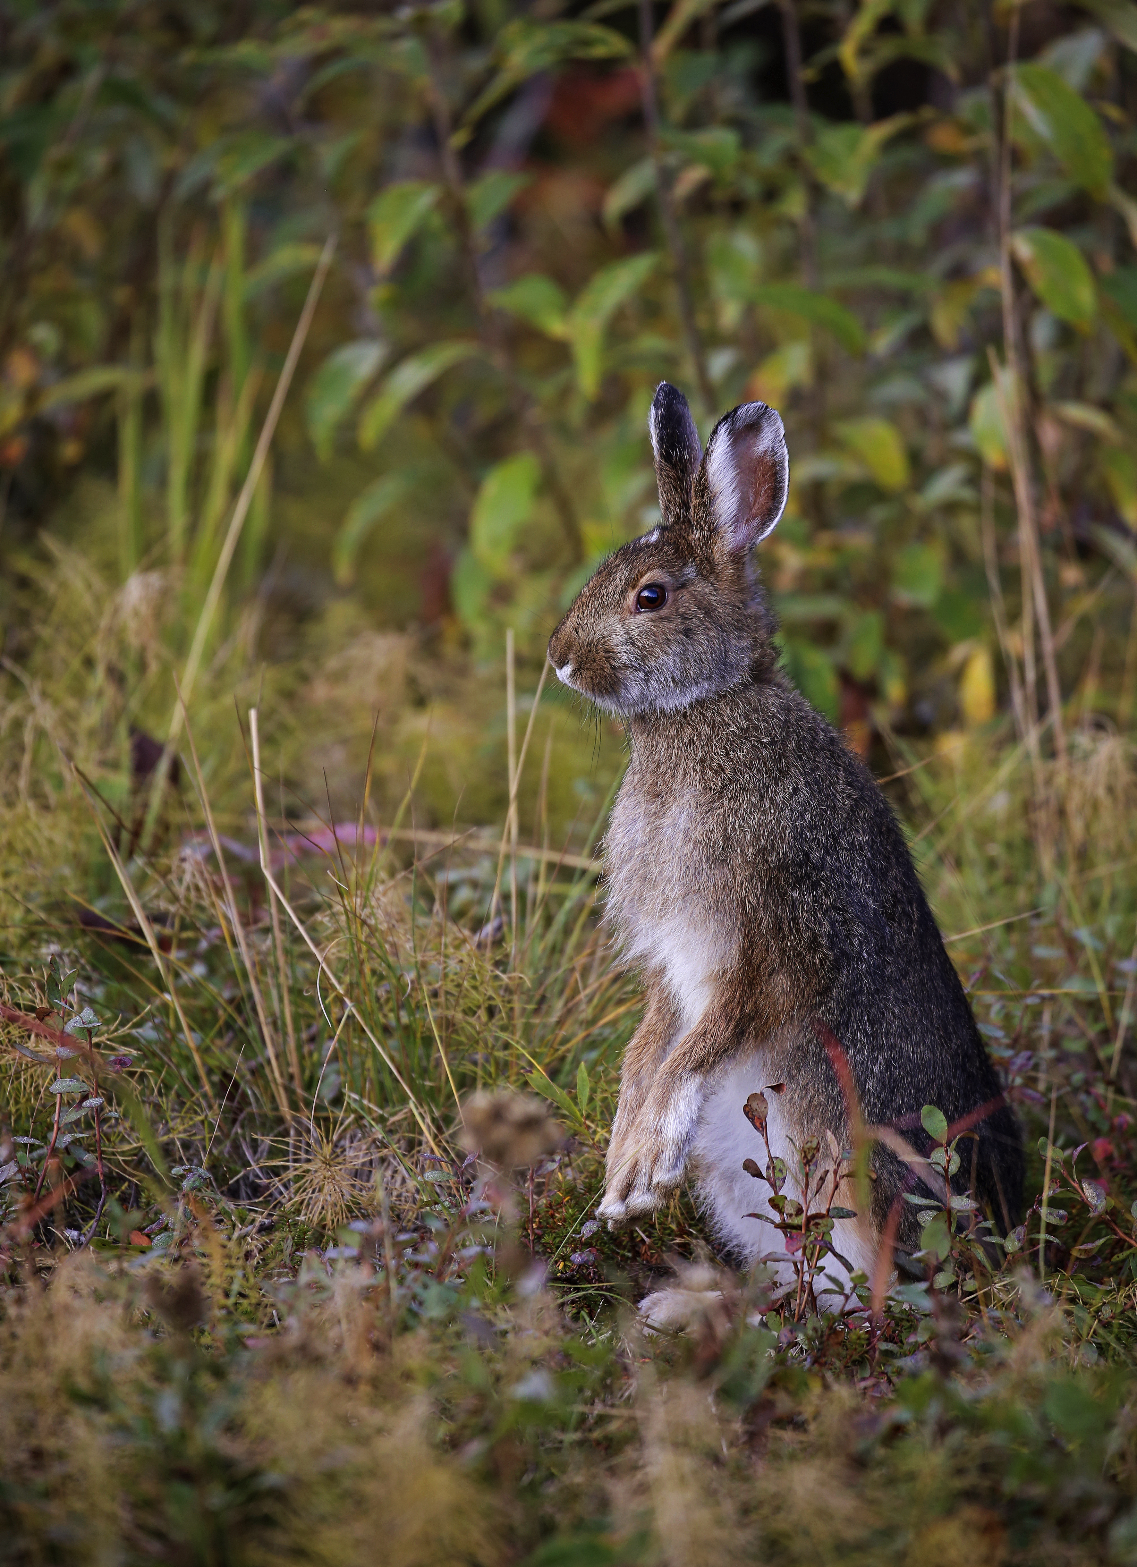
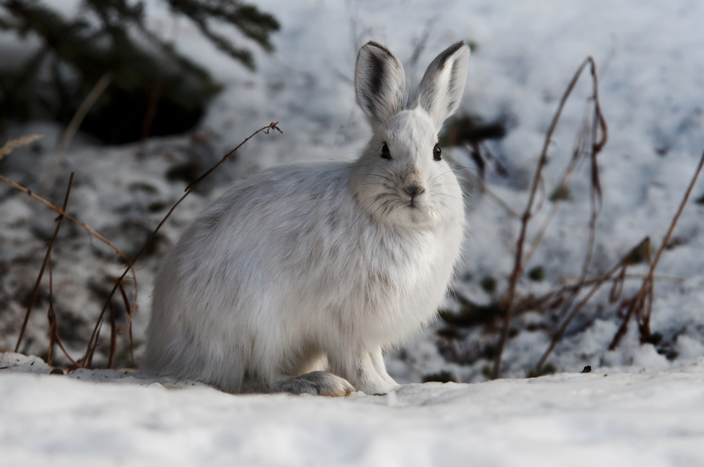
Snowshoe hare, Lepus americanus
Notes:
Notes for the Instructor: Give a little background on the species. For example:
Snowshoe hares are indigenous to coniferous and boreal forests of North America
They are active year-round and are very important as prey items for many species
The snowshoe hare has also been called the snowshoe rabbit. Ask the students where they think the name comes from. [Answer: Its name comes from the large size of its hind feet. Their feet size helps them walk and hop on snow without sinking into it, and the fur on them helps them survive the freezing temperatures where they live.]
Coat changes color with the seasons so they blend in.

Slide 4
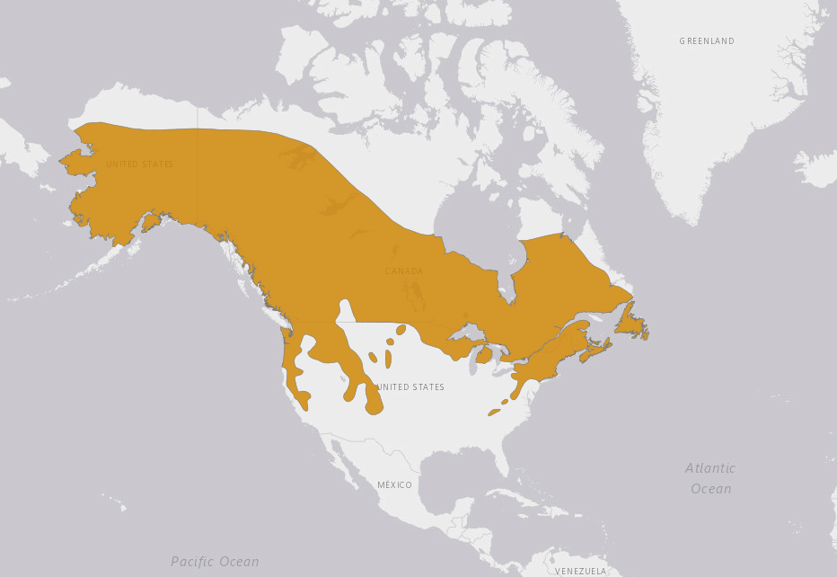
Geographic Range of the Snowshoe Hare in North America
Mills, L. & Smith, A.T. 2019. Lepus americanus. The IUCN Red List of Threatened Species 2019: e.T41273A45185466. https://dx.doi.org/10.2305/IUCN.UK.2019-1.RLTS.T41273A45185466.en. Accessed on 17 June 2022.
Notes:
Notes to Instructor:
For some background on snowshoe hares, the research on them, and why they have been of such interest to ecologists, see this link:
https://www.zoology.ubc.ca/~krebs/ecological_rants/the-snowshoe-hare-10-year-cycle-a-cautionary-tale/
It will help you, the instructor, with the next few slide prompts for students.
A short source for background information includes: https://www.nps.gov/articles/snowshoe-hare.htm

Slide 5
Ecological Questions
What explains the distribution of hares in the continental U.S.?
What evidence might scientists have that the white hares and the brown hares are the same species?
These are very secretive animals, so how might we determine population sizes?
What factors likely determine population sizes?
Notes:
Notes to Instructor:
Instructor should have students ponder the answers to these questions, perhaps doing quick online searches and bringing back information.
Answers (Note – the next slide prompts many of these):
Their distribution in the continental U.S. is odd looking because they are limited to higher elevation areas (mountains) where it’s cold—much like it is where they are in Canada and Alaska. Note they appear to be in the Sierra Nevada and the Colorado Mountain ranges. Ask students why they aren’t in eastern mountains? (Answer: They’re unable to cross deserts and plains, which are hot, to get the highest parts of the Appalachian Mountains, which are cold enough.)
Recall that the colors are just seasonal changes. They can reproduce with one another regardless of color since they are all the same species. Perhaps, researchers held the rabbits in the lab under controlled temperatures, and they not only converged in color but bred. Or perhaps the researchers did a DNA analysis. Or perhaps the researchers observed correlations between the population sizes of the winter (white hares) and warm-weather darker hares. Remind students that color is a phenotype not a genotype.
Population sizes are hard to estimate. Hares can be trapped, then released, but today, researchers use video cameras to largely estimate numbers over some area.
• Students should speculate on species’ interactions (competition), predation, etc.

Slide 6
Already Wading through Ontological & Epistemological Assumptions
Individual organisms are coherent, real, legitimate objects of study.
An organism is coherent through time—changing coat color or size or regenerating cells does not make it a new or different organism.
Organisms can be categorized as species; inclusion or exclusion of individuals in species can be disputed but the category is real.
Records of individuals observed through time in different locations provide knowledge about this species’ range or distribution—where in the world it can be found. The range is not haphazard or completely random but follows patterns.

Slide 7
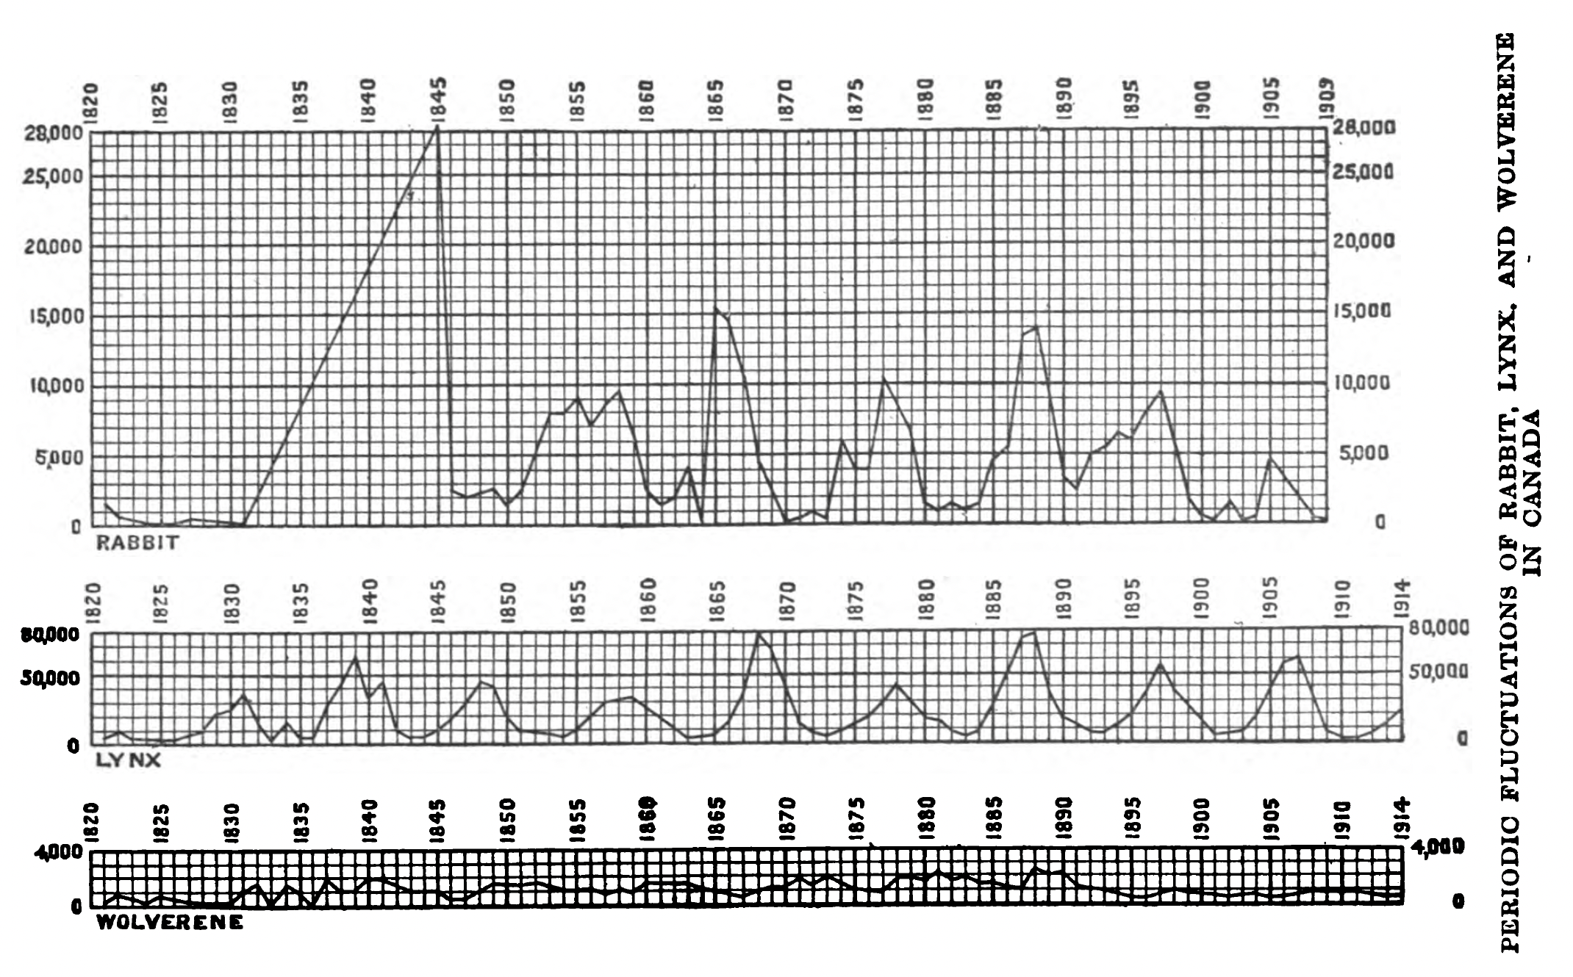
Abundance of hares through time seems to follow a regular pattern, noted here in numbers of fur pelts acquired in 19th century.
Notes:
Background for the Instructor for this and the next several slides:
(From the National Park Service): “Snowshoe hare populations cycle in 8- to 11-year periods, and densities may fluctuate 5- to 25-fold during a cycle. The causes of the cyclic fluctuations of snowshoe hares are debated among scientists. Scientists have proposed many hypotheses to explain the changes in population size that lead to these cycles. These hypotheses usually center on food limitation, patterns of predation, and links between food supply and predation. Recent studies in Kluane National Park and Reserve, Yukon, Canada suggest that cyclic fluctuations of snowshoe hares probably result from an interaction between predation and food supplies.”
(From “Ratings by Charlie Krebs & Judy Meyer”): “The snowshoe hare cycle has been known from Canada lynx fur return data for more than 100 years, and of course known to First Nations people much before that. Hares are herbivores of small trees and shrubs; they reproduce at age 1 and rarely live more than 1-2 years. They have 2-4 litters in a summer, with litter size around 4-6. Juvenile losses are high and at best populations increase about three-to-four-fold per year. Almost everything eats them–lynx, coyotes, great-horned owls, goshawks, a long list of predators on the young. Reproduction collapses with rising density and females reduce their output from 4 litters to 2 in the peak and decline phase.”

Slide 8
What Is a Population?
Population is a category between individual and species – a group of individuals of the same species, defined by interactions (e.g., breeding population) or co-existence in defined space and time
Populations can be counted and categorized further by age, sex, or behavior of individuals
Knowledge about how population size changes over time and what causes these changes is used to infer and predict how the species interacts with the world more generally
Notes:
Notes to Instructor: ASK STUDENTS: Are populations real, ontologically? It depends—it’s often not explicit. Populations can be considered abstractions that “work” but are not real, or real entities in that they are a category necessary to understand other entities with verifiable properties. Is there pragmatic indifference among ecologists?

Slide 9
This pattern seemed to sync with patterns of lynx abundance— are they related?
Hewitt, C. G. (1921). The conservation of the wild life of Canada. New York: C. Scribner.

Slide 10
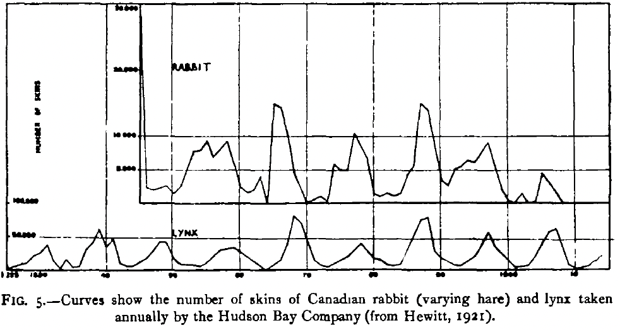
Elton (1924)
Began with established knowledge of cyclic fluctuations and attempted to find underlying cause
Wanted general explanation that could be relevant to all cyclic populations
“About every ten years the numbers of rabbits increase to a maximum…and then almost the entire population is killed off by an epidemic disease.” How and why?

Slide 11
Elton (1924)
Reasoned from current principles (e.g., Darwin) and drew correlations
Synthesized data from published accounts of animal numbers and climate
Concluded climatic variation was ultimate cause of population cycles, evident by correlations with sunspot cycles mediated by volcanic activity

Slide 12
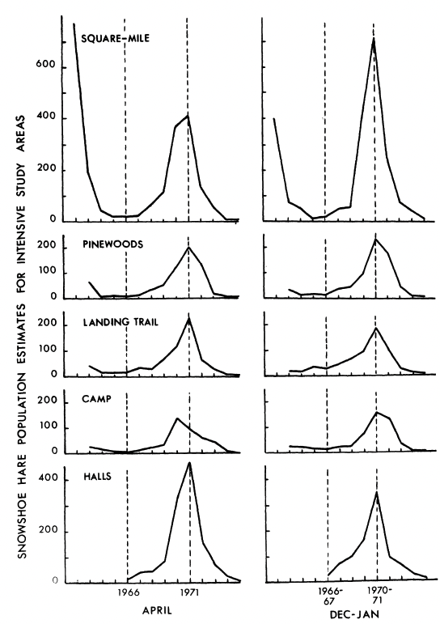
Keith and Windberg (1978)
Quantitative study of population demography, relying on statistical analysis of repeated sampling
Made mathematical models of population growth rates as function of several reductive factors—survival, growth, and reproduction—and compared with data
Interpreted modeling results as support for conceptual model where hare abundance is a product of interrelated predation and food availability

Slide 13
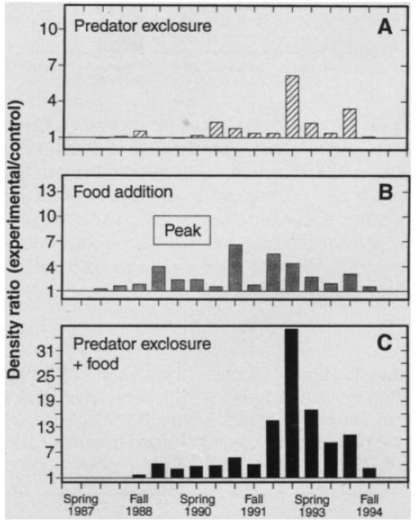
Krebs et al. (1995)
Field experiments at multiple locations
Built on previous models that isolated important components of demographic change (survival, reproduction)
Experiments considered stronger evidence of causation
Concluded predation and food limitations interact beyond simple additive effect
Fig. 3. Ratio of 1 would be equal to average of control plots

Slide 14
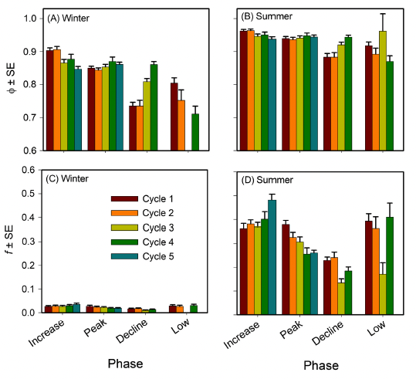
Oli et al. (2020)
Past observations identified clear cycles with distinct phases.
Experimental work provided causes consistent with observations and models.
But were these patterns generalizable? How consistent were results across cycles?
If models are “right,” they should “work” across cycles.
The study modeled 40 years of data; found models were broadly consistent; and identified which parts of the model were sensitive to current conditions.
Fig. 3. Top row represents survival parameter, bottom represents recruitment
Notes:
Background for Instructors: Oli et al. note in their paper: “Snowshoe hare population cycles have been a major contributor to our understanding of population regulatory mechanisms in vertebrates and feature prominently in most ecology textbooks. The most notable feature of these cycles is the changes in abundance, with highly variable cyclic amplitudes…Experimental and observational studies suggest that snowshoe hare population cycles are driven by one or more of the following factors: (1) direct mortality caused by their predators (Krebs et al. 1995, Krebs et al. 2018); (2) indirect, sublethal effects of predators mediated via predator-induced stress response; and (3) winter food shortages. Each of these potential causal mechanisms is predicted to impact demographic rates. … However, rigorous empirical characterizations of demographic structure in cycling hare populations grounded in observational or experimental data are currently lacking. … [So…] our goal was to discern demographic drivers of snowshoe hare population cycles in a boreal forest in southwestern Yukon [using long-term field data spanning 40 yr (1977–2017) and temporal symmetry capture–mark–recapture (CMR) modeling framework.”

Slide 15
What Connects These Studies? What Differentiates Them?
Elton (1924): “It will be shown in the body of this paper that the periodic fluctuations in the numbers of certain animals…must be due to climatic variations.”
Keith and Windberg (1978): “The aim of the present paper is twofold: (1) to describe the set of demographic events that characterized 15 years (1.5 cycles) of population change…and (2) to compare and collate information… to identify those demographic elements that are consistently involved in the snowshoe hare cycle over large geographic areas
Krebs et al. (1995): “Because in all cyclic populations many factors will change in a manner correlated with population density, necessary conditions can be recognized only by experimental manipulations.”
Oli et al. (2020): “Using long-term field data spanning 40 yr (1977–2017) and…capture–mark–recapture (CMR) modeling…our goal was to discern demographic drivers of snowshoe hare population cycles in a boreal forest in southwestern Yukon, Canada.”
Notes:
Notes to Instructor: Consider going over what is stated in each paper to remind students, then pose the question in the next several slides to get them to think more deeply about unstated assumptions, approaches, motivations….

Slide 16
Consider the studies on snowshoe hare population cycles just presented. For each study, discuss the following:
What ecological entities were the objects of the study? What ecological concepts or abstractions were involved?
Describe the reasoning used in each study. How did the authors formulate their questions, what kinds of information were important to them, and how did they use that information to draw conclusions?
What motivated each study? This can include stated motivations but think about why those motivations might be considered valuable or reasonable, and what you think the purpose of this kind of knowledge might be.
Notes:
Notes to Instructor: This discussion is flexible and can be very brief if based only on information in presentation/slides; discussion should be longer if articles/excerpts are available to students/participants.

Slide 17
Consider the studies on snowshoe hare population cycles just presented. For each study, discuss about the following:
Compare and contrast your responses between studies. For example, did the ecological entities change? Do they share assumptions about which kinds of evidence are important? Are their motivations similar?
These studies focus on hare populations, but relationships with other ecological entities are pervasive. What relationships with other living and non-living entities or phenomena are explicitly or implicitly included in these studies, and what is excluded?
Think about all these studies together. What makes them ecology and not some other disciplinary domain?
Why have the phenomena involved stimulated a century of research? What did the scientists involved in this work hope to gain, and why did studies continue beyond work published in the late 1970s? Can ecological questions be “answered”?

Slide 18
Hare case study shows development of ecological thought – in this case…
Observations about ecologically relevant entities (individuals, species) are interpreted as patterns.
Patterns generate questions and hypotheses about potential causes and relationships with other relevant entities or phenomena.
Further observations targeted questions/hypotheses by collecting data. Inferences combined approaches—data was collected based on theorized abstract models but reduced phenomena to its parts.
Experiments considered strongest evidence—provided evidence of causality that aligned with observations and theoretical models.
But long-term or spatially extensive data can be used to test generality of models and past results.

Slide 19
Bibliography
Snowshoe Hare Example:
Charles, J. K., Stan, B., Rudy, B., A, R. E. S., J, N. M. S., Mark, R. T. D., K, M., & R, T. (1995). Impact of food and predation on the snowshoe hare cycle. Science, 269(5227), 1112–1115.
Elton, C. S. (1924). Periodic fluctuations in the numbers of animals: their causes and effects. Journal of Experimental Biology, 2(1), 119-163.
Hewitt, C. G. (1921). The Conservation of the Wildlife of Canada. New York: C. Scribner.
Keith, L. B., & Windberg, L. A. (1978). A demographic analysis of the snowshoe hare cycle. Wildlife Monographs, (58), 3-70.
Oli, M. K., Krebs, C. J., Kenney, A. J., Boonstra, R., Boutin, S., & Hines, J. E. (2020). Demography of snowshoe hare population cycles. Ecology, 101(3), e02969.
Socio-Environmental Synthesis Example:
Johnson, L. R., Johnson, M. L., Aronson, M. F., Campbell, L. K., Carr, M. E., Clarke, M., ... & Sonti, N. F. (2021). Conceptualizing social-ecological drivers of change in urban forest patches. Urban ecosystems, 24(4), 633-648.
Johnson, L. R., & Handel, S. N. (2016). Restoration treatments in urban park forests drive long‐term changes in vegetation trajectories. Ecological Applications, 26(3), 940-956.
La Sorte, F. A., Aronson, M. F., Williams, N. S., Celesti‐Grapow, L., Cilliers, S., Clarkson, B. D., ... & Winter, M. (2014). Beta diversity of urban floras among European and non‐European cities. Global ecology and biogeography, 23(7), 769-779.
Nagy, R., Lockaby, B. G., Zipperer, W. C., & Marzen, L. J. (2014). A comparison of carbon and nitrogen stocks among land uses/covers in coastal Florida. Urban ecosystems, 17(1), 255-276.

