Slide 1
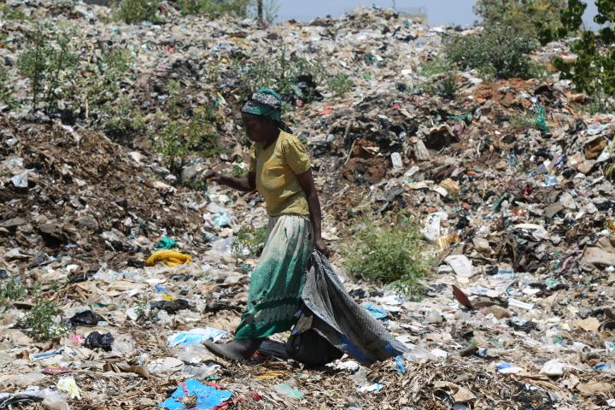
Notes:
Mbale dumping site in Uganda is full of older women who labor to make compost from the garbage. They work all day in poor conditions with no protective gear like gloves and masks to protect them from the smell and unhygienic conditions. Wikimedia Commons Share Alike (open source)

Slide 2
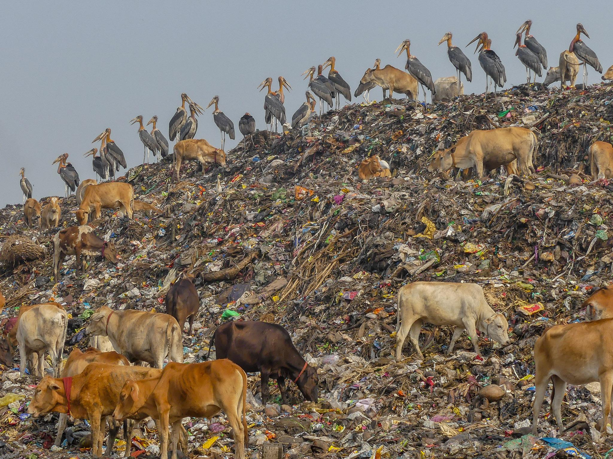
Notes:
Greater Adjutants and cows at Guwahati Rubbish Dump, Bangalore, India. Mike Prince from Bangalore, India, CC BY 2.0 <https://creativecommons.org/licenses/by/2.0>, via Wikimedia Commons

Slide 3
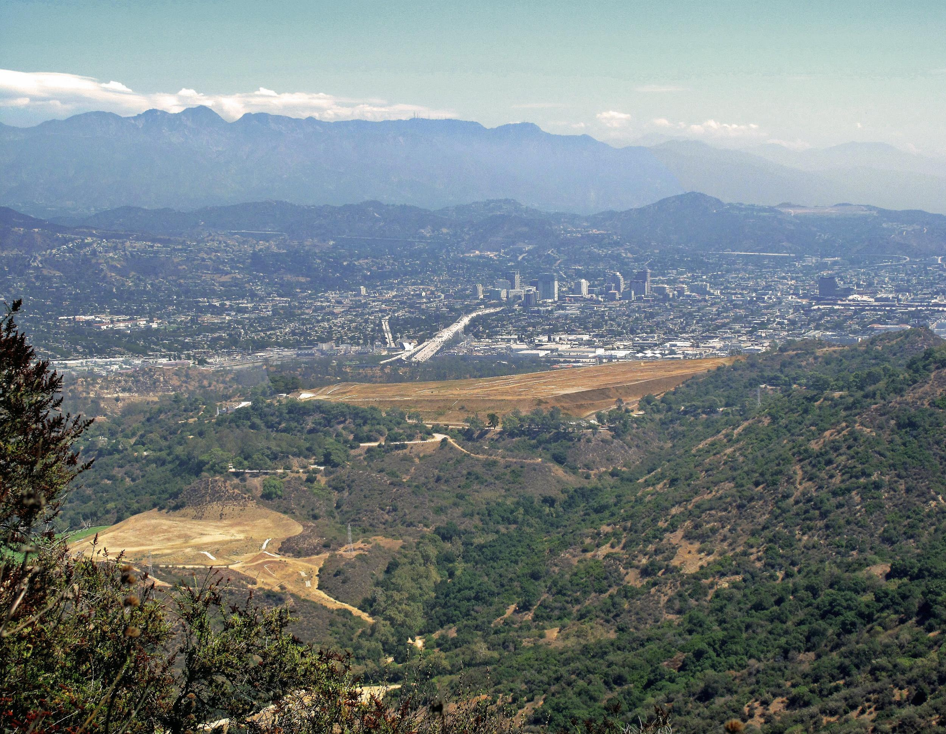
Notes:
The view Northeast from Cahuenga Peak toward the Toyon landfill in Griffith Park, downtown Glendale CA, and the Verdugo Mountains to the right. The mountains in the far background are the Santa Susana Mountains. The view is from the trail between Lonesome Pine and the Hollywood Sign. Location approximate. Wikimedia Commons Share-Alike (open source).

Slide 4
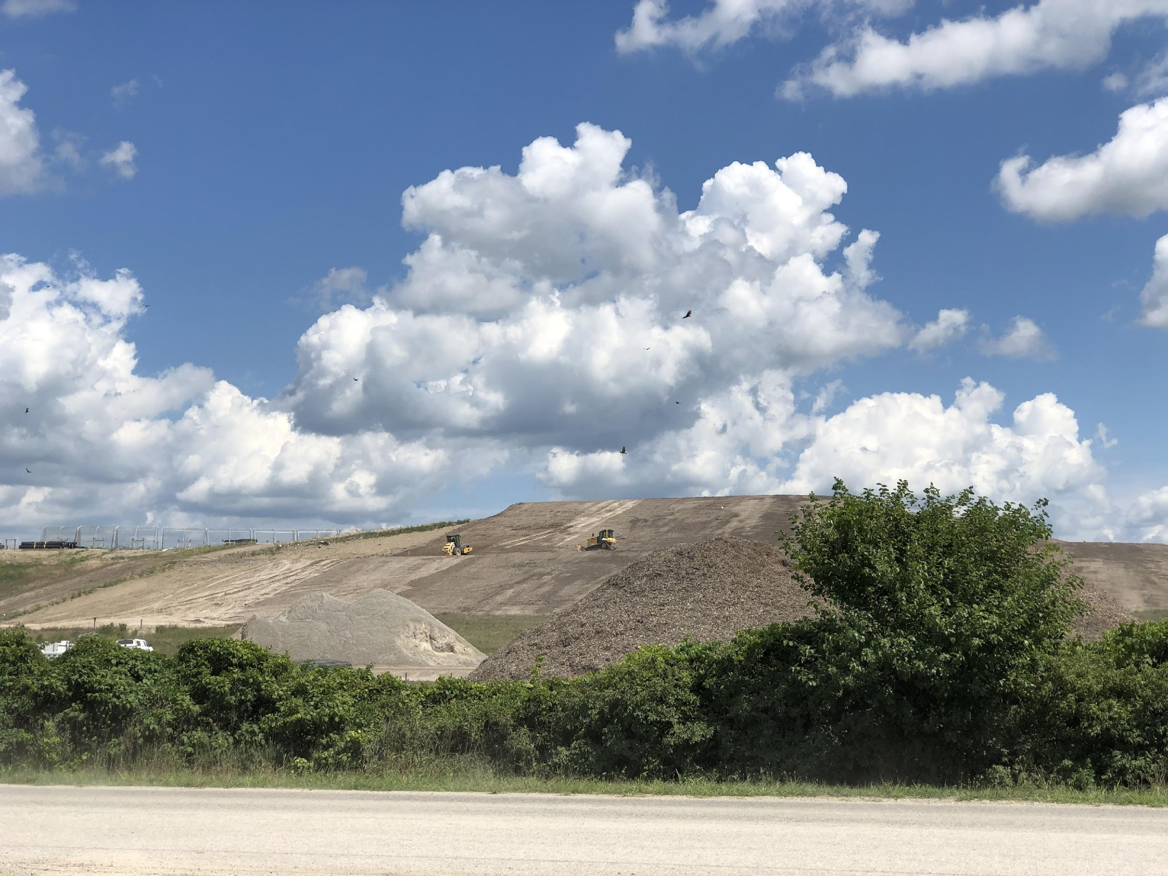
Notes:
Wood County, OH landfill. Mbrickn, CC BY 4.0 <https://creativecommons.org/licenses/by/4.0>, via Wikimedia Commons

Slide 5
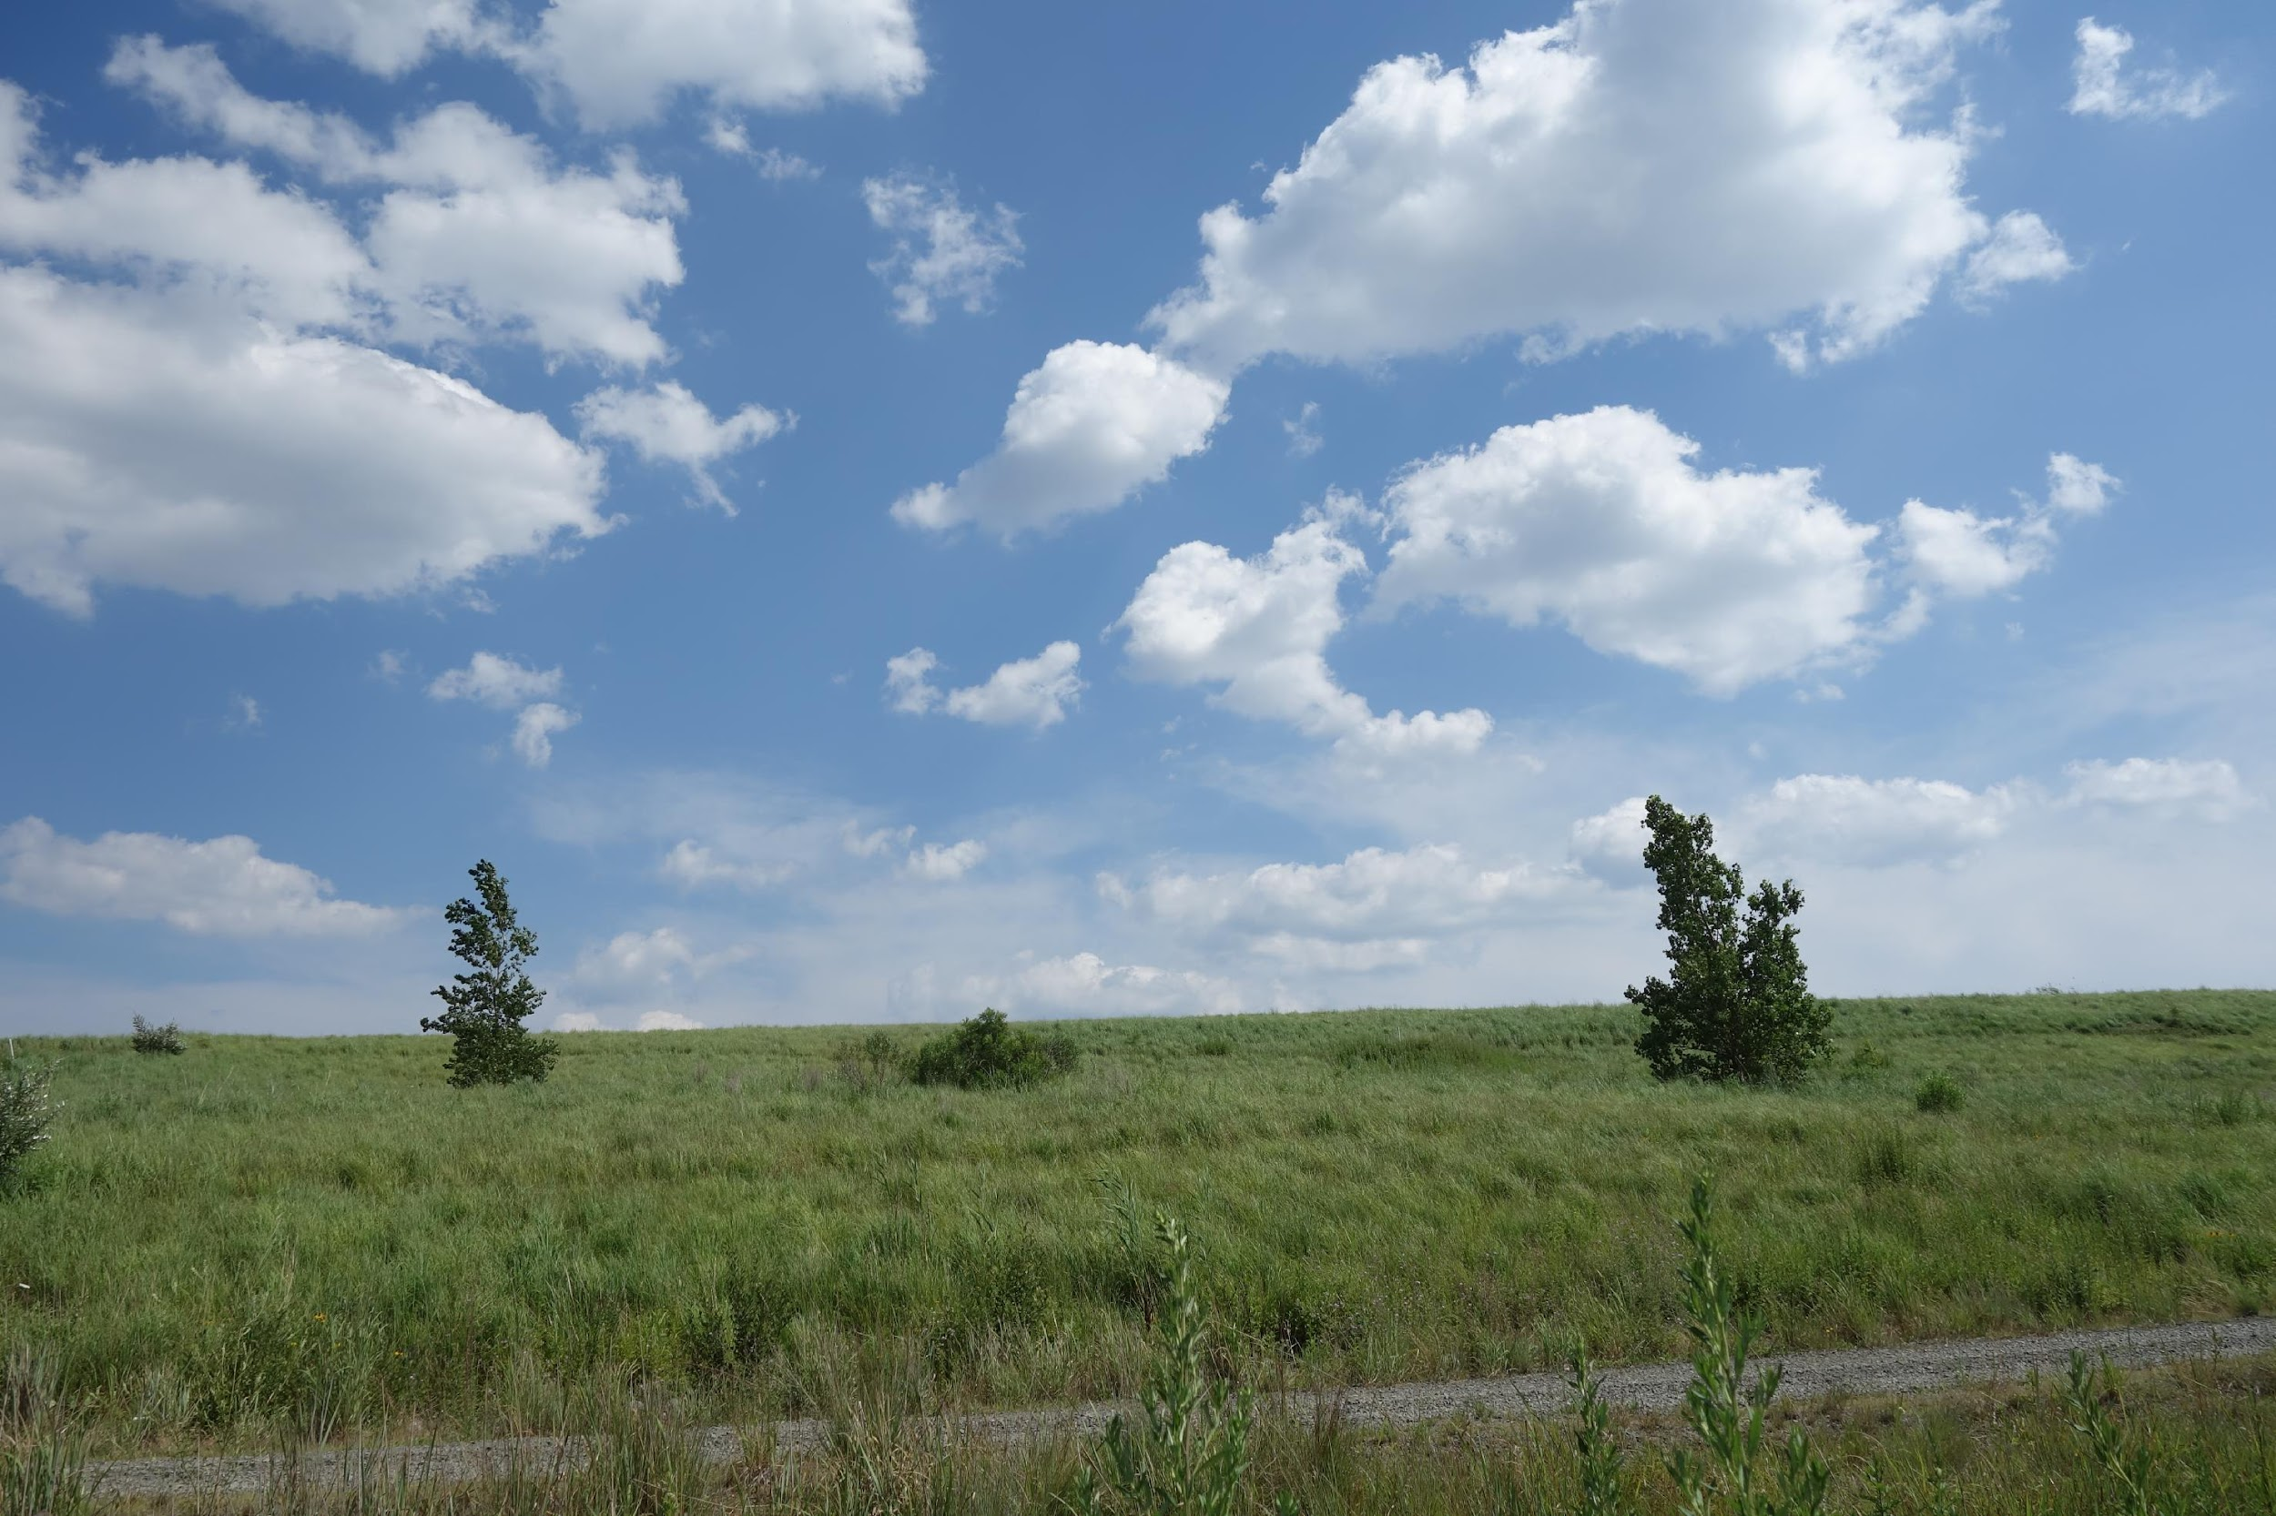
Notes:
Looking into the former Fountain Avenue Landfill from the Shore Parkway Greenway, on the south side of the Belt Parkway at Erskine Street in Spring Creek, Brooklyn NY. The former landfill is in the process of being converted into the second section of Shirley Chisholm State Park. Tdorante10, CC BY-SA 4.0 <https://creativecommons.org/licenses/by-sa/4.0>, via Wikimedia Commons

Slide 6
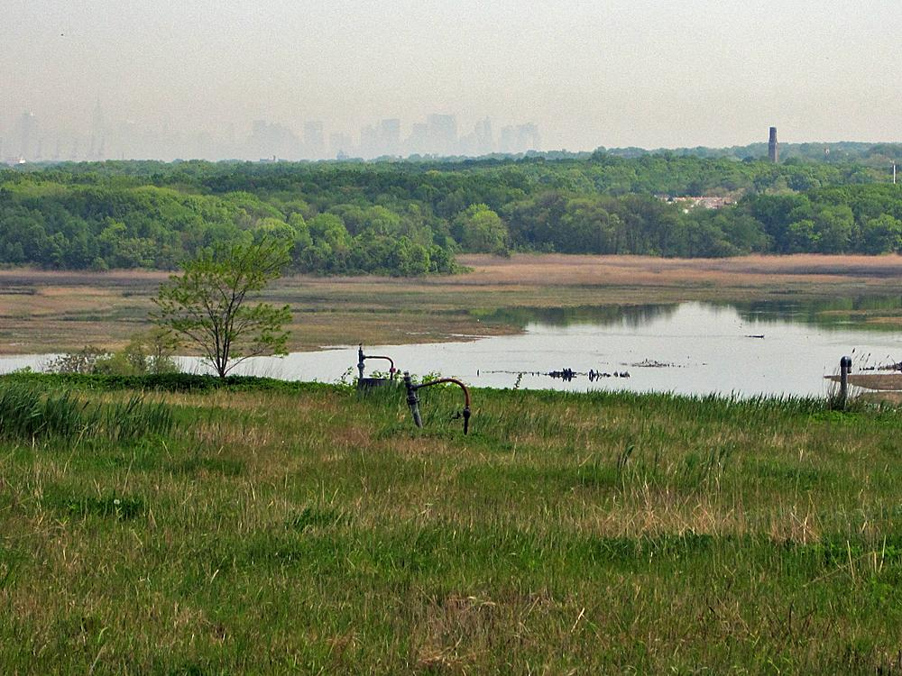
Notes:
Downtown Manhattan view over Freshkills Park, Staten Island NY. H.L.I.T., CC BY 2.0 <https://creativecommons.org/licenses/by/2.0>, via Wikimedia Commons

