Slide 1

Introduction: What Is Ecology?
By: Alec W. Armstrong

Slide 2
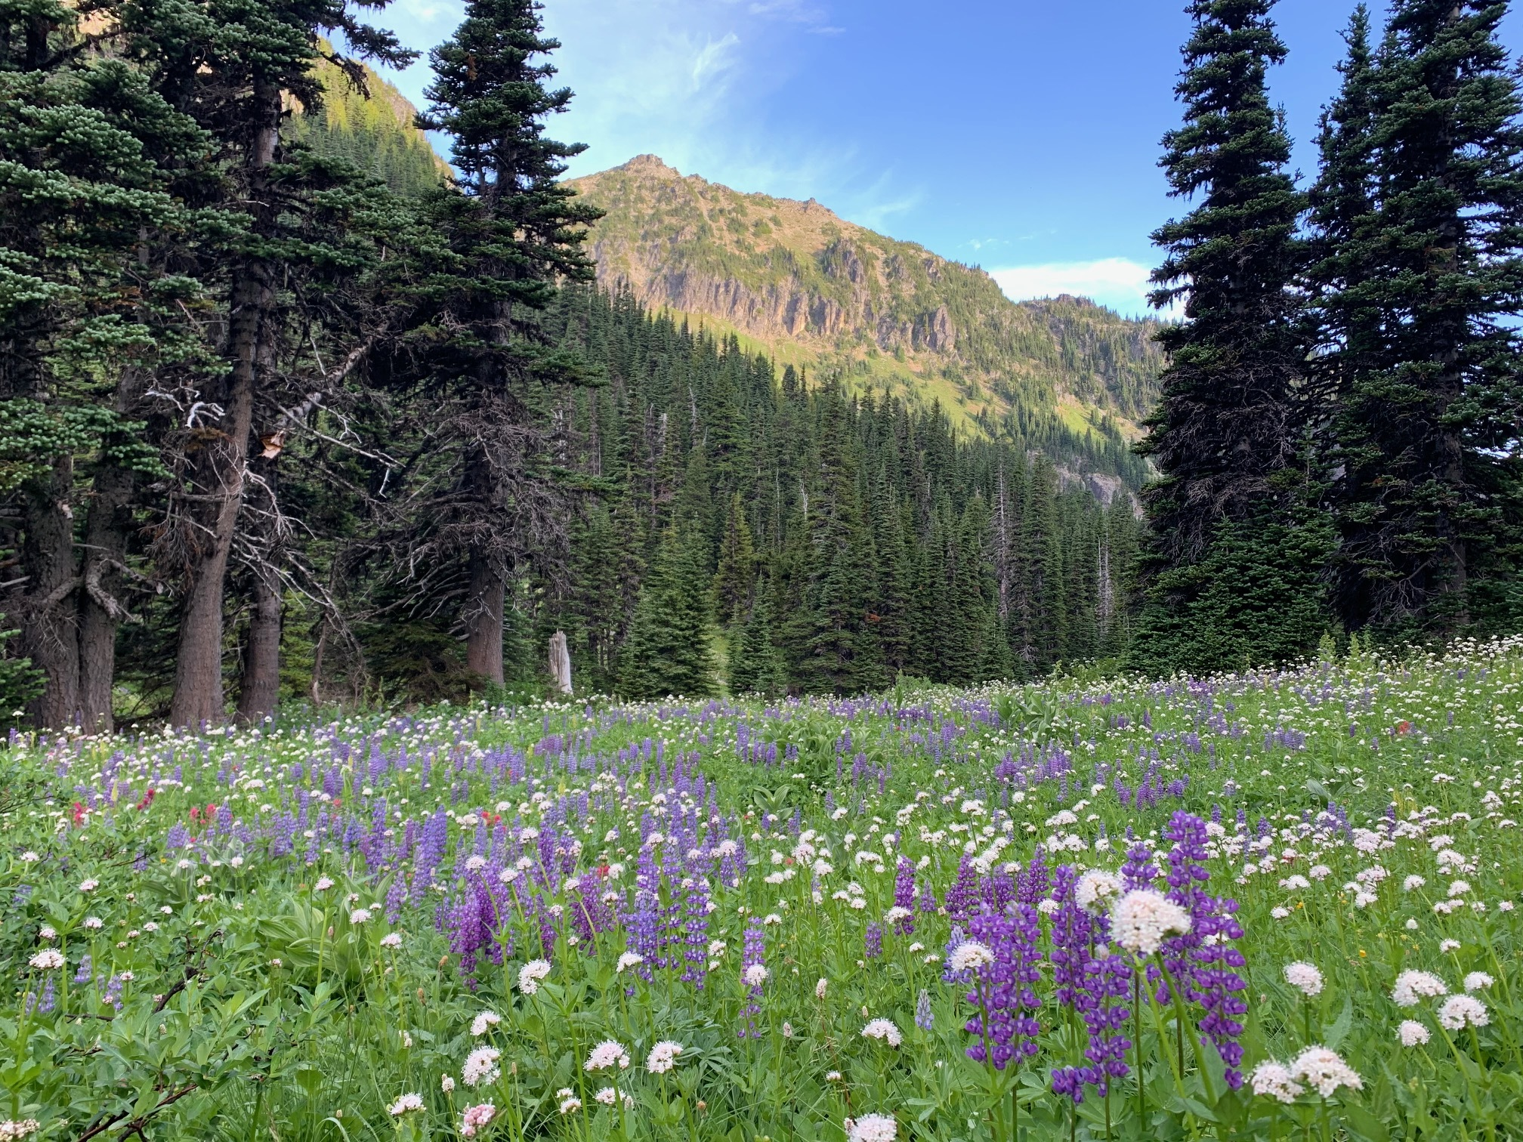
What is “ecological” in this image?
What concept, idea, pattern, phenomenon, etc. do you see here that seems like
a properly ecological thought?
Examine the image
and write down your response (>5 minutes).

Slide 3

What Is Ecology?
Usually defined in terms of its scope—which parts of the world it studies
Ecology = oikos + logos
Haeckel’s oecology (1866): “The whole science of the relations of the organism to the environment including, in the broad sense, all the ‘conditions of existence.’” – Quoted in Egerton 2010

Slide 4
What Is Ecology?
“The scientific study of interactions between organisms and their environment” (Cain, Bowman & Hacker 2011)
“The study of relationships between organisms and the environment” (Molles 2005)
Attempts to narrow —“the scientific study of the interactions that determine the distribution and abundance of organisms” (Krebs 2001)—and broaden— “the study of the structure and function of nature” (Odum 1963)—but definitions above are most common and persistent (from Reiners & Lockwood 2010)

Slide 5
What Is Ecology?
Many subdisciplines, changing emphases through time
Subfields often defined by scale of organization and focal entities
  Individual organisms (autecology)
  Populations
  Communities and meta-communities
  Ecosystems
  Landscapes (or spatial ecology)
Interactions between entities can be studied at any of these scales

Slide 6
Ecology can focus on individual organisms/species and their interactions.
E.g., these lupine plants

Slide 7
Ecology can focus on individual organisms/species and their interactions.
E.g., these lupine plants
What determines the growth rate of individual plants?
What interactions exist between the lupines and the valerians (white flowers)?
How does a lupine’s ability to “fix” atmospheric nitrogen affect its distribution?

Slide 8
Ecology can focus on populations—e.g., the collection of lupines shown here.

Slide 9
Ecology can focus on populations—e.g., the collection of lupines shown here.
How many individual lupines are there in an area, and how does this change from year to year?
What lupine traits affect population size and stability?
How, when, and where do herbivores alter lupine population sizes?

Slide 10
Ecology can focus on communities—e.g., all the plants in this meadow

Slide 11
Ecology can focus on communities—e.g., all the plants in this meadow
How many plant species are present in the meadow each year? Are there trends over time?
How does plant diversity affect things like herbivore population size, or soil nitrogen?

Slide 12
Ecology can focus on ecosystems—e.g., this meadow

Slide 13
Ecology can focus on ecosystems—e.g., this meadow
What affects the total amount of plant production in this meadow each year?
How do events like droughts or fires affect meadow productivity?
How does herbivory change soil nutrients over time?

Slide 14
Ecology can focus on landscapes—e.g., the distribution of meadow vs.
forest

Slide 15
Ecology can focus on landscapes—e.g., the distribution of meadow vs. forest
How are increasing temperatures affecting size of meadow areas?
Do new pests increase or decrease areas of meadow vs. forest?

Slide 16
What Is Not Ecology?
Ecology is…
Biological but it’s not biology
Biogeochemical but it’s not chemistry or geology
Energetic but it’s not physics
Inclusive of society and human influences but it’s not a social science or the humanities
Boundaries between Disciplines
If there are disciplinary boundaries, who arbitrates them?
What are the boundaries between “objective” science and activism/advocacy?
Notes:
Notes to instructor: These bullets are each rich for discussion. The instructor could use these bullets as prompts—asking students to write a few sentences on some of these or to do quick web searches and then discuss their responses/results.
Biology bullet: Biology is the fundamental study of cellular and organismal processes; it is not ecology; although ecology is biological, it is not biology.
Biogeochemical bullet: The fundamental study of the nature of matter is chemistry—not ecology; and the fundamental study of mineral, atmospheric, and hydrological processes is geology—not ecology. However, ecology does focus on the intersection of the biological (microbial), geological (soils, water, air), and chemical (nutrients, carbon) with its focus on decomposition, mineralization, and material fluxes through ecosystem science.
Energetic bullet: The fundamental study of thermodynamics is physics, not ecology; but ecologist do focus on the flow of energy through ecosystems e.g., productivity.
Society bullet: Ecology primarily focuses on biophysical phenomena, even if people are involved.
Boundaries bullet #1: Who arbitrates the boundaries between disciplines is messy and contentious. Think of recent work on: “evolutionary ecology,” “metacommunities and metaecosystems,” or how one defines the boundaries of an ecosystem.
Boundaries bullet #2: The boundaries can be complicated; despite popular use of the term “ecological,” most ecology is descriptive or predictive, not prescriptive, or normative—though ecologists’ motivation might lie in their commitment to environmental ethics or the application of their work to conservation. However, environmentalism does not equate with “ecological.”

Slide 17
Question to Consider Next…
How do ecologists produce knowledge?
What assumptions do ecologists make?
What methods do they use?
How do these methods influence their work?
What ontological commitments do ecologists build upon?
How do ecologists evaluate competing claims about the world?
e.g., population cycles of snowshoe hares
Notes:
Notes to instructor: If the participants have not yet discussed the words—epistemology, ontology, metaphysics—have them do so now. Perhaps begin by asking them to jot down what they think those words mean then discuss them. Note: these questions will be discussed more in the next set of slides.

Slide 18
Bibliography
Philosophy and Definitions of Ecology
Cain, M. L., Bowman, W. D., & Hacker, S. D. (2011). Ecology (2nd ed.). Sinauer Associates, Inc.
Egerton, F. N. (2012). Roots of Ecology: Antiquity to Haeckel. University of California Press.
Keller, D. R., & Golley, F. B. (Eds.). (2000). The Philosophy of Ecology: From Science to Synthesis. University of Georgia Press.
Molles, M. C. (2005). Ecology: Concepts and Applications (3rd ed.). McGraw Hill.
Odum, E. P. (1963). Ecology. Modern Biology Series. Holt, Rinehart, and Winston.
Reiners, W. A., & Lockwood, J. A. (2010). Philosophical Foundations for the Practices of Ecology. Cambridge University Press.
Notes:
Notes

