Slide 1
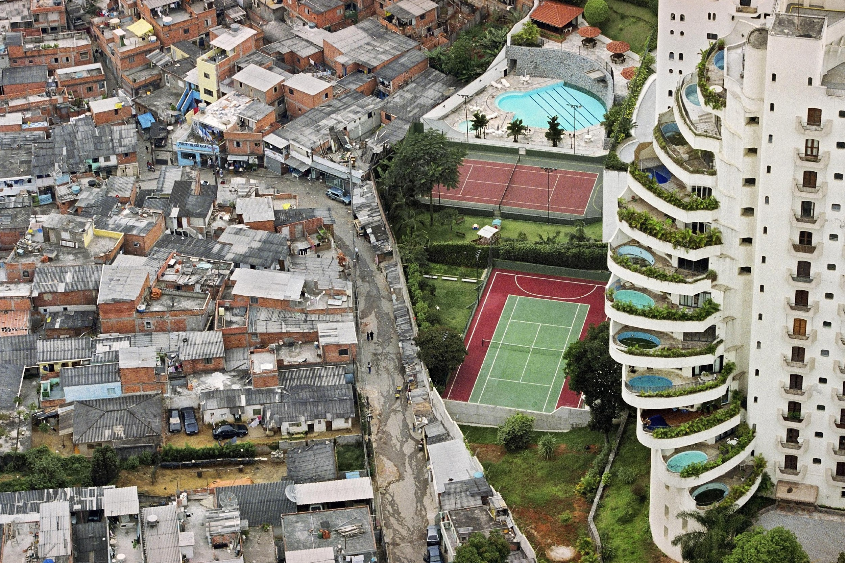
What is Political Ecology
Notes:
Ask the students what they see in the photo.

Slide 2
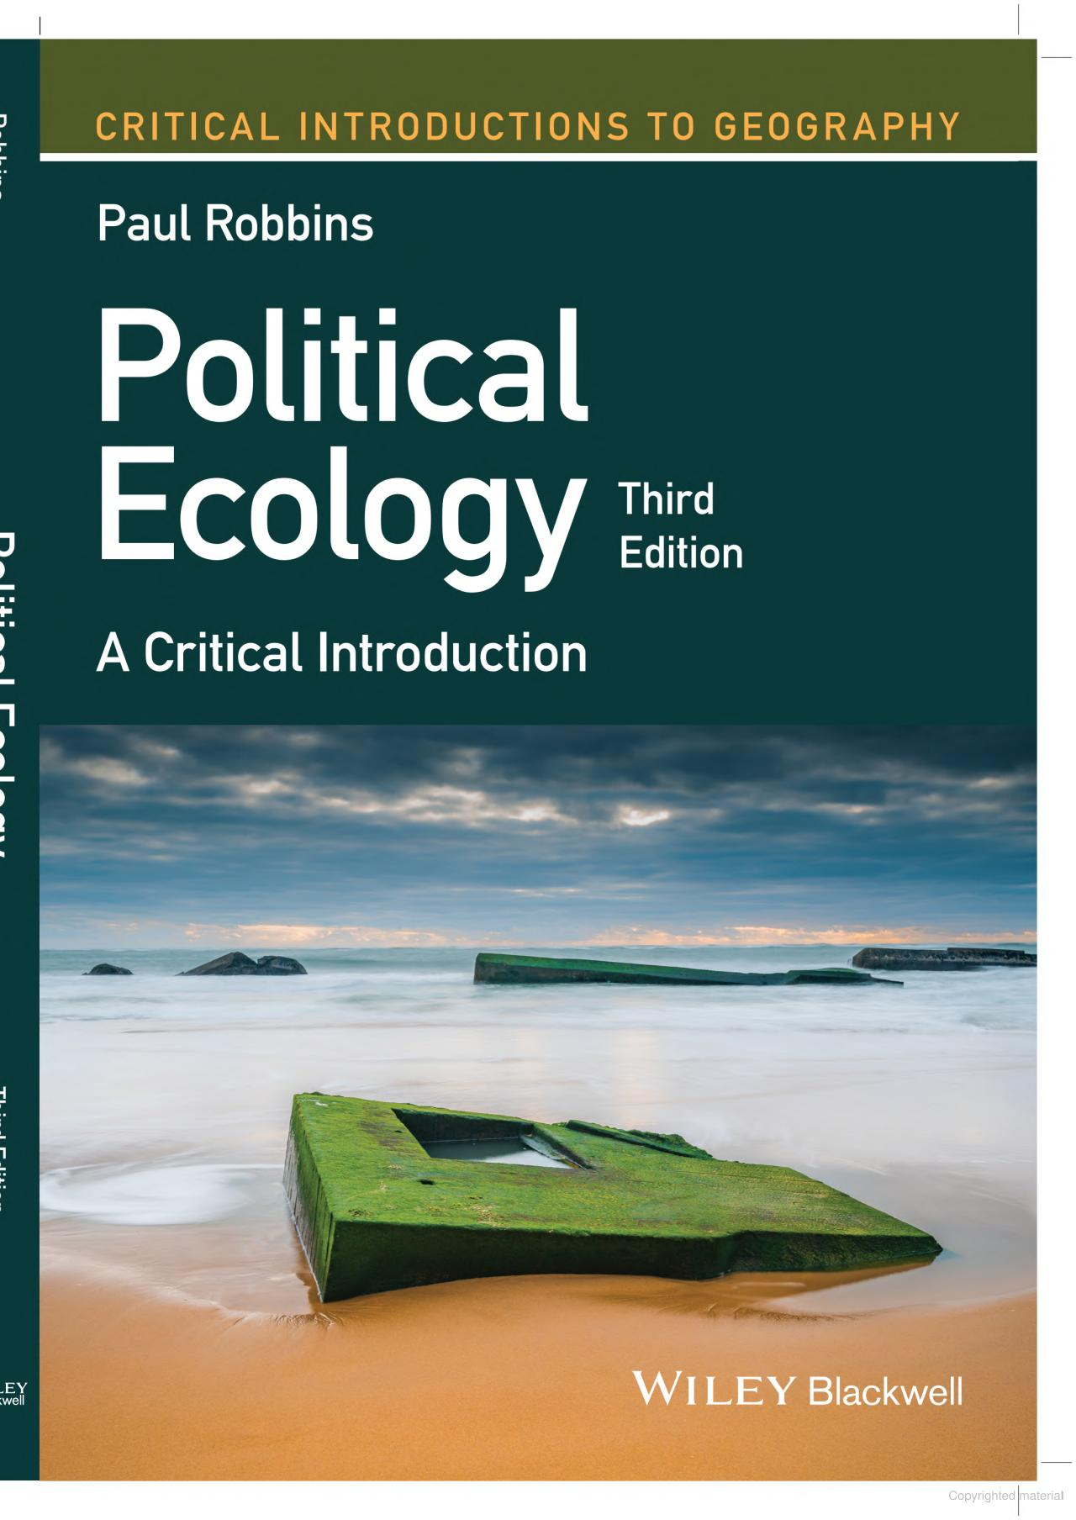
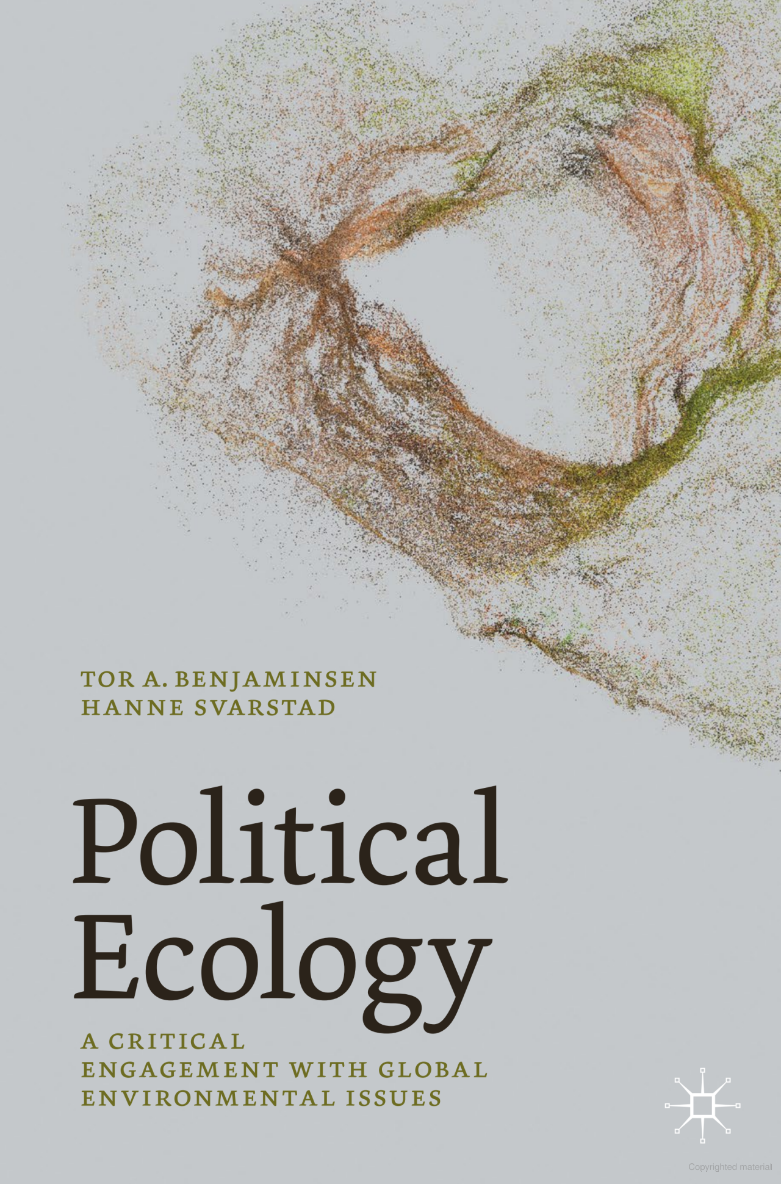
Political Ecology
something you do …. not a body of scholarship
Notes:
A few useful texts

Slide 3
Some argue
it is a community of practice ¹
What does this mean?
an epistemological project ²
What is/are the epistemologies of your discipline?
an effort to shatter comfortable & simplistic “truths” about the relationship between society & its natural environment²
What is meant by “truths” here?
¹ Robbins. 2012. Political versus apolitical ecologies. Political ecology: A critical introduction, 11-24.
² Perreault et al. (Eds). 2015. The Routledge handbook of political ecology.

Slide 4
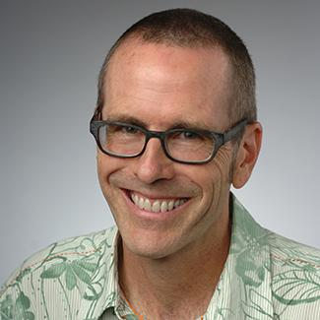
Characterizing Political Ecology
Tom Perreault argues:
“it is best characterized not by a research topic … the field’s
coherence derives from a set of commitments held in common.”
He describes four commitments:
Tom Perreault, Syracuse University
1. a theoretical commitment to critical social theory
What do YOU think critical social theory is?
How do scholars of this theory describe it?
Notes:
Note on Perreault’s quote: “research topic” here is referring to things like deforestation, resource governance, etc.
Have students first write down or say what they think critical social theory is THEN present them with a scholarly definition (to clear up misconceptions) as in the next slide

Slide 5
Critical Social Theory
…from a scholar’s view
… an approach to social enquiry that goes beneath the surface appearance
by critically engaging with prevailing conceptualizations of the social world¹
… a perspective that focuses on reflective assessment of social systems to
identify, evaluate, and challenge systems of power ²
… an umbrella term for theories advocating social justice & sharing a set of assumptions that recognize the impacts of systemic oppression on all members of society. …posits that theory can not be separated from practice because people enact their understanding of the world e.g., a person who believes the world is inherently just and fair may deny that systemic problems exist and may act in ways that perpetuate injustice³
¹ Harvey, L. 2022. DOI: 10.1080/13538322.2022.2037762; ² Curtis, M.G. 2022 DOI: 10.1111/jftr.12449; ³Brennan et al. 2022. DOI: 10.1016/j.iheduc.2021.100830
Notes:
These three descriptions by different scholars invite a rich discussion by participants in the group.

Slide 6
Characterizing Political Ecology
Tom Perreault argues:
“it is best characterized not by a research topic … the field’s
coherence derives from a set of commitments held in common.”
He describes four commitments:
Tom Perreault, Syracuse University
2. a theoretical commitment to a post-positivism understanding of nature
What is post-positivism?
What are examples of research fields in which scholars typically adopt this and fields that have traditionally shunned such?
Notes:
Instructor: have the learners first write down a definition and example in reasons to the two questions then open the floor for sharing.

Slide 7
Characterizing Political Ecology
Tom Perreault argues:
“it is best characterized not by a research topic … the field’s
coherence derives from a set of commitments held in common.”
He describes four commitments:
Tom Perreault, Syracuse University
3. a methodological commitment to in-depth, direct observation involving qualitative research often in combination with quantitative methods and/or document analysis
What are examples of qualitative research methods?
How can qualitative and quantitative data be used together?
Notes:
The first question posed to the learners: could be answered by them directly or have them do quick 3-minute searches. Another option is to have them watch SESYNC’s short video on “Qualitative Data”. Examples might be: interviews/ethnographic approaches, surveys, etc.
For the second question, the instructor could discuss how survey data can be converted to quantitative data if the survey responses are associated with a Likert scale (e.g., ‘agree’ [with this statement], ‘agree a little’ etc.) or you could mention the use of Qualitative Comparative Analysis (which combines qual and quant research). But, qualitative data is also excellent when used in a Mixed Methods design in which, for example, the qualitative data helps explain/interpret quantitative results, provides context, etc.. Especially because as Perreault points out: “Some understanding of the place-based, historically sedimented social relations of production and exchange, and environmental practices is crucial for political ecological analysis.” The instructor could also refer to Mysha Clark’s SESYNC lecture on the use of mixed methods titled: “The Human Dimensions of Natural Resource Management: What is the Role of Mixed Methods Approaches”

Slide 8
Characterizing Political Ecology
Tom Perreault argues:
“it is best characterized not by a research topic … the field’s
coherence derives from a set of commitments held in common.”
He describes four commitments:
Tom Perreault, Syracuse University
4. a normative political commitment to social justice and
structural political change
In what way might your own work involve normative aspects?
Notes:
Have the students think about the following statement: Often ecologists have normative views on biodiversity but never question them, e.g., biodiversity is always a good thing.
Instructor follow up: Perreault expands on this commitment as follows:
“Political ecology is an explicitly normative intellectual project, which has from its beginning highlighted the struggles, interests, and plight of marginalized populations: peasants, indigenous peoples, ethnic and religious minorities, women, the poor. In this sense, and in contrast to many other approaches to social and environmental analysis (e.g. cultural ecology, land use/land cover change analyses, etc.), political ecology is explicitly normative in its approach. Political ecologists thus seek not just to explain social and environmental processes, but to construct an alternative understanding of them, with an orientation toward social justice and radical politics.”

Slide 9
History of political ecology
Early Focus: environmental degradation is huge and the impacts fall disproportionately on those with little power
What are some examples of disproportionate impacts on groups during the 1970’ – late 1980’s?
Has the disproportionality of environmental impacts decreased
over time? Does this vary geographically?
Notes:
Guide the students from historical to recent times. Ask them “who wins, who loses from environmental externalities?”

Slide 10
Later Focus: shifts away from a focus on biophysical degradation toward the “politics” side
major focus on the politics & economics of the environment and how power plays out
What are some sources of power?
Where do power differentials play out? provide examples
Notes:
During this time period and even up until today many believe that the ecology has been lost from political ecology. (See article by Turner et al 2016 who argues that there is still an important role for political ecology as a mode for engaging with ecologists and ecological science. DOI: 10.1177/0309132515577025)
Have students think about power, what it is and how it plays out:
*SOURCES of POWER: gender, income, sexuality identify, geographic region of origin, family status, etc.
*Theaters in which power differentials play out: Push them to go beyond income status, e.g., power plays out in terms of being
a) able to afford something (like a home in and uncontaminated areas). Others might include:
b) who is at the “table” when zoning laws are set, who provides input into new legislation, into where environmental remediation and restoration projects are completed, etc
c) who has a voice, i.e., you may be at the table but your input is rarely acknowledged or acted upon - have learners brainstorm examples, ideally from their own experience
d) in relationships (especially gender is important here)
c) in jobs (director vs. staff, owner vs. maid, etc)
d) in setting in which ‘prestige’ is an issue (doctor vs. patient, clergy vs. parishioner, police vs. citizen, etc.)

Slide 11
Today: many would argue that political ecology is still just about politics and power…but it is much more
it also asks researchers to think about positionality and assumptions underlying one’s work and about how socio-environmental systems are studied, framed, and who is involved
What is meant by positionality in the context of research?
What assumptions are you making in your work?
Notes:
This is often a very difficult topic for natural scientists – i.e., to think about their own positionality. Do they bring western, U.S. assumptions to the table? What is accepted in the U.S. may be very different in other cultures, e.g., what we see as unacceptable use of natural resources may be very different in other cultures. Ask the participants to challenge one another on their assumptions.

Slide 12
Today: many would argue that political ecology is still just about politics and power…but it is much more
Also, for many it is about merging scholarship with activism
Is this consistent with your views about the role of scholars?
Has this become more acceptable over the last 10 years?
What ‘forces’ make this more/less acceptable?
Notes:
Instructor may want to show clip from Christina Hicks video where she talks about this. Have the students reflect on this. Allied topics include how they define advocacy? Is this the same as actionable science (see SESYNC materials on this)? Is there basic and applied research…a clear demarcation?

Slide 13
