Slide 1

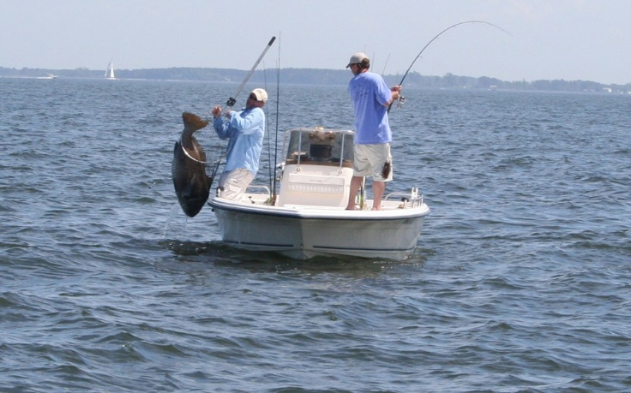


Applying environmental economics to policy
Optimal restoration
Dr. Lisa Wainger, UMCES-CBL
Sesync Immersion Workshop
November, 2020

Slide 2
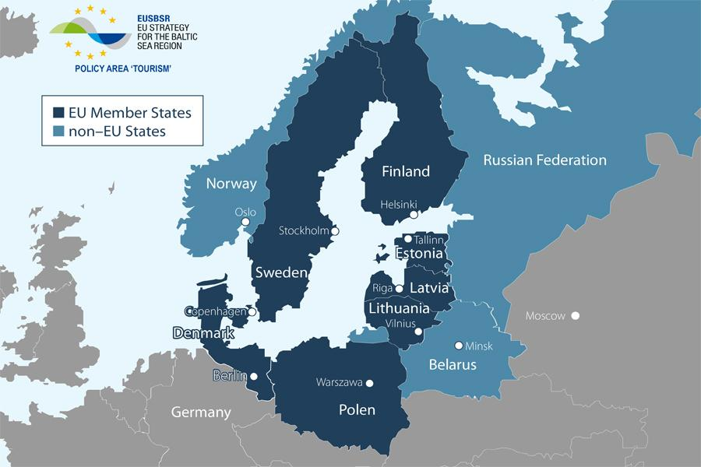
Economic analysis of the Baltic Sea Restoration

Slide 3
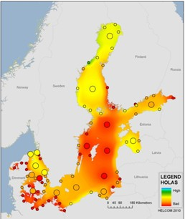
Restoration goals
Ecosystem Health Status
Valuation survey examined WTP
Water clarity
Blue-green algae blooms
Seagrass
Fish (cod and herring)
Oxygen levels

Slide 4
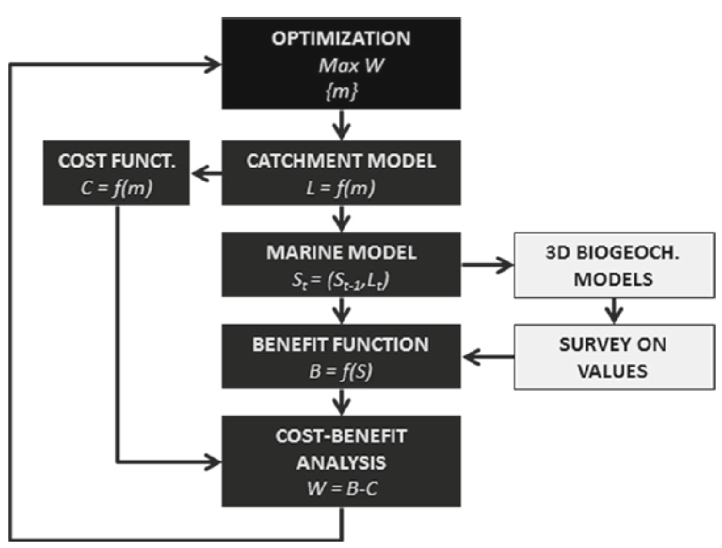
Optimize to compare policy outcomes
Max net present value
Practices by location
Biophysical effects
(Hyytiäinen et al. 2015)
Notes:
We assume things like – people are profit-maximizer

Slide 5
Alternative policy goals compared
Policy Goal I: Meet all load reduction targets of the BSAP cost–effectively
Policy Goal II: Meet sub-basin-specific load reduction targets of the BSAP cost–effectively
Policy Goal III: Meet the state target of the BSAP
Policy Goal IV: Optimize nutrient abatement in the Baltic Sea
Policy Goal V: Optimize nutrient abatement guaranteeing positive net benefits for each littoral country

Slide 6
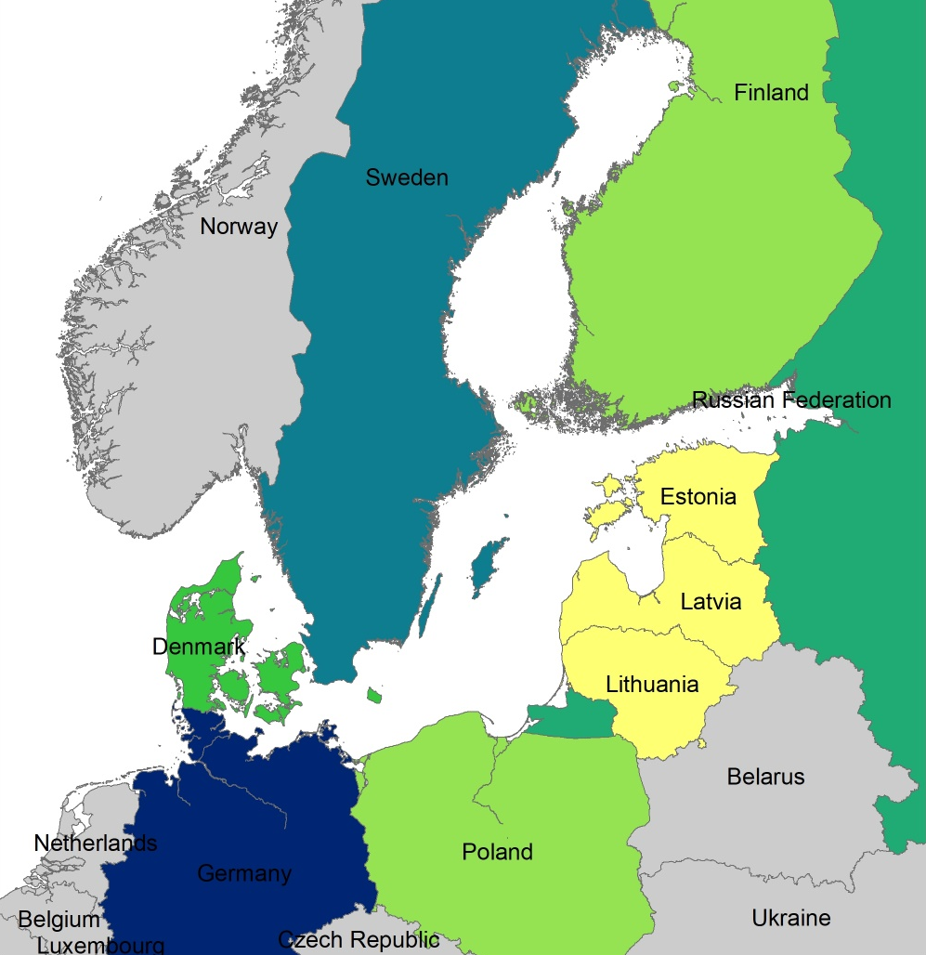
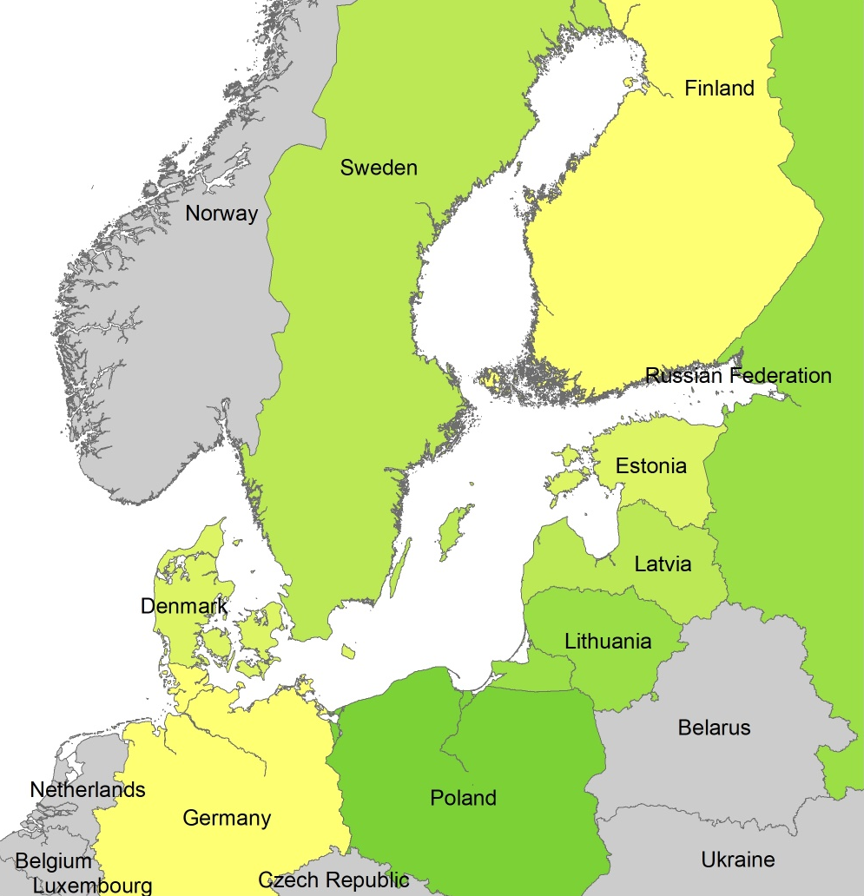
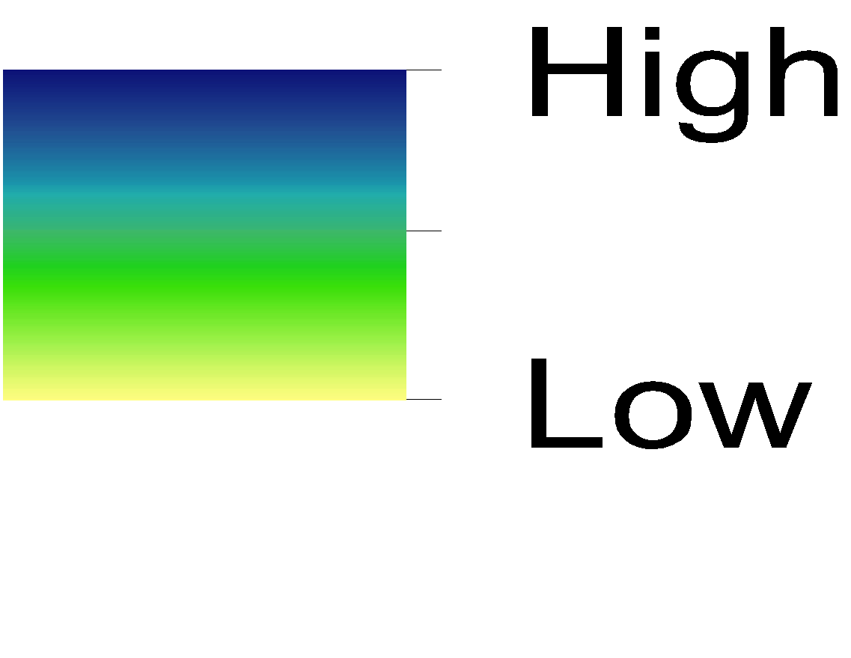
Comparing net benefits of two policy options to reduce nutrient loads to the Baltic Sea
Costs (M€) | 2,805
Benefits (M€) | 4,625
Net Benefits (M€) | 1,820
Costs (M€) | 631
Benefits (M€) | 4,373
Net Benefits (M€) | 3,742
Policy costs
Optimized costs
(Hyytiäinen et al. 2015)
Notes:
Left side – proportional allocation based on emissions (and sub basin targets)

Slide 7
Why don’t economists measure more values?
One answer: The missing causal links
Identify action
Restore wetlands
Measure effectiveness of action
Probability of toxic algal blooms
Relate change to human well-being
Exposure to contaminated seafood & health risk
Establish value of change
Willingness to pay to avoid health risk
Action
Ecological Outcome
Benefit Indicator
Social Value
From: Wainger et al. 2017

Slide 8
Other ways to use values in decision-making
Restoration Option A
Restoration Option B
Weigh tradeoffs
Maximize well-being

Slide 9
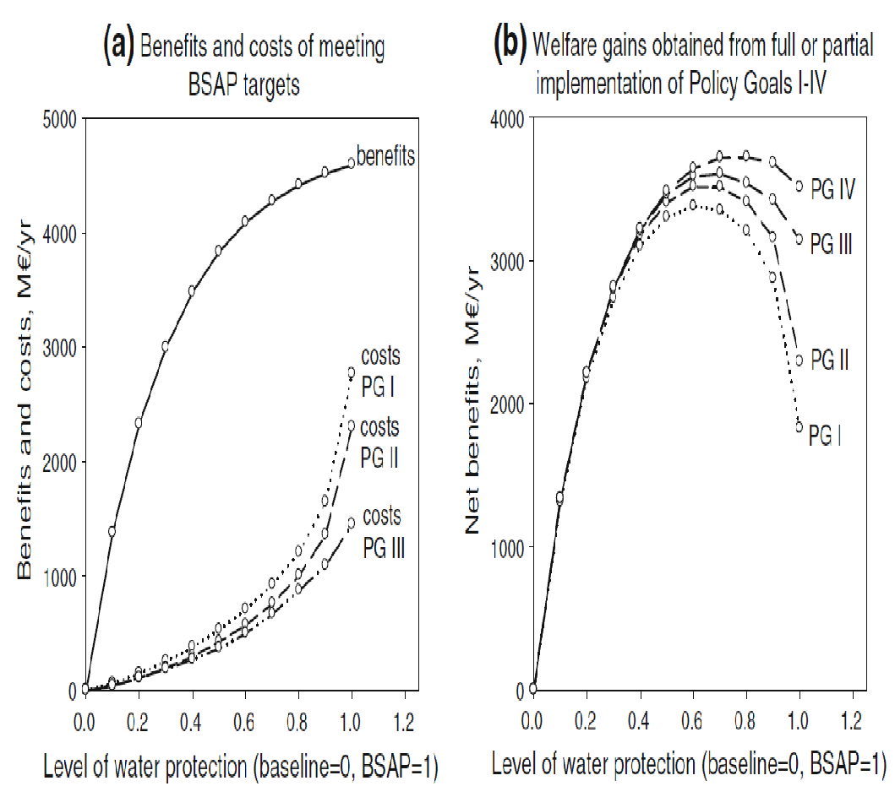
Goal setting to maximize benefits
Welfare gains with increasing effort
Economic analysis can be used to set pollution targets where they balance benefits and costs
costs
(Hyytiäinen et al. 2015)
Notes:
Extremely protective policies can be very expensive to achieve
80% of costs occur in last 20% of compliance

Slide 10
Optimization modeling conclusions
Optimization allows valuation to be used to examine approaches to maximizing net social benefits
  Can include political and technical constraints
Cost savings of optimized policies can be substantial
  In Baltic example, the total cost of achieving a healthy Baltic could be almost halved if the mix of measures and the regional targets were planned in a spatially cost–effective manner
Achieving the optimal approach can create the need for legal and political flexibility

