Slide 1
Identifying Socio-Environmental System Solutions:
A Causal Approach to Actionable Research Design
James Boyd
Director of Social Science & Policy, SESYNC
Senior Fellow, Resources for the Future

Slide 2
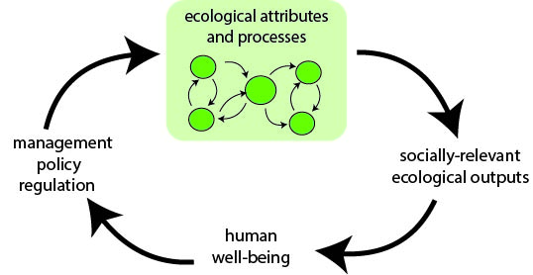
The Approach: Causal Diagramming
An analytical tool to help people understand complex systems, visualizing the key components of the system and the connections between them and how they relate to the state of the system.
Identifying social actions that can alter the socio-environmental (S-E) system to protect or enhance socially beneficial outcomes through cross-disciplinary discussion and research planning is required to elucidate how the components of a S-E system are connected in relation to the desired outcome.

Slide 3
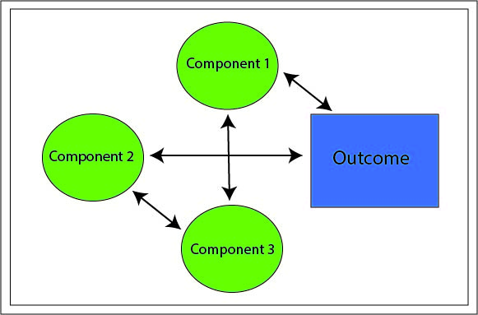
STEP 1: Depicting the Socio-Environmental System
The first step in causal diagramming is to simply draw a node and arrow diagram that reflects the basic components and relationships of interest to your research
TIP
Begin the diagramming with a central core of relationships known to be of interest to
the team or individual and representing the minimal components believed essential to the system under study.

Slide 4
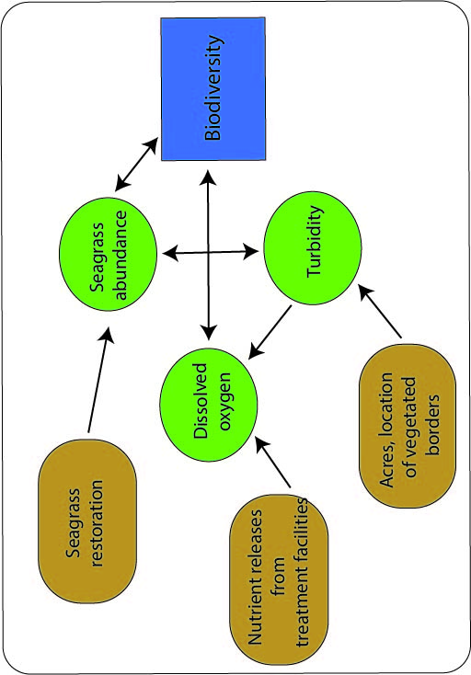
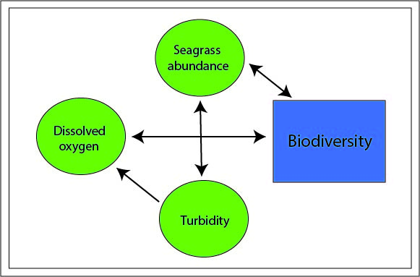
STEP 2: Connecting the Science of the System to
Concrete Actions
Identify features of your system that are “actionable”—system components that can be directly changed by social policies or behaviors.
VS.
Figure 1: Biophysical causal diagram, not solution-oriented
Figure 2: Solution-oriented causal diagram; potential actions in brown
Additional work is necessary to evaluate the effects of social policies and behaviors on the system. The addition of action variables in Figure 2 (in brown) poses additional research questions to be addressed—in particular, the need to understand the causal relationships between the action variables and the original core components.

Slide 5
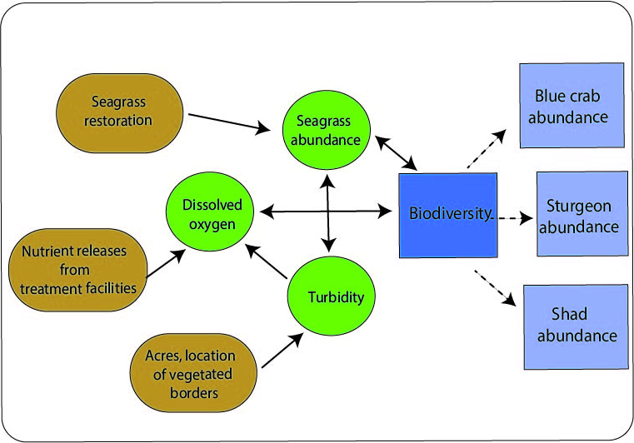
STEP 3: Identifying and Expressing the Social Relevance of Outcomes
Identifying outcomes understandable and viewed as directly meaningful by the public, stakeholders, and policy makers facilitates communication with lay audiences and helps interdisciplinary research teams create linkages between the natural and social aspects of their S-E system.
Solution-oriented causal diagram with socially relevant outcomes (light blue)
Step 3 yields an expansion of the outcome variables considered (the new socially relevant outcomes). With any expansion of the system, the research task is expanded. It is now necessary to explore, and perhaps quantify, the causal relationships between biodiversity (our original outcome measure, in dark blue) and crab, shad, and sturgeon abundance (in light blue).

Slide 6
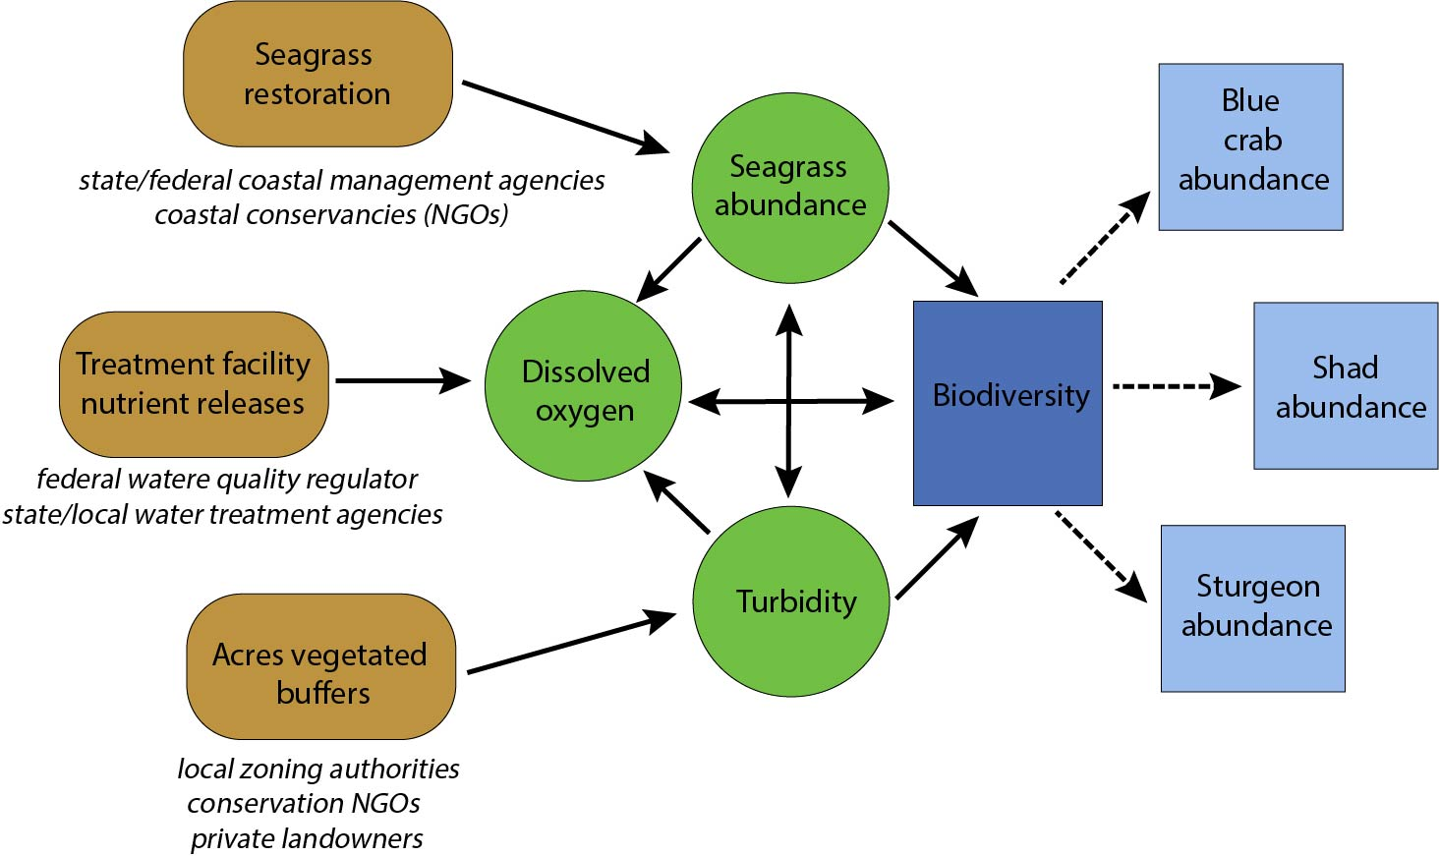
STEP 4: Identifying Responsible Parties
Relate action variables and link outcomes to specific institutions, social groups, or individuals. This step helps researchers tell the story of how their ecological system of interest can be managed and by whom.
Causal diagram showing parties (text below brown boxes) responsible for actions. Responsible parties can provide insights to action-oriented research by helping identify additional options (action variables), the costs of various options, and legal or regulatory drivers that can foster or impede taking action in the S-E system.

Slide 7
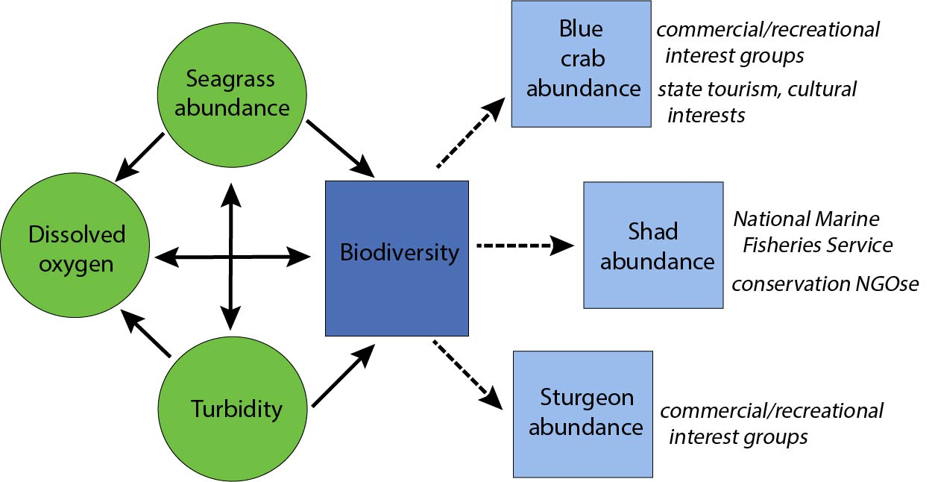
STEP 5: Identifying parties interested in the outcome
Focus on why socially relevant outcomes matter to diverse stakeholders, which may be governmental (e.g., when an agency’s decisions influence the responsibilities of another); commercial (e.g., a business that relies on the ecosystem outcome); or a community of households (whose health, property values, recreational opportunities, etc. depend on the outcome).
Causal diagram showing parties with interest in the socially relevant outcomes By identifying the connections of socially relevant outcomes to these interests, your research can better describe why your study matters, as well as promote protective and restorative actions in the system, and any policy recommendations emerging from those interested in your research.

Slide 8

Conclusion
All environmental problems are social problems; thus, research with the potential to change policy or behaviors requires a focus on when and why people care enough that they are motivated to act.
Causal diagramming is one of many ways to analyze a S-E system problem, including the players that influence and are influenced by it, the system’s status, or change.

Slide 9
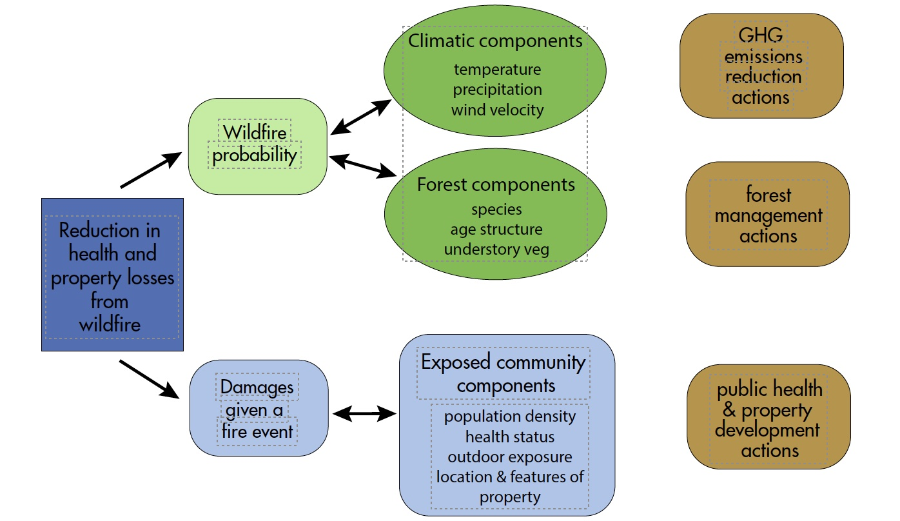
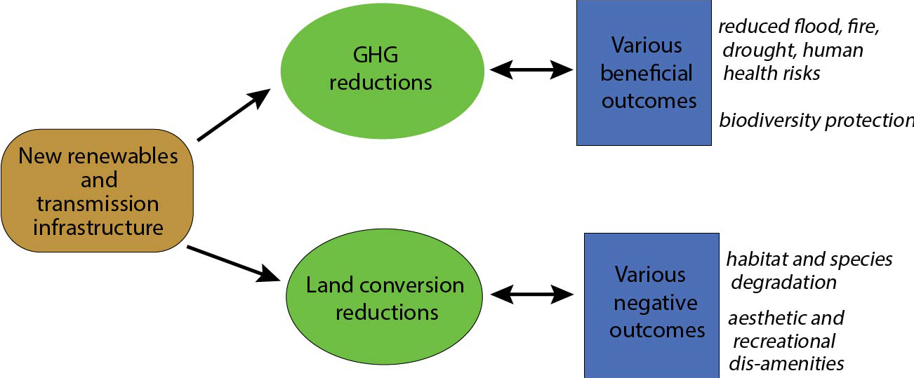
Corollary Content
The following examples illustrate the approach’s flexibility, applicability to different types of S-E systems, and how different “starting points” can be used by researchers to build their causal analysis.
Starting Point: Policy Action
Starting Point: Socially Relevant Outcome

Slide 10
Example 1: Start with a Policy Action
A research team’s point of entry can be an environmental action that then triggers inquiry into the S-E system components that action affects, both positive and negative
Causal diagram developed by starting with policy actions
The brown node represents an action; the green nodes represent system components; and the blue nodes represent system outcomes.

Slide 11
Example 2: Start with a Desired Socially Relevant Outcome
Another possible point of entry is a desired policy outcome dependent on change and actions taken within a S-E system. This example, with its emphasis on community components, illustrates a final important point: that S-E systems analysis can involve complex interactions that are social, not just biophysical.
Causal diagram involving changes within the socio-environmental system. Interactions within and across these collections of components would be explored by a research team interested in how associated actions (in brown) could alter the climate and forest systems to achieve reductions in wildfire probability. The “Exposed Community” components in this example are social components of the system related to the people and property damaged in fire events.

Slide 12
A Word of Caution
Researchers should ask themselves:
Have I considered potential confounding factors and unintended consequences? That is, variables that can cause the same outcome but are not linked to the “treatment” of interest.
Researchers should also recognize that implementing actions can and often do have social consequences—either positive or negative.

