Slide 1
Improving Scientific Impact: How to Practice
Science That Influences Environmental Policy & Management
Jonathan Fisher, Stephen Wood, Mark Bradford, and Thomas Kelsey
Conservation Science and Practice 2 (7): e210
DOI: 10.1111/csp2.210

Slide 2
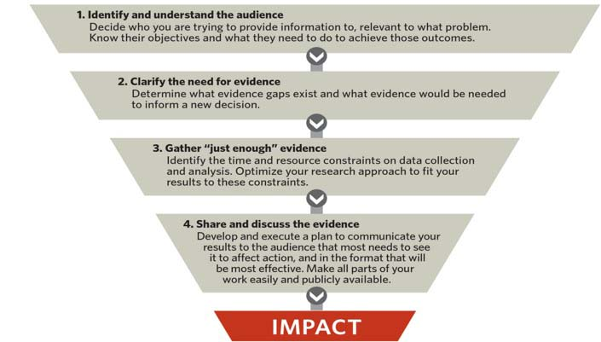
Focusing Steps to Increase Your Impact

Slide 3
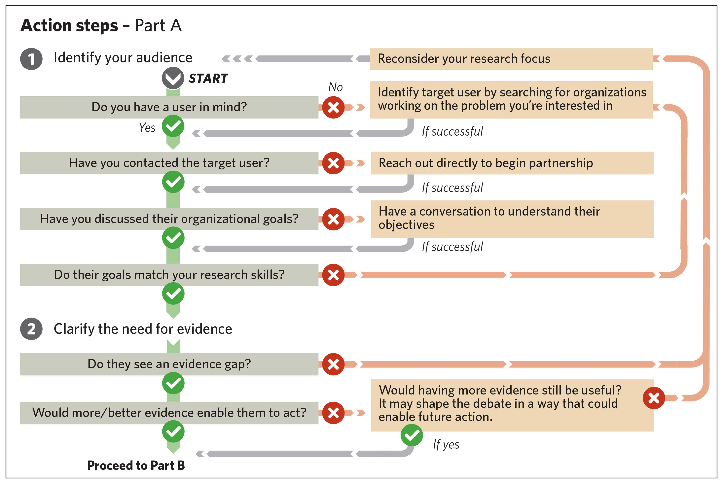

Slide 4
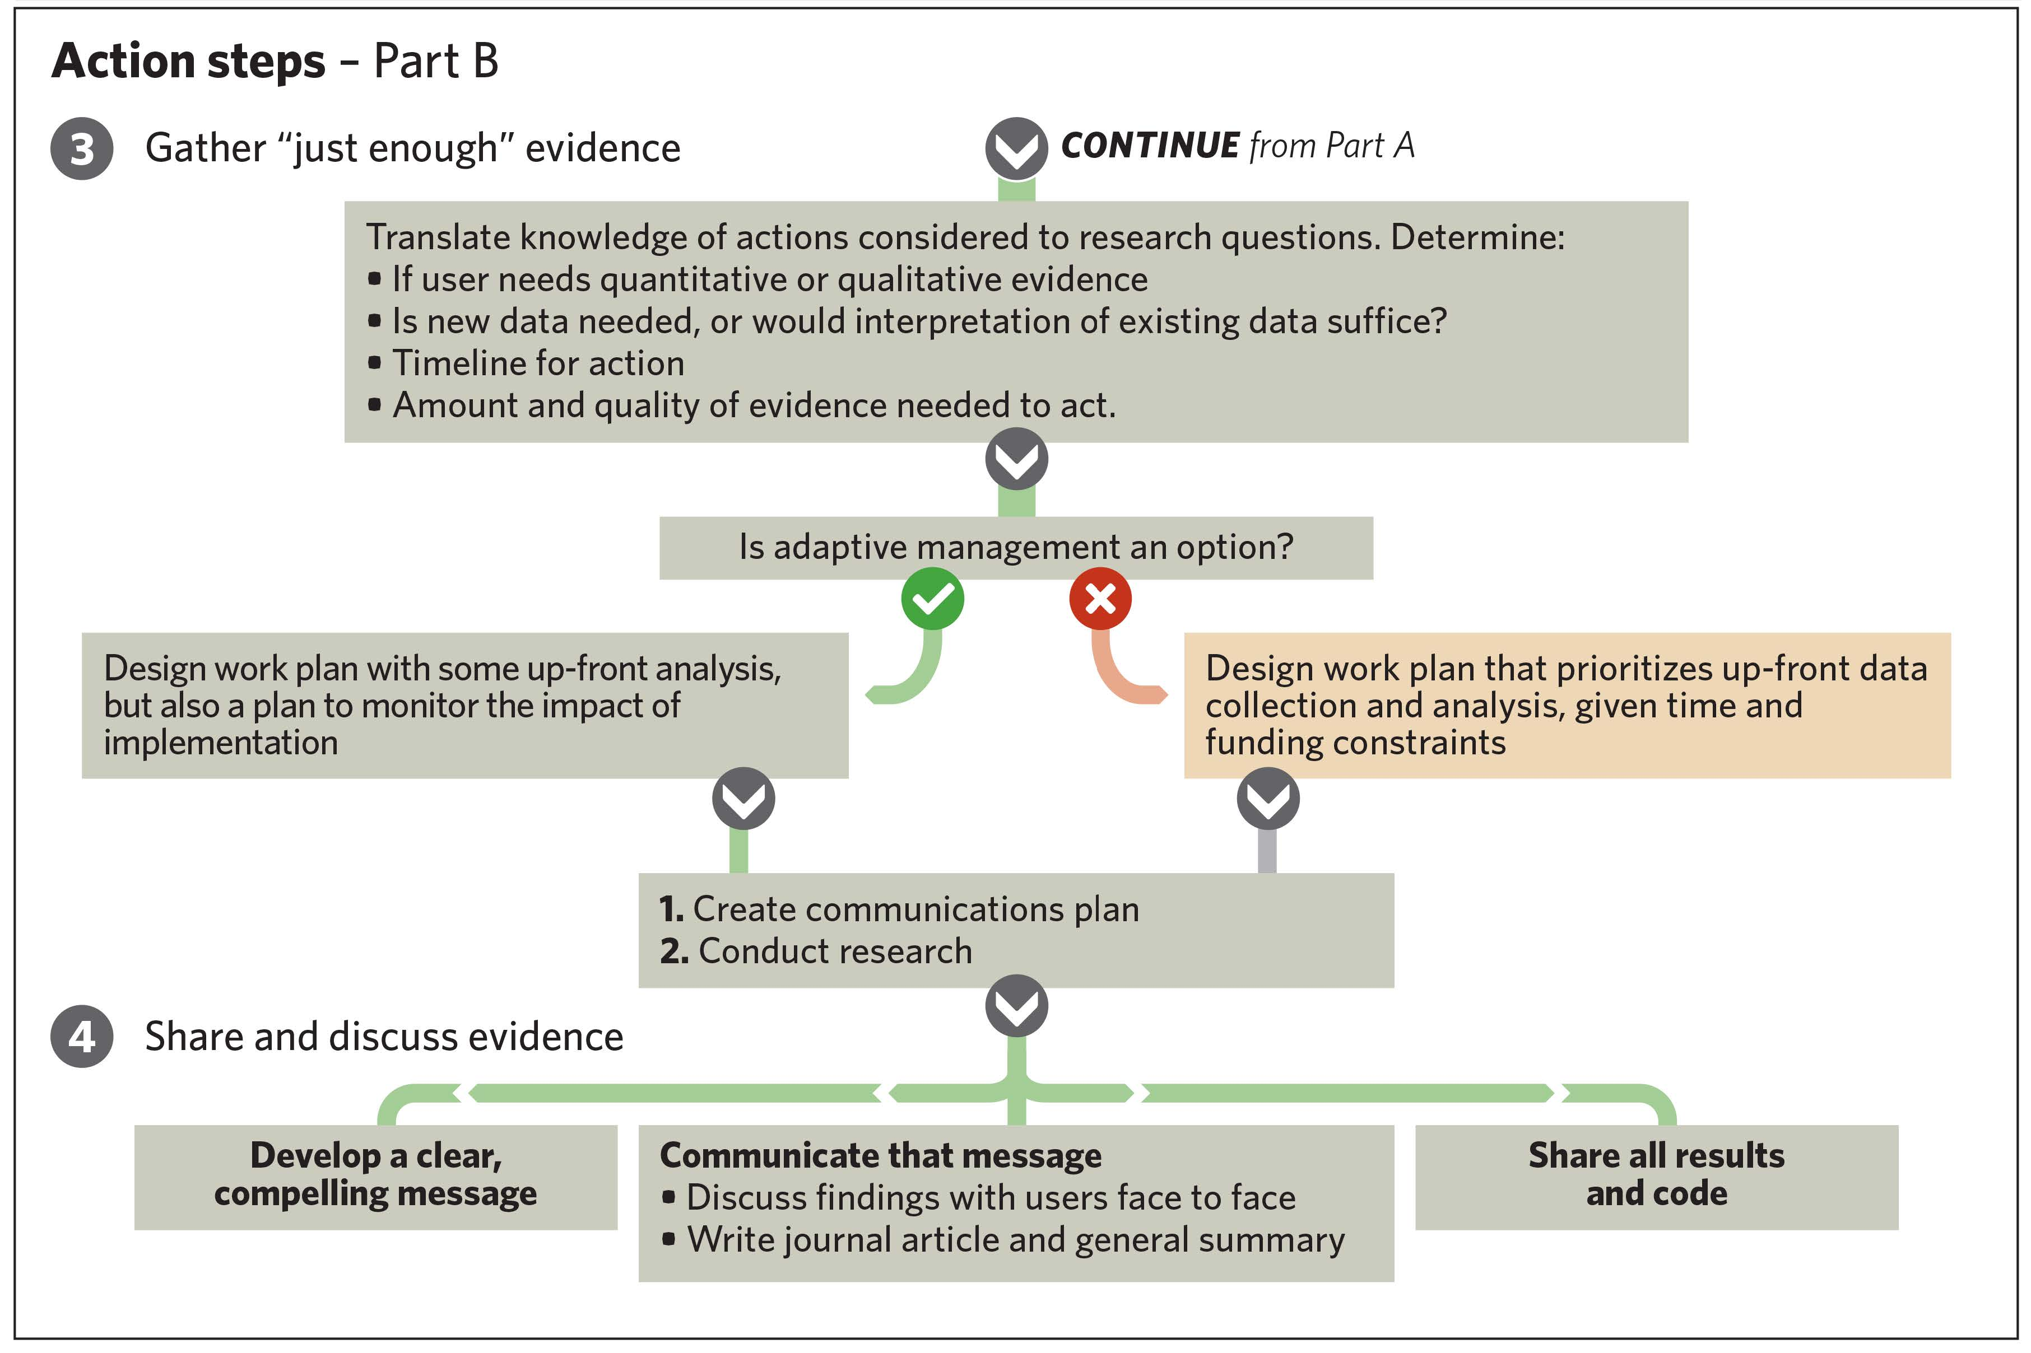

Slide 5
